Slide 1
Integrating Security in Agile projects
(real case study)
Notes:
Efrat:
Hello everybody. We are very excited to be here today and present the important topic of Integrating Security in Agile projects.
As you know the topic very often discussed in every conference in both Agile development and Security.
And why we still want to re
turn to the topic again?
שלום לכולם,
אנחנו מאוד מתרגשו ליד כאן היום לספר לכם את הסיפור האישי שלנו בנושא שילוב נושא הסקיוריטי/אבטחת מידע בפרוייקט אג'ילים.
אולי כבר שמעתם על הנושא, הוא די חם, ועולה על הפרק הן בועידות אג'ייל בכל העולם והן בועידות הסקיוריטי
אז למה אנחנו בכל זאת מדברות על הנושא היום?

Slide 2

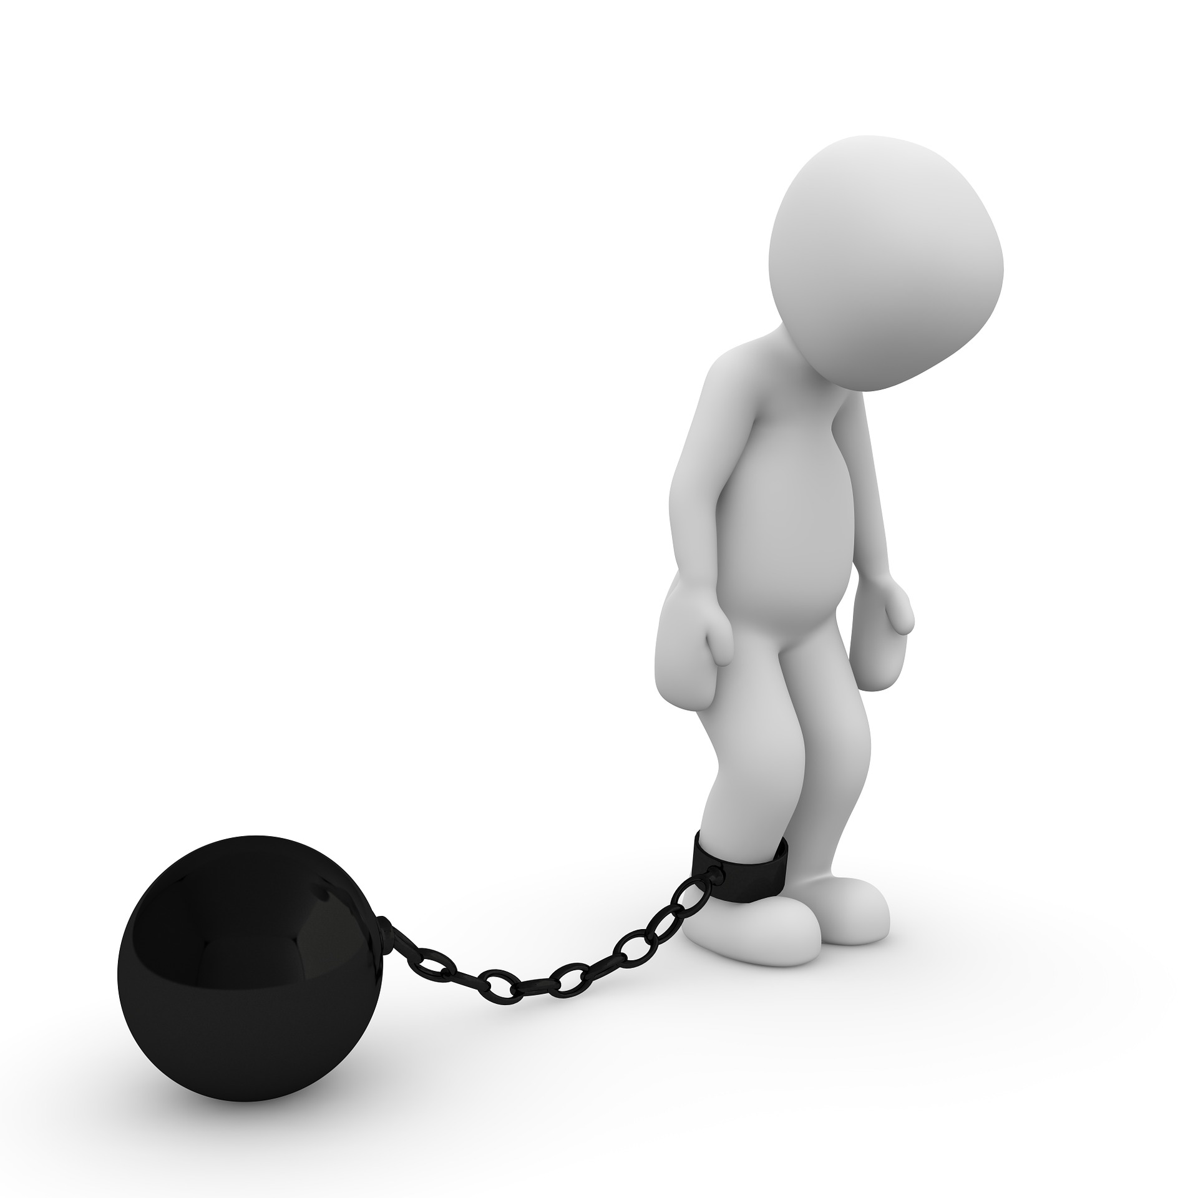
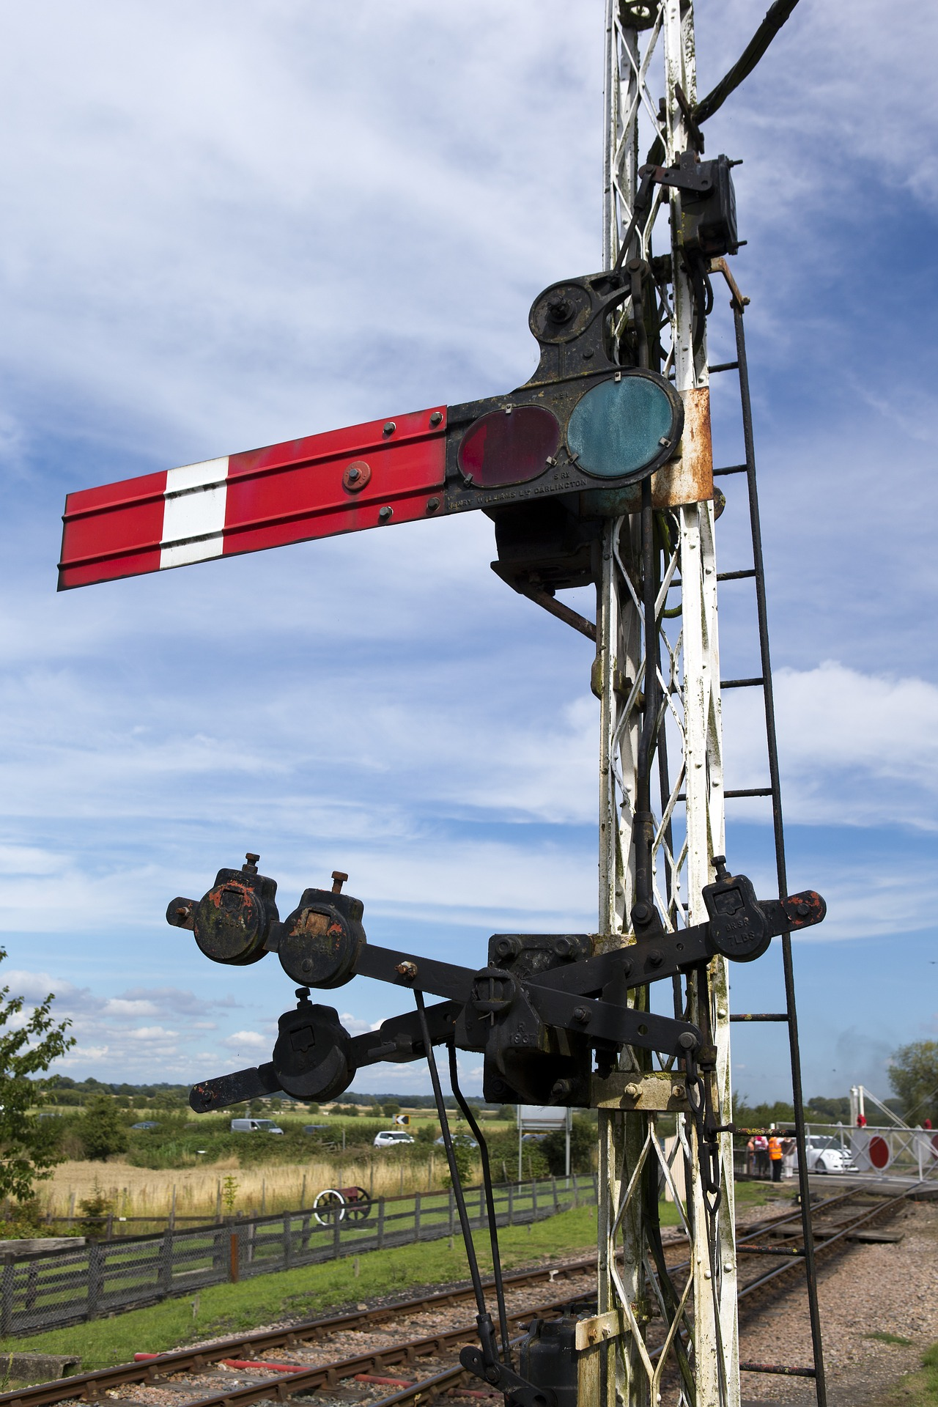
Secure Development vs. Agile Development
Notes:
Elena:
Yes, why we think that we need to raise it again in this forum?
Because even after many years that agile has been practiced around the world and we all understand importance of secure development, many people still have concerns.
<click>
They say – Agile project should move very fast and security is slowing down.
<click>
Or they say – we have the releases train and security is stop us just before the delivery and brake the rhythm
<click>
Whether Agile and Security are Oil and Water and we can’t get effective mix of these two?

Slide 3

Secure Agile Development
We believe Agility and Security are on the same side
Notes:
Efrat:
No! We are sure that Agile Development and Security are partners, they work together well when they work as a team on common goals. They understand weaknesses and strengths of each other and providing backup ad support in on-going activities.
אז לא- אנחנו בטוחות שאג'ייל וסקיוריטי יכוללים לעבוד יחד יד ביד , זה לצד זה עם מטרות משותפות ,בהבנה מלאה של החוזקות והחולשות של כל אחד מהצדדים, בתיאום ובסנכרון, לשתף פעולה ולנצח.

Slide 4
Who we are…
Elena:
HPE Software Security Lead for HPE’s Application Delivery Management (ADM) Business Unit
25+ years of software engineering and 4 years in product security
MSc in Applied Mathematics from Leningrad State University
Efrat:
Senior Program Manager in HPE SW StormRunner Load (SRL)
17+ years in Software Development, and 9 years as a Program manager.
BSc in Computer Science and Mathematics
MBA in Business Management and Marketing
Notes:
Elena: So who are we, and why did we decided to present this topic today?
Since we are working together on integrating security in agile projects already three years. <click>
אלנה אחראית אצלנו על כל תחום הסקיוריט. היא מביאה איתה 25 שנות ניסיון בתחום פיתוח תכנה ו4 שנים בתחום אבטחת מידע, וכן היא בעלת תואר שני במצמטיקה שימושית.
Efrat:
Elena represents the Security side of the project and brings vast experience in both development and security areas.
She is responsible for a department developing 12 products ( ~400 developers)
Elena:
<click>
Efrat is representing the development team as a Senior Program Manager responsible for the lifecycle of Storm Runner Load - the cloud based product developed according to Agile methodology.
Efrat is Brings deep knowledge and experience in both software development and project management.
The group consists of 4 development teams ( 50+ developers) and requires coordinating the product delivery with 6 groups from different disciplines, providing integrations and services. Quite a complicated task ☺!

Slide 5





What we will discuss today
  Planning and coordination, Roles
  Challenges
  Secure development lifecycle management
  ( SLM)
  Practical tips
  Agile development practices
Notes:
.
Elena:
So, based on our experience, we’d like to present you some main points of our collaboration
<click>
We’ll shortly describe the main challenges
<click>
and the techniques & procedures helping to overcome those challenges.
<click>
We’ll present the Security Lifecycle Management (SLM) Framework developed and used in HPE SW in the last three years,
Efrat:
< click>
בנוסף נתאר איך שילבנו את זה בתהליך מחזור חיי המוצר שמפותח בתודולוגיית אג'ל, ונשים דגש על התהליכים והטקסים המיוחדים שבחנו וכן על תפקידי המפתח שלדעתנו מהווים בסיס להצלחה.
Click
לבסוף נסכם ונתן לכם כמה טיפים על איך גווף סקיוריטי מסודר עם אגנדה מאוד ברורה יכול להשתלב כחלק אינטגרלי מ]אוייקט אג'ילי ולעשות זאת בהצלחה רבה.
and describe how it is integrated into the development of new SaaS-based fully agile developed product, with emphasis on main activities and roles. As a part of the presentation we would like to highlight the importance of the proper program management and role of the PMO (and others) and how it became a key success factor in the effective security program implementation.
<click>
And finally we’ll provide some practical recommendation how a very comprehensive security program, managed by a dedicated security office, CAN be successfully integrated in an agile project based upon a real case example.

Slide 6
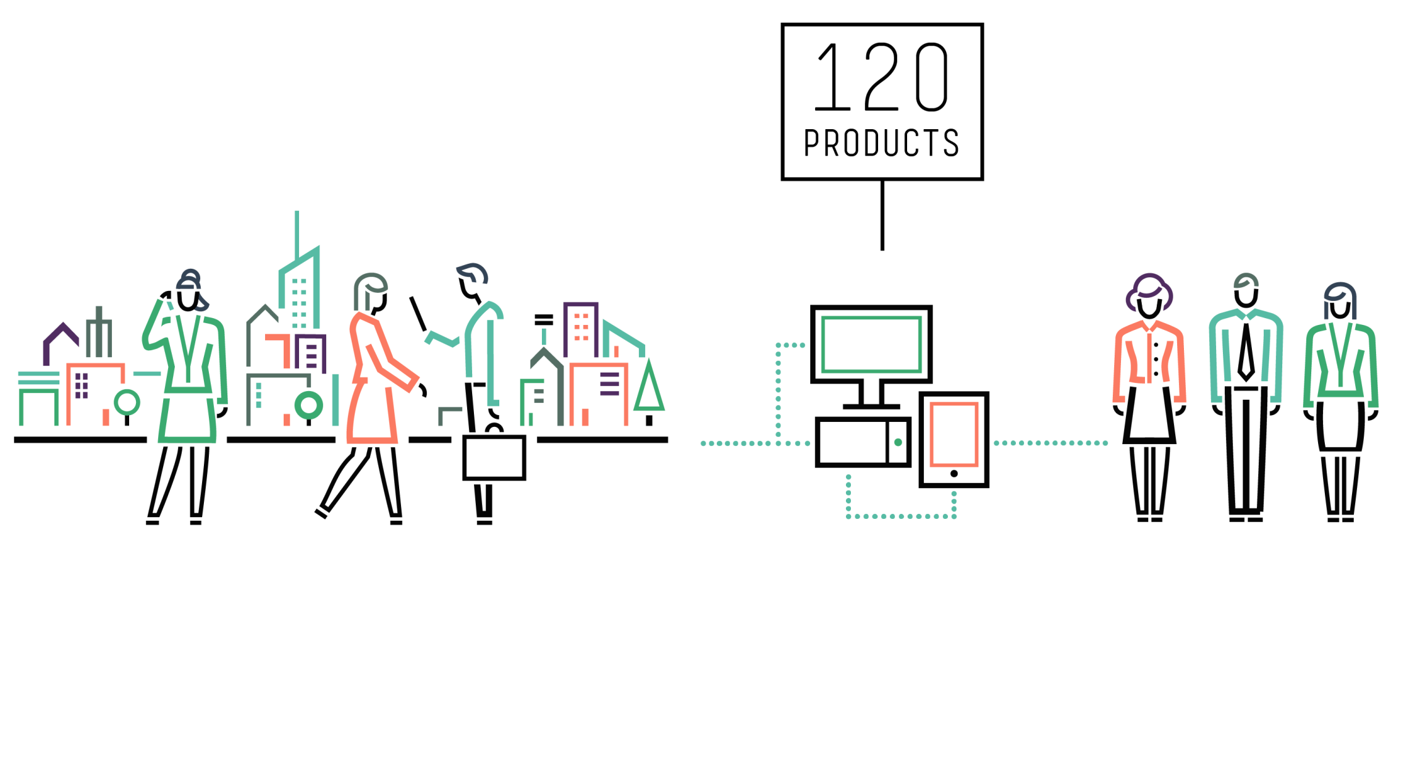
HPE ADM organization and portfolio
Countries
12
Developers
5
~400
Notes:
Elena:
Before we will deep dive into the practical aspects of the integration, I’d like to provide some background regarding our organization and the processes we built.
As you know, HPE Software is a big global organization. And the department which I am responsible for as Security Lead , has a very solid portfolio containing 12 products. Most of them are known in the market for a decade. The products are developed and supported by more than 400 employees located in 5 countries.
Obviously such big organization has many policies, processes and tools which should be used to support efficient development in big global enterprise.

Slide 7









SLM framework
Design
Implement
Education
Requirement
and planning
Release
Response
Verify
Deployment
Deployment
Planning
Integration
Feature Freeze
Dev
Code freeze
GA
QA
Security Plan
Threat Modeling
Design Review and mitigation
Security risk assessment
Sign Off
Notes:
Elena:
To ensure the proper security activities are done on relevant development stage we ( S&TO) defined the Secure Lifecycle Management framework and started to implement in products according to enterprise requirements and product maturity.
We started from big well-established products, with long development cycle and built the SLM framework presented in the slide.
The framework enables the proactive integration of security into its products lifecycle. The integration of comprehensive security controls such as design review, threat modeling, security testing, and more into the product lifecycle makes sure the risks are identified and appropriate mitigation is provided prior to the product release.
On the slide you can see the activities mapping according to development stages.
After the framework proved its value we continue to apply it on entire portfolio and found the next generation is coming.

Slide 8




Our product overview
Web based application for web and mobile performance testing in the cloud
Smart , Simple , Scalable
Persona: professional performance engineers
SaaS product, continues delivery, hotfix
5 development teams, ~50 people
Managed in Agile methodology “flavor”
6 versions a year (every 2 months)
7+ groups collaboration
Notes:
Efrat:
אז קצת רקע על הקייס סטאדי שלנו. מדובר במוצר לבדיקות עומסים. המוצר שלנו רץ בענן והוא מבוסס סאאס שזה
Sw as a service
click
יש לנו 5 קבוצות פיתוח שזה כ 50 מפתחים
Click
אנחנו אחת מהקבוצות המהירות ביותר במרכז הפיצוח שלנו כאן בישראל. אנחנן מוציאים 6 גרסאות בשנה, כל חודשיים גרסה רשמית מלאה, ארוזה, מומצרת, מתועדת, בדוקה, כאשר בכל אחת יש כ 5 פיצרים חדשים לפחות ועוד מאות תיקוני באגים.
Click
המוצר מבוסס סאאס. כלומר אין צורך בהתקנות כבדות כמו פעם או לחכות לדחסק התקנה , אין צורך להכשיר אדם אצל הלקוח עבור זה ואין צורך בחוצרה בבית הלקוח. הכל ניתן כשירות כל מה שהלקוח צריך לעשת זה להיכנס לאתר ולקנות רישיון בכרטיס אשראי. אגב – מומלץ. ☺
אז המציאות הזו מכריחה אותנו לרוץ מהר. להגיב עוד יותר מהר לשטח, להיות קלילים וגמישים. במידה ויש בעייה אצל לקוח ונדרש הוט םיקס- הום מתקנים מעליין לקלאוד והנה התכה התחלפה ללקוח מתחת לרגליים וכל מה שהוא מריך לעשות זה לוג אין ביום ראשון וזה כבר יכלול את התיקון.
click
המוצר קלל, פשוט וחכם-
מיועד לאנשים טכניים שרוצים תוצאות ומהר בלי יותר מדיי צעדים, כלי פשוט שעונה על כל צרכיהם.
Click
לפיכך
המוצר עצמו תומך עוצב ויויעד לתמוך פרוייקטים אג,ילים ובא לשירות את גוף או תחום בדיקות העומסים העובדים הפרוייקטים אג'ילים ולכן לא רק שהוא מכוון לשוק הזה, אנחנו בעצמנו משתמשים בפרקטיקה האג,ילית בזמן הפיתוח של.
Click
ואמנם כבר הבנתם שהקבוצה היא כמו סטרטאפ בתוך חברה גדולה, אך עדיין אנו מחוייבים לסנטנדרטים מסויימים לבירוקרטיה אם תרצו , אנו כפופים לתנאים ורגולציות ולוחות זמנים חיצוניים. אנחנו עובדים עם הרבה מאוד גופים בתוך החברה, חלקם קבוצות פיתוח שונוץ, על אינטגרציה פונקציונאלית , חלקם קבוצות נותני שירות כגון קבוצות הסאאס והדוקומנטציה, וחלקם גופי רגולציה כגוון הסקיויריטי אופיס אותו אלנה מייצגת ועוד גופים נוספים. סה"כ יש לקבוצה שלנו שיתוף פעולה עם משהו כמו 7 קבוצות באצר וכל זה בסייקלים מאוד יעילים וקצרים, ואנחו כל הזמן מנסים למצוא את האיזון בין "הארנב" לצב" – זה אתגר, ואת המקרה הפרטי של שילוב הסקיוריטי בקצב המהיר ןהחדש הזה-אנחנו רוצים לדבר איתכם היום..
So some background on my Product.
The product we are talking about is a cloud based performance testing tool.
We have 4 development teams and 1 QA team, (total of ~50 developers).
We are one of the most fast delivering groups in the Site. We issue 6 versions a year, which means one full tested , packaged, productized, documented version every two months, including at least 5 new features each.
The product is SaaS based, this means the continuous delivery , the pace the light wait of delivering both formal communicated versions and hotfixes- is crucial. SaaS means this is no longer on prem Heavy installation and HW maintenance. This is provided as a service all the customer has do is purchase a license and we are good to go.
The Product is very smart , simple and scalable and the reason for this is that it is targeting very technical, high end developers and performance engineers. The kind of people who want results with not too many steps, easy to use – and suitable for agile project.
Which brings us to the next point and part of the topic for this presentation- the product supports agile development cycles and there for is also developed and managed project wise- according to the agile methodology- with a flavor- we will talk about that later.
Finally last but not least- although you might have already understood we are some sort of a startup mindset group inside a cooreperate, we are obligated to comply with all cooperate regulations. One of them being- security. Which we will talk about today.
Other collaborations we have start with functional itegrations with other dev groups and end with alignment to cross organizational Processes such as Project Life cycle management checklists. So this is quite an operation- and finding the balance between the so called “rabbit” and the “turtle” has become our day to day reality.
Collaboration - SaaS, PCoE, Documentation, Security, integrated services, MarketPlace

Slide 9


Agile development practices
Ceremonies
Minimal shippable product (MSP)
Prioritized backlog flexible to change
Strict heart beat (HB)
Tool for agile project management
High automation coverage
No Sprints
(1 HB = 1 Release = 1 Sprint)
No heterogenic scrum teams
No scrum master (Feature leader role added)
Additional untraditional ceremonies
Additional configurations in the project management tool
Notes:
Efrat :
אז הדבר הראשון שעשינו זה בחנו את האג'ייל. בהתחלה הלכנו לזה בצורה די עיוורת, ומאוד מהר הבנו שזה לא ילך. הגדרת הספר זה משהו אחד, והחייים זה משהו אחר. החלטנו לבחון מה מתאים לנו וסיגלנו לעצמנו מה שנקרא אג'ייל פלייבר.
בעתיד אנחנו נראה שזה אחד הדברים שעזרו לנו ככ לשתף פעולנ עם ככ הרבה קבוצות בניהים קבוצת הסקיוריטי.
So, speaking of flavors, here are some small examples of what we did “by the book” and what we didn’t.
According to all agile best practices and the Agile manifesto we have the regular agile ceremonies which you might all be familiar with : Pre planning, Planning, Daily ,retrospective, Demo etc.
We make sire to deliver the most minimal shippable product.
We have a prioritized backlog ready for implementation at all times- and we let our self be flexible with it according to customer feed back.
Sprints- We have a strict heart beat- with a “But”.
We have a project management tool- to mange the content and the defects.
And we keep a high automation coverage rate – which basically enables to to keep the quality at a certain level and their for test only the gaps and move faster.
What we do not do:
Remember that “But”?
So we do have a strict heart beat but that HB is 1 release. 1 release is 2 months and we have no sprints. The whole release is one sprint. So 6 release a year. Steady heart beat but within the release we not have scheduled sprints but rather checkpoints dressed up as status meetings ☺.
We do not have par excellence scrum teams. They are not heterogenic because the core teams did not agree to split. So we have the original FE and BE teams. This is another example to work with what you have to win, don’t beat them, join them. ☺
As we do not have pure scrum teams- guess what else w don’t have? Scrum masters. We decided to take on a role of the feature leader, since we did want someone to technically lead the features developed. So this is kind of the compromise we found- to have a lead but not the classical agile role of the scrum master.

Slide 10

SLM adjustments for Agile project
Design
Implement
Education
Requirement
and planning
Release
Response
Verify
Deployment
Deployment
Content review
Feature based TM
Design Review/Mitigation
Security risk assessment
Sign Off
Content review
Feature based TM
Design Review/Mitigation
Security risk assessment
Sign Off
Notes:
Elena:
In this way we understood that we need to adjust the existing framework. The simplest solution – as we see on example of Microsoft SDLC was to create a separate framework for Agile development.
However we already had the framework fully aligned with corporate processes and tools. It means we wasn't too flexible in these process.
So we started to look closely on all practices and processes run in Agile development and we found ( don’t kill me Agile guru)
– Agile project performs same activities as WF project but faster, shorter and more frequently. So we took our existing SLM, adjusted it to the Agile reality by changing the scale and started to perform same activities in lightweight mode with fast feedback.
For example we still have release criteria, content review, design review, security risk assessment and version sign-off but more often and in shorter timeframes.
The activities are performed together by development team and external security governance team.

Slide 11

External security governance aspects
Main checkpoints embedded in process:
  Content review (Security impact labeling)
  Design review (Feature based threat modelling)
  Security assessment (Penetration testing)
Notes:
Elena :
You possibly asking – why we still need the external security team since we know that by the book agile team should have all required skills to perform all activities inside the team itself.
But ( without disregard our developers, who are very professional) we see that, in general, developers not mature enough to make proper security decision, since application security is a new discipline and PT technics are not common knowledge yet (even passed secure coding secure design or ethical hacking courses)
We constantly improving over collaboration process to have it lightweight and flexible.
As as mentioned before, we still have the main checkpoint embedded in development such as release criteria, content review, design review, security risk assessment and version sign-off
For example during the content review checkpoint we are performing the security impact labeling.
I know, according to agile practices it should be done internally, but let’s take a couple of real examples:
Feature <>, yes it is obvious. It has high security impact since affect major security control implemented in the application
Feature <>, who think it has SI? Who think “no”? Who is right? I don’t know, we need more information. We need to ask some additional question..

Slide 12

Security Impact
Any content level:
  Theme, Epic, Feature, User Story etc.
Know the product:
  Security controls implemented in the product
  Data managed by the product
Ask the feature lead:
  Which security controls are affected
  Which data types are affected
  Which new risks might be inserted
Notes:
Elena:
You can use Owasp TT for possible risks analysis
The OWASP Top 10 - 2013 is as follows:
A1 Injection
A2 Broken Authentication and Session Management
A3 Cross-Site Scripting (XSS)
A4 Insecure Direct Object References
A5 Security Misconfiguration
A6 Sensitive Data Exposure
A7 Missing Function Level Access Control
A8 Cross-Site Request Forgery (CSRF)
A9 Using Components with Known Vulnerabilities
A10 Unvalidated Redirects and Forwards

Slide 13

Security assessment
  Penetration testing flavor:
    Think as an attacker
    Know product as a developer
    Work according to time limits
    Work in controlled environment
    Get all required support from development team
Notes:
Elena:
Our security assessment differs from the classic PT only by some aspects:
1. Done before product release
2. White box approach
3. Done in testing environment
As you see even we are external team we are working very close with development team according to their release plan and timelines w/o significant effect on the release train schedule.
And how we succeed to achieve this?
Obviously we can not have a successful security program without good cooperation with development teams. We started security education program for RnD engineers, based on their role in the development process: developer, QA, architect etc. ,
We’ve created an “institute” of security ambassadors in every product – we call them “security champions” to increase the collaboration and security awareness as well as better visibility and accessibility of security related activities inside development teams.
In addition, together with product program manager we built the process to embed the security activities to product lifecycle and Efrat will elaborate about this part of our cooperation.

Slide 14
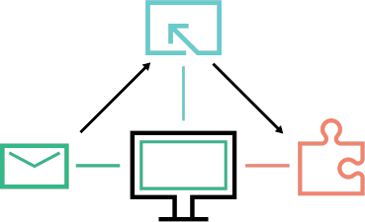
Best practices
  Processes:
    Security assessment cycle is part of every release timeline
    Security Bucket is allocated for Dev teams in every release planning
    Security criteria is a part of the Release criteria
    Status and Risks reviewed as part of all project management meetings
    Dedicated security environment preparation with predefined data
    Project ceremonies
Notes:
Efrat:

Slide 15

Best practices
Ceremonies:
Bi weekly sync meetings:
  Content review
  Design reviews
  Security assessment review and summary
  Demo and handover training every release
Notes:
Efrat:
Best practices : biweekly, release criteria, security impact, planning, defect validation, version sign-off etc - Efrat
bi-weekly with dynamic content
Fields in content management tool ( we use our own, you can use what is suitable to your team)
Env preparations, knowledge session
Add some snapshot for AGM or other illustrations
Work item – Security Tickets\Bugs\ER’s\US

Slide 16
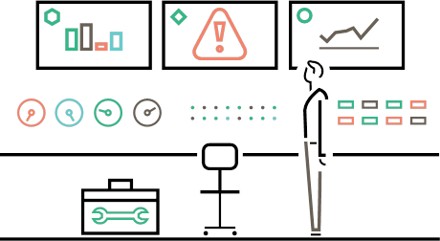
Best practices
Tools:
  Manage security content as part of the general release content
  Audit every security task in project management tool
  Additional configurations in the project management tool
    Item name prefix. [Security]
    Tags: Security Impact and Security Comments
    Security defect template
Notes:
Efrat:
Best practices : biweekly, release criteria, security impact, planning, defect validation, version sign-off etc - Efrat
bi-weekly with dynamic content
Fields in content management tool ( we use our own, you can use what is suitable to your team)
Env preparations, knowledge session
Add some snapshot for AGM or other illustrations
Work item – Security Tickets\Bugs\ER’s\US

Slide 17
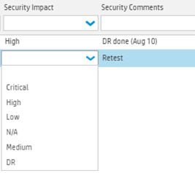
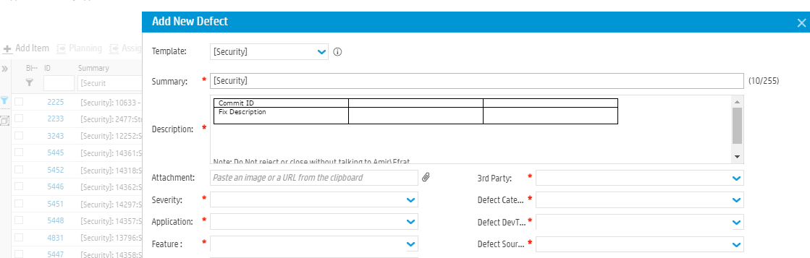
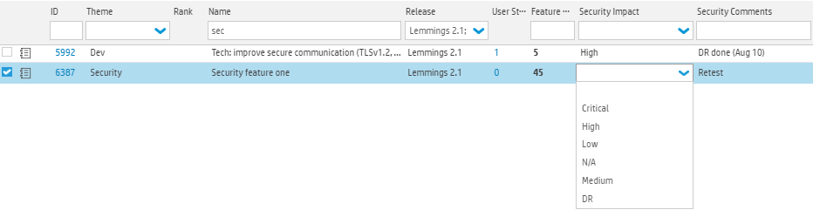
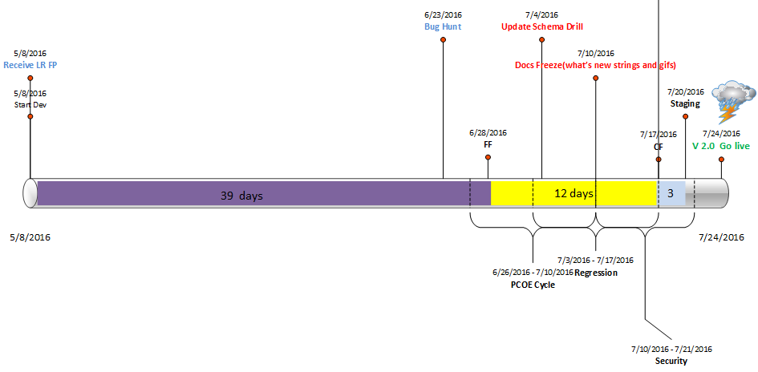
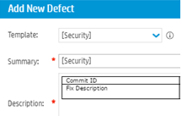
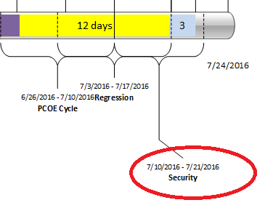
Best practices- screenshots
Notes:
Efrat:
Best practices : biweekly, release criteria, security impact, planning, defect validation, version sign-off etc - Efrat
bi-weekly with dynamic content
Fields in content management tool ( we use our own, you can use what is suitable to your team)
Env preparations, knowledge session
Add some snapshot for AGM or other illustrations

Slide 18

Roles
Security champion
Tactical technical focal point
  Product insights
  Technical demonstration
  Code referee
  Security ambassador
Architect
Strategical technical focal point
  Design review
  Product Road map
  Architecture adjustments
Project manager
Orchestrator and key stakeholder
  Processes leadership
  Meetings management
  Tasks auditing
  Team engagement
  Continuous improvement
Notes:
Efrat: PMO – Main Orchestrator and Key role holder in the success of integrating security in Agile projects.. If you do not have a PMO- get one ☺, any one in the organization can take this role. Main goals:
Lead, schedule and manage sync meetings
Audit action items and validate execution
Engage RND to security sense of urgency
Make sure security elements are taking in to consideration in all project life cycle management: planning-> execution->QA ->retrospective
Embed joint process into Product agile flavor
Follow up
Manage risks
Main FP to Security team needs
Schedule PT cycles
Security Champion- Tactical technical Focal point.
Explain technical risks, aspects and implementations
Work closely with PT team when in need of technical help in reproducing a ticket\bug.
Technical demonstrator
Code referee
Architect- Strategic technical focal point
DR’s
Embed Security aspects in product Road map
Make sure architecture is aligned.

Slide 19
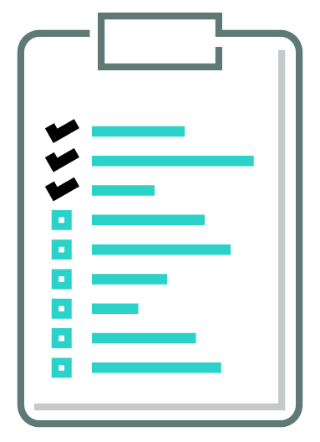
Tips
Know your partner
Drop the text book definitions! Take the suitable agile flavor and optimize it
Cooperate and back up one another
Work iteratively
Meet & Sync periodically either via calendar invite or “coffee tests”
Use tools to audit everything, be an inseparable part of the project content and success criteria
Promote and formalize integration of secure development into all agile projects in your organization
Notes:
Efrat : use each other tools, fit into their processes and timelines
Elena: See the practical side, adopt the theory to your real situation
Efrat: cooperate and provide back up and support each other
Elena: Work integrative, learn on your both success and failures
Efrat: Meet and sync
Elena: Use tools
Efrat: ??
Elena: Finally …

Slide 20

Summary
Don’t say “security doesn’t work with agile”
Be flexible, adjust yourself and your processes,
find a good partner and you will succeed together!
Notes:
Efrat:
At the end we just to wan to underscore that the full cooperation, partnership, sharing common goals, knowledge and experience will bring us to real success in secure agile development as one consolidated methodology.

Slide 21
Q&A
Thank you
Elena.Kravchenko@hpe.com
Efrat.Wasserman@hpe.com

