Slide 1
Could a few lines of code F@#k it all up?

Slide 2
Dependencies
Probably 90% of commercial application make use of Open Source Software
Open Source is great but….
Node.js is quickly becoming a leading framework
Some issues with node’s repository are concerning from the security pov

Slide 3
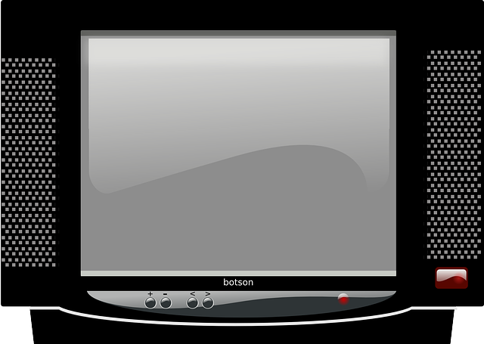

Notes:
Lets start with some nostalgia.

Slide 4
The Left-Pad Saga
Azer Koçulu
A fairly anonymous developer at that time decided to “Liberate” his modules following a disagreement with NPM staff.
Among them was a module named Left-Pad

Slide 5
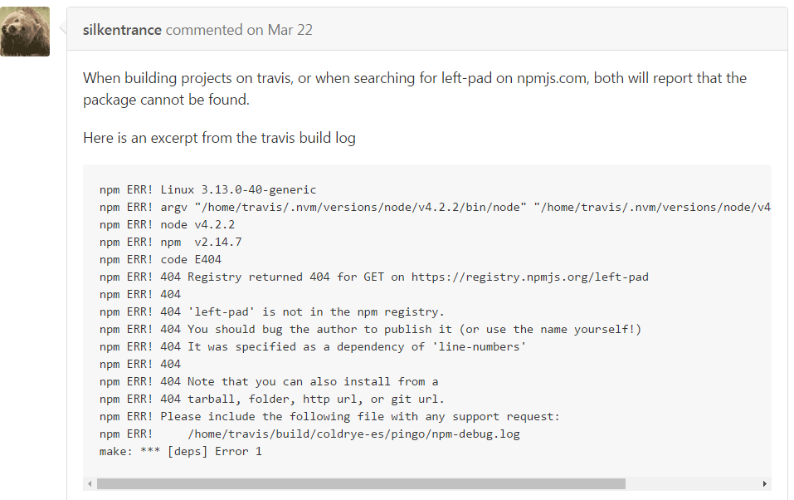
The Left-pad Saga
npm ERR! 404 Registry returned 404 for GET on https://registry.npmjs.org/left-pad
npm ERR! 404 'left-pad' is not in the npm registry.
npm ERR! 404 You should bug the author to publish it (or use the name yourself!)

Slide 6

The Left-Pad Saga
Left-Pad was/is used by ~40 npm modules
  including React and Babel (used by FB, AirBnB and others)
First of all Azer is no longer anonymous.
He actually triggered and important discussion within the community
Should an author be able to un-publish his work without a process?
What happens to the available module names?

Slide 7
The NPM Platform

Slide 8
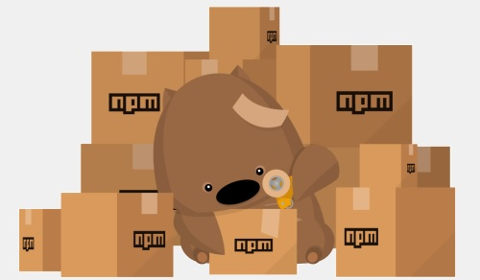
npm– Node.js Package Manager
NPM is the node.js open source package manager
“Find, share, and reuse packages of code from hundreds of thousands of developers”
Around 300K modules available

Slide 9

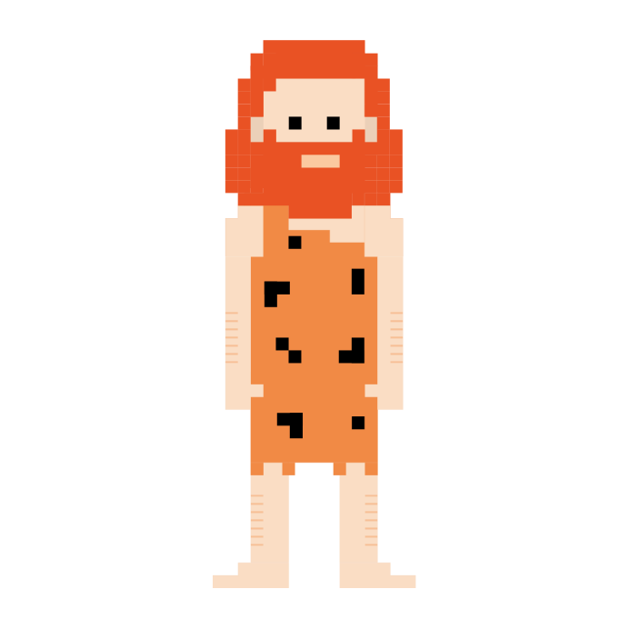
Some points to note about npm repo
Semantic Versioning – npm encourages the use of semver, or semantic versioning.
  Dependencies are not locked to a certain version by default.
  For any dependency, the dependency author can push a new version of the package.
Upgrade

Slide 10

Some points to note about npm repo
Persistent authentication – npm utilizes persistent authentication to the npm server.
  Users are not logged out until they manually do so.
  Any user who is currently logged in and types npm install may allow any module to execute arbitrary publish commands
Of course
I am Superman.

Slide 11
Some points to note about npm repo
Centralized registry – NPM utilizes a centralized registry
  Typing npm publish ships your code to this registry server, where it can be installed by anyone.

Slide 12
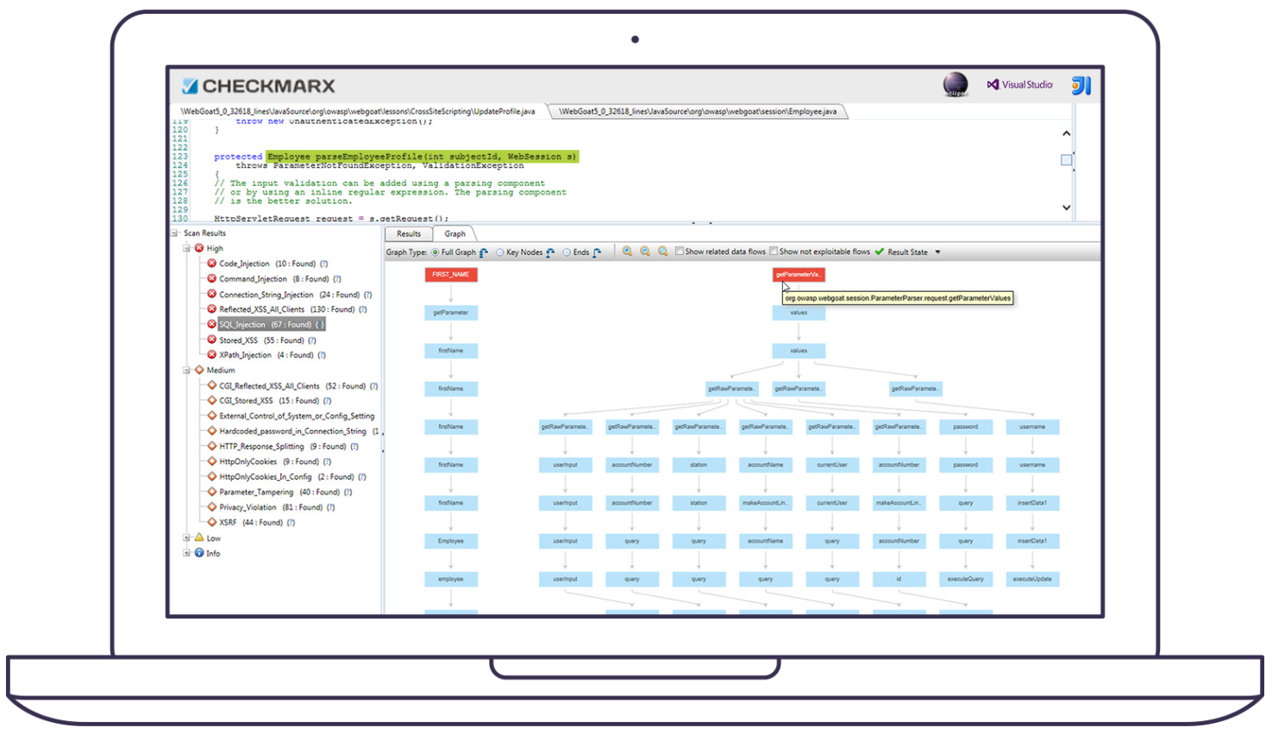
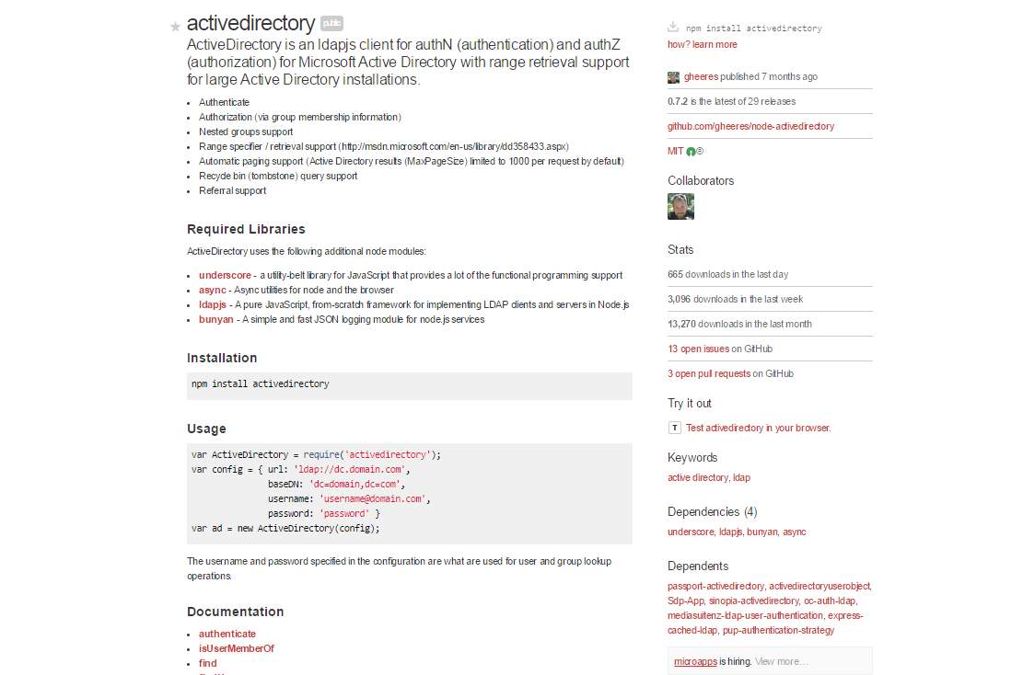
Lets take an example npm
^{4 Dependencies?}
^{“activedirectory”}
LDAP client for AuthN and AuthZ
^{~13K downloads last month}
^{4 Dependencies?}

Slide 13
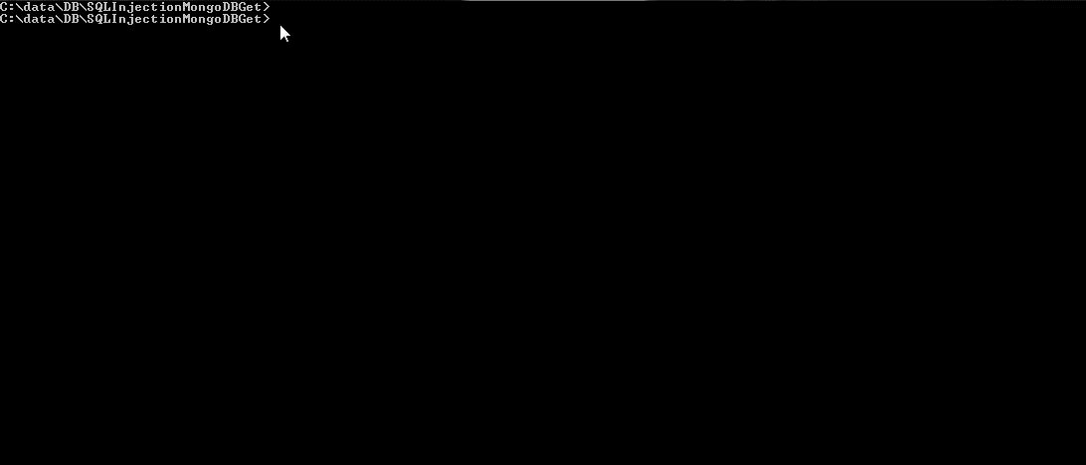
So simple - npm install <module name>

Slide 14
Lets take an example npm
^{lodash}
^{4 Dependencies?}
^{Underscore}
^{ldapjs}
^{bunyan}
^{async}
^{dtrace-provider}
^{verror}
^{vasync}
^{moment}
^{Safe-json-stingify}
^{dashdash}
^{once}
^{backoff}
^{asn1}
^{once}
^{Ldap-filter}
^{Asert-plus}
^{mv}
^{Dtrace-provider}
^{lodash}
⁴⁺¹⁰⁺⁴⁺¹⁼¹⁹

Slide 15
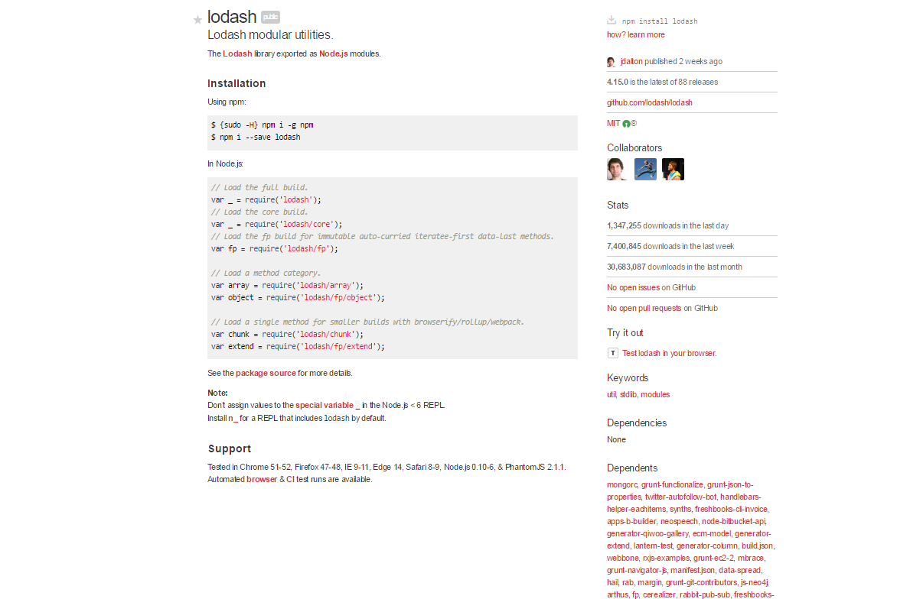
What about lodash?
^{lodash}
30,683,087 downloads last month!
^{0 Dependencies?}
^{82K Dependents!}

Slide 16
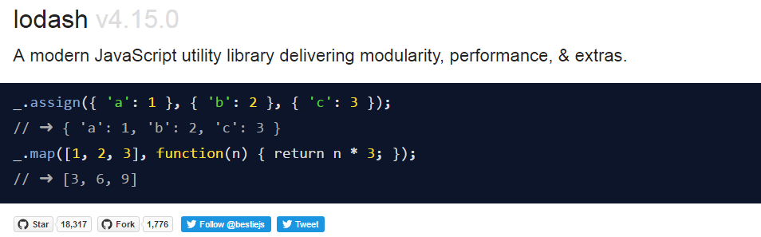
Lodash npm
Almost 90,000 packages depend on lodash

Slide 17
Let’s take a look at some potential scenarios

Slide 18
Ways to cause damage
Create a useful module
  Some good old marketing
  Update it after it gets adoption
Create module with similar name (Typo attacks)
Packages are identified by names (No unique identifier/key)
Taking over control of a legit account
Create a self replicating worm
Notes:
Worth the effort when the package has 80K packages depending on it.

Slide 19


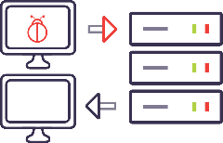
Creating a self replicating NPM worm
Socially engineer a npm module owner to npm install an infected module on their system.
  Worm creates a new npm module
  Worm sets lifecycle hook on the new module to execute the worm on any install
  Worm publishes the new module to the user's npm account
  Worm walks all user’s npm modules (publish permissions) and adds new module as a dependency in package.json.
  Worm publishes new versions to each of the modules with a “bugfix” level semver bump.
Full reports by Sam Saccone
https://www.kb.cert.org/CERT_WEB/services/vul-notes.nsf/6eacfaeab94596f5852569290066a50b/018dbb99def6980185257f820013f175/$FILE/npmwormdisclosure.pdf

Slide 20

Creating a self replicating NPM worm (Lifecycle Scripts)
Socially engineer a npm module owner to npm install an infected module on their system.
  Worm creates a new npm module
"scripts": {
"start": "node create malicious_npm_module",
"predeploy": "echo im about to deploy",
"postdeploy": "echo ive deployed",
"prepublish": "coffee --bare --compile --output lib/foo src/foo/*.coffee"
npm install Hydra_A
John
Full reports by Sam Saccone
https://www.kb.cert.org/CERT_WEB/services/vul-notes.nsf/6eacfaeab94596f5852569290066a50b/018dbb99def6980185257f820013f175/$FILE/npmwormdisclosure.pdf

Slide 21
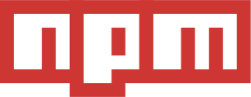

Creating a self replicating NPM worm (Persistent AuthN)
  Worm sets lifecycle hook on the new module to execute the worm on any install
  Worm publishes the new module to the user's npm account
npm publish
John
Legit 1
Legit 2
malicious_npm_module
John
Full reports by Sam Saccone
https://www.kb.cert.org/CERT_WEB/services/vul-notes.nsf/6eacfaeab94596f5852569290066a50b/018dbb99def6980185257f820013f175/$FILE/npmwormdisclosure.pdf

Slide 22
Creating a self replicating NPM worm (Semver)
  Worm walks all user’s npm modules (publish permissions) and adds new module as a dependency in package.json.
  Worm publishes new versions to each of the modules with a “bugfix” level semver bump.
Package.json
"dependencies": {
"primus": "*",
"async": "~0.8.0",
"express": "4.2.x",
"malicious_npm_module": "
John
Full reports by Sam Saccone
https://www.kb.cert.org/CERT_WEB/services/vul-notes.nsf/6eacfaeab94596f5852569290066a50b/018dbb99def6980185257f820013f175/$FILE/npmwormdisclosure.pdf

Slide 24
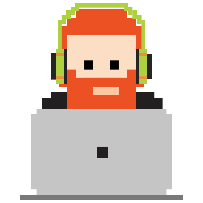
Yossi_A
Yossi_B
Yossi_C
Yossi_A
Yossi_B
Yossi_C
Hydra_A
Hey, Checkout this new npm
npm install Hydra_A
Yossi
Hydra

Slide 25
Package.json update
"dependencies": {
"primus": "*",
"async": "~0.8.0",
"express": "4.2.x",
"winston": "git://github.com/flatiron/winston#master",
"bigpipe": "bigpipe/pagelet",
"plates": https://github.com/flatiron/plates/tarball/master
},

Slide 26
From Malicious to Careless

Slide 27
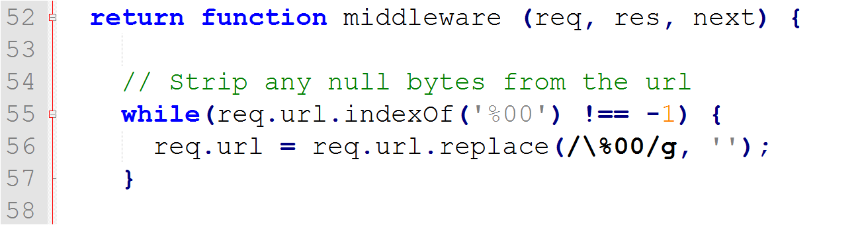
What is wrong with this picture?

Slide 28

What we did
Scan for security issues
  Top 50 popular packages
  Top 50 dependent-upon packages
  Other popular packages
Analyze results
Responsible Disclosure
  Contact dev
  Wait for patch
  Publish

Slide 29
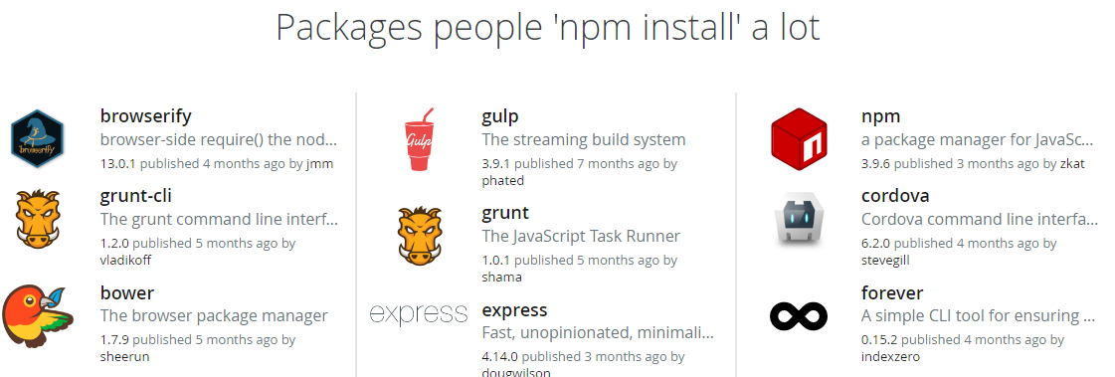
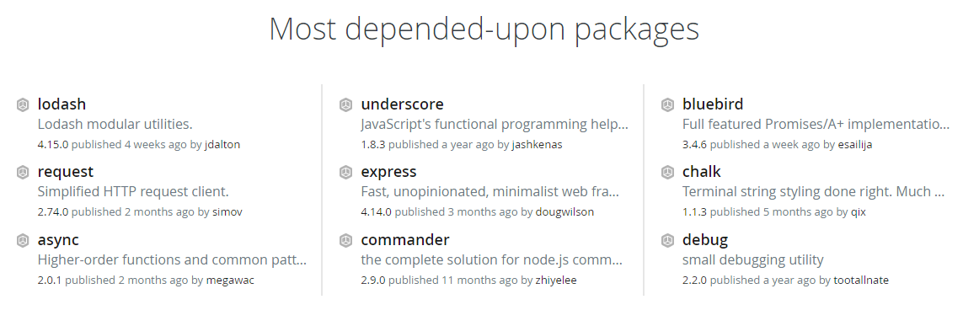
Top 50 NPM packages
https://www.npmjs.com/
https://www.npmjs.com/

Slide 30
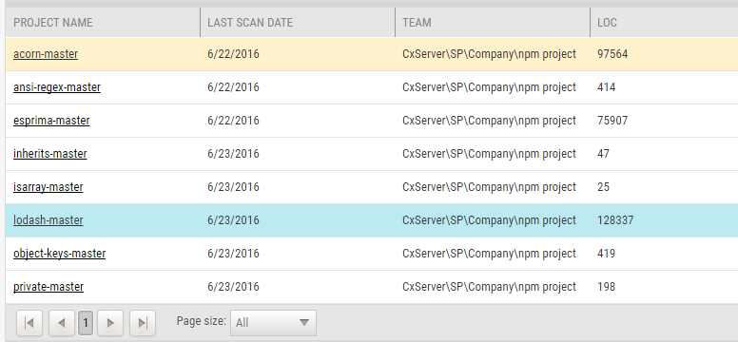
Scan for security issues

Slide 31
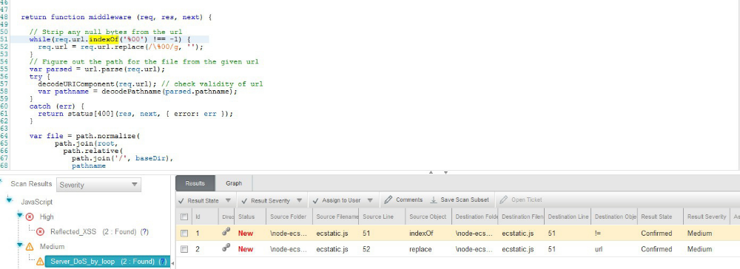
What is wrong with this picture?

Slide 32
What is wrong with this picture?

Slide 33
What is wrong with this picture?
node-ecstatic
12,454 downloads in the last day
66,658 downloads in the last week
278,399 downloads in the last month
369 other npm packages are dependent on ecstatic

Slide 34

Developer Response
PoC:
  22kb payload - 1 sec lag
  35kb payload - 3 sec lag http://www.checkmarx.com/%00%00%00%00%00%00 (...)
  86kb payload - server crashed

Slide 35

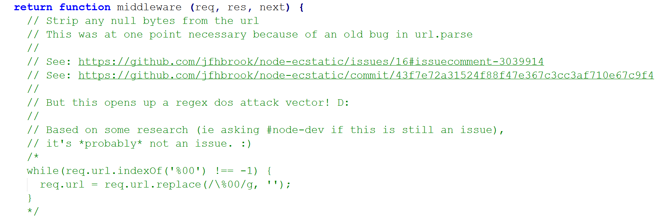
Developer Response

Slide 36
Other Scan Results
Command Injection
  Variable from user input was used as an argument for an OS command.
  Dev response: “The flaw exists because the original author used it… A possible solution is to delete the vulnerable file”.

Slide 37
Other Scan Results
Command Injection
Stored XSS
Denial of Service by Loop
Denial of Service by Regex (ReDoS)
CSV Injection
Insecure Randomness
Open Redirect

Slide 38
So how do I protect myself?

Slide 39
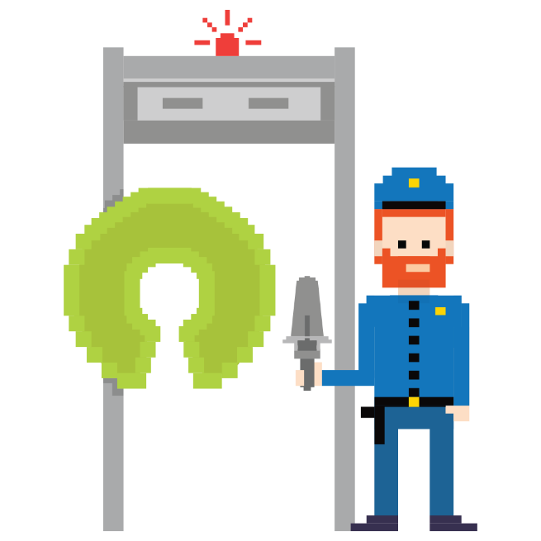
Be Safe User!
Check if there are any hooks - npm show $module scripts
Inspect the code - http://registry.npmjs.org/MODULENAME/-/MODULENAME-VERSION.tgz (A malicious package will probably not expose its cards)
Don’t allow scripts to execute automatically– npm install –ignorescripts
Use npm shrinkwrap to lock down your own dependencies
Sometimes it’s better to write your own functions!
Analyze your code but your code includes your dependencies!
Log out!
Notes:
npm allows the module author to specify a number of hooks to be run at different stages of the install or uninstall. These hooks are run by default when you perform these npm actions.
To make sure these hooks aren’t run when you want to review a package, don’t npm install it, but look at the source code in its repository first. Note that the repository does not have to represent the package in any way shape or form. A malicious package will most likely not show its cards here or even have a repository.
You can download the tarball of the module directly and inspect it.
If you do just want to install it from npm, the easiest way is to use the npm install option --ignore-scripts which doesn’t protect you from malicious or native code in the module, but does stop the script hooks from executing immediately on installation.

Slide 40
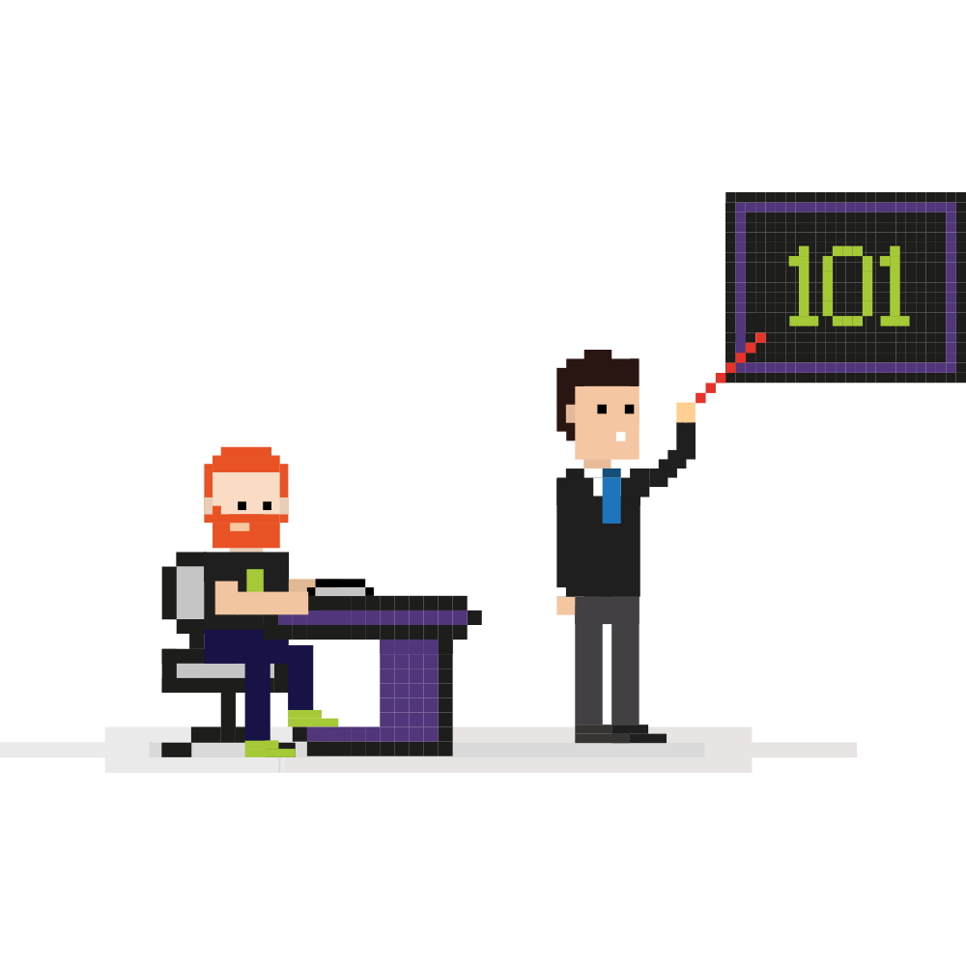
Be Safe Corporate!
Run a local NPM repo
Prevent installing from main registry

Slide 41
Some vulnerable examples in August 2016
Swagger-UI – XSS - XSS in URL Query String Parameter
  Used by 29 different modules
  60K downloads a month!!!
Node-krb5 - Spoofing attack due to unvalidated KDC
  Used by 2 modules
  300 downloads a month

Slide 42
Thank You.

