Slide 1

Theories of Agile,
Fails of Security
Daniel Liber
CyberArk
Notes:
Hi all,
Thanks for coming to this lecture. I am very happy to present here at OWASP AppSec Israel 2015, hopefully you are as excited as I am.
This lecture will be in English since the purpose is to share it with other OWASP chapters. I hope you are comfortable with this.
Ok, Let’s start – Today we will talk about the “Theories of Agile, Fails of Security”.

Slide 2

Short Bio
R&D Security Leader @ CyberArk
  Promoting product security
  SDLC
~10 years of experience
  Research, consulting, PT, engineer
CyberArk:
  Privileged accounts security
  http://www.cyberark.com
Notes:
Before we continue, I would like to introduce myself. I am currently R&D Security Leader at CyberArk Software.
You might ask yourself what does a security lead do, and my main objectives are promoting the security of CyberArk products along with assuring a high standards, on point secure development lifecycle principles.
I have been around the security industry for about a decade in different positions and job places – researcher, consultant, penetration tester, engineer. Each taught me a little piece of what I know today and still, as we all know, there’s always so much more to learn in this field.
CyberArk software is located in Petah Tikva (yes, I know, it’s THAT city) and focus on privileged account security – meaning, protecting abuse and misuse of accounts with elevated privileges. I am not going to talk more about CyberArk, but if you are interested you can read more in our website.

Slide 3
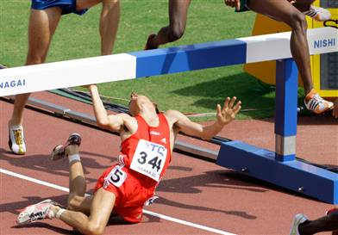
“Success is stumbling from failure to failure with no loss of enthusiasm.”
(Winston Churchill)
Why Fail?
Notes:
I would like to start with a quote from Winston Churchill: “Success is stumbling from failure to failure with no loss of enthusiasm”.
As an security community, we have enthusiasm to stay secure and should keep that enthusiasm. For that purpose, I will try to assist you. I do not want you to fail somewhere in the middle, nor even in the start. I want you to be able to prevent some of the unpredicted fails of security in an Agile world. (Click)
You wouldn’t like to be surprised like this guy here, would you?

Slide 4

What can you take out of this talk?
Predicting and preventing Agile-Security bottlenecks
Balancing out security risks
Security practices visibility
Collaboration, delegation, validation
Notes:
First of all, I would like everybody to stay calm – You will have the slides after this talk and also a brochure that will summarize the points that are in here. I believe I see a sigh of relief from half of the audience here ☺
Secondly, let’s summarize what exactly are we going to talk about that you can later on implement in your organizations:
Predicting and preventing bottlenecks that created Agile-security integrations
Eliminating hidden risks that rise because of the methodologies used
We will talk about how to make sure that the security tasks do not get lost in tracking
Last but not least – How you can join forces with others to succeed with your tasks better but still make sure they happen

Slide 5
Most popular Agile slide in the world!
Individuals and interactions over
processes and tools
Working software over
comprehensive documentation
Customer collaboration over
contract negotiation
Responding to change over
following a plan
Notes:
Usually when talking about Agile, one must put this slide on. This is from the Agile Manifesto (there are 12 principles). The main agenda of the Agile is having a working software, which is basically good for business. However, digging into the high levels of the Manifesto is troublesome for security. For example, comprehensive security is put aside for the working software, which is a good priority, but then again – when you need to find a security review of a feature from a sprint 9 months ago, it is tricky. Also, Agile is built on feedback, meaning that you release as soon as you can and try to improve the product in the following iterations. I cringed a bit when I read it because if have encountered a case of shipping out a product with security issues, trust me, the feedback is not easy to take in. In general, my feeling was a bit like this:

Slide 6
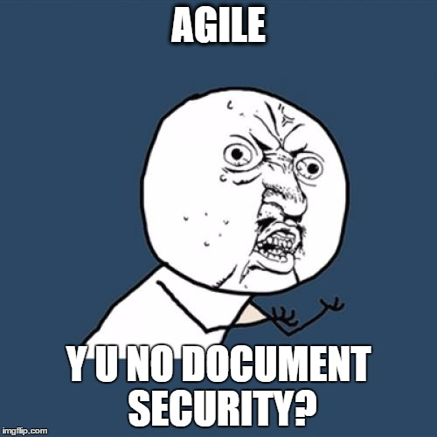
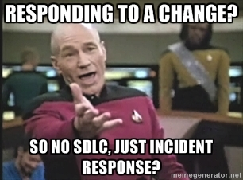
Agenda
We need to start from somewhere…
Notes:
Having that said, I had enthusiasm (that’s right, like Churchill said), so I knew I needed to start from somewhere

Slide 7
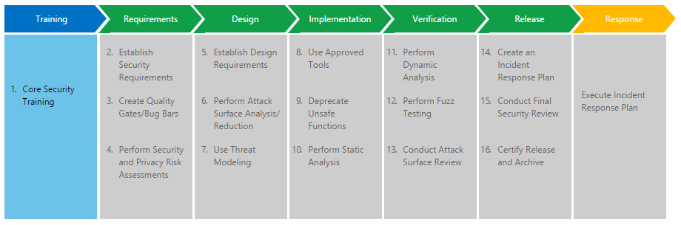
Microsoft’s SDL (Traditional)
Notes:
Microsoft’s SDL program is very easy to understand and constructive. It has the traditional division to the five elements of development lifecycle: Requirements, Design, Implementations, Verification and Release, with the additions of Training and Incident Response. Each phase has security tasks that need to be carried out during that phase, and moving on to the next phase only happens once those tasks were completed.

Slide 8
Microsoft’s SDL (Agile)
Sprint
Essential
Bucket
Important
One time
Foundational
once at the start of every new Agile project
Performed every sprint
on a regular basis but can be spread across multiple sprints
Notes:
In 2010 Microsoft presented at BlackHat a newer version of the SDL. Agile development was already increasing in popularity, and adjustments had to be made to the traditional SDL. 3 new classes were introduced:
One time tasks are the foundation for the project. It could be a bit misleading though; Obviously the definition of what is exactly an Agile project is could vary between different participants. What’s guaranteed is, it will happen more than one time
Bucket tasks are important and built on top of the foundations, however not required on every sprint.
The ongoing, essential tasks happen every sprint, mainly because doing them every few sprints will result in a significant delay in case that one of this tasks is not completed.
Having this said, I wanted to dive a little deeper and understand exactly what does a sprint mean.

Slide 9

Scrum Explained
Sprint: regular, repeatable, deliverable cycle
Backlog: Prioritized stack of features
Roles: Product Owner, Team, Scrum Master
Stories: Requirement as user point of view
Grooming: Refining the backlog
Meetings: Planning, Daily, Summary, Retro
Product Backlog
Spring Backlog
Sprint
Deliverables
Notes:
So let’s talk a bit about sprints, or the methodology – Scrum.
Scrum methodology revolves around regular, repeatable time units, or as they called – cycles or sprints – that by the end of every sprint, a the completed tasks are deliverable and ready for release. The tasks come from the backlog, which is a stack or queue where every feature is prioritized for development. The backlog is managed by a product owner, who is basically in charge of determining what are the next tasks. The features are told as stories, utilizing the point of view of the user. The process of shifting those stories from the product backlog to the sprint backlog is called grooming, meaning that the stories are defined and refined before being developed.
Also, the team meets for daily scrum meeting, sprint planning and summary, and also retrospective where you learn what and how to improve from previous sprints

Slide 10
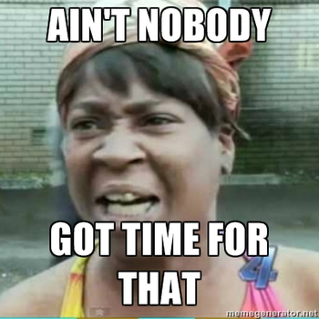
“Daily vs. Security Practitioner” Problem
Sprint of 2 weeks
Overlooking 4 teams
Participating in every daily
15 minutes each daily
10 days X 4 teams X 15 minutes
= 10 hours ~ 1 day
= 10% of your sprint time
Notes:
As a security expert in scrum environment, I wanted to participate in the daily meetings so I could know what’s going on.
Lets say that the sprints, which are usually 1 to 4 weeks in Scrum, are 2 weeks. I am overlooking 4 teams (yes, I know that in real life this is usually much more) and I participate in every daily for 15 minutes just to get the hang of the security tasks.
This means that around 10% of my time is spent just on trying to know what’s going on. Evaluating all the tasks we have as security teams, this is too much.

Slide 11

“Daily vs. Security Practitioner” Problem
Solution – use security champions
Team members
Security friendly
Eyes and ears on meetings
Potential for security team
(In a way, the team’s security bouncer)
Notes:
When Microsoft presented at BlackHat their proposal for Agile security. Key principles in these framework are based on classifying the different tasks from traditional SDL into sprints, buckets and one-timers. Before we dive into these classes, I just want us to understand a bit better where sprints come from

Slide 12
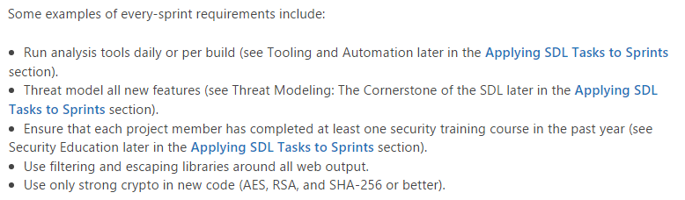
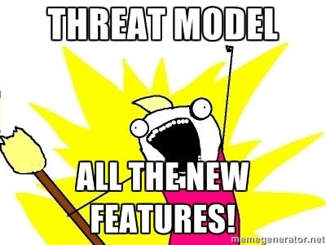
Going back to Microsoft’s Agile SDL
Notes:
When Microsoft presented at BlackHat their proposal for Agile security. Key principles in these framework are based on classifying the different tasks from traditional SDL into sprints, buckets and one-timers. Before we dive into these classes, I just want us to understand a bit better where sprints come from

Slide 13
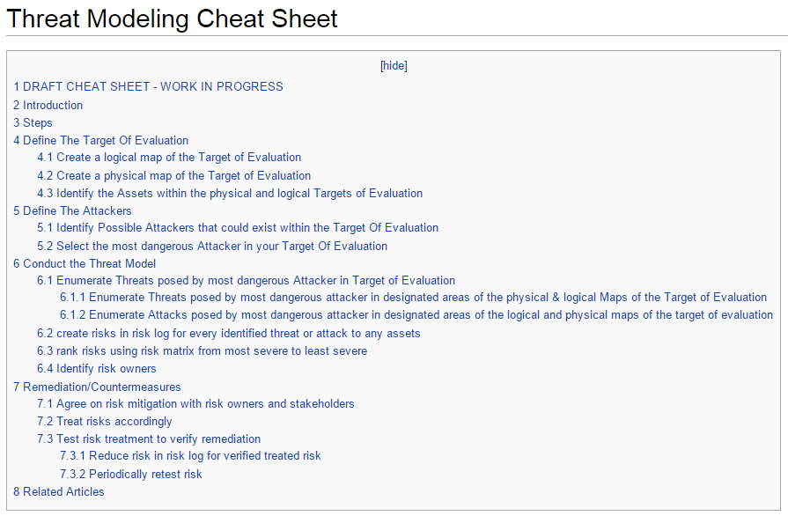

Fast, short, easy threat modeling…?
Notes:
When Microsoft presented at BlackHat their proposal for Agile security. Key principles in these framework are based on classifying the different tasks from traditional SDL into sprints, buckets and one-timers. Before we dive into these classes, I just want us to understand a bit better where sprints come from

Slide 14
“Demanding Security Task, Short Cycle” Problem
Solution – talk to Product Owner
Product roadmap sharing
Sensitive epics / features to review
Allocate security sprints (buckets)
Cut off: Decide on top threats to explore
(Cooperation with business is essential)
Notes:
When Microsoft presented at BlackHat their proposal for Agile security. Key principles in these framework are based on classifying the different tasks from traditional SDL into sprints, buckets and one-timers. Before we dive into these classes, I just want us to understand a bit better where sprints come from

Slide 15
Visibility of Security in Agile
“The most efficient and effective method of
conveying information to and within a development
team is face-to-face conversation.”
face-to-face meetings can’t reflect status of security task to a 3rd party
Interactions require two or more to participate
Notes:
When Microsoft presented at BlackHat their proposal for Agile security. Key principles in these framework are based on classifying the different tasks from traditional SDL into sprints, buckets and one-timers. Before we dive into these classes, I just want us to understand a bit better where sprints come from

Slide 16
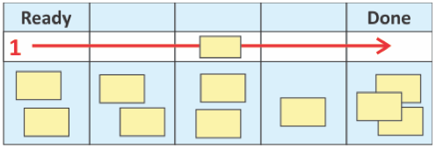
Kanban Explained
Incremental: Improvement by continuous change
WIP: Working In Progress
Cycle Time: Time from start to done of a task
Visibility: Flow of work is visualized
Board: Activity is managed using a Kanban board
Notes:
When Microsoft presented at BlackHat their proposal for Agile security. Key principles in these framework are based on classifying the different tasks from traditional SDL into sprints, buckets and one-timers. Before we dive into these classes, I just want us to understand a bit better where sprints come from

Slide 17

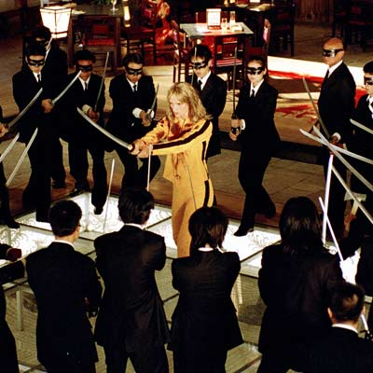
Security Fixes and Improvements
How you wish to feel How you feel
Notes:
Have you ever been to a meeting talking about security fixes?
Security has no visible ROI since it is non functional
In agile it’s harder – due to changing requirements.
Eventually, you sometimes feel like this when negotiating

Slide 18
“This Security Issue Will Have To Wait” Problem
Solution – Define one of the next tracks:
SLA (Hint: challenging, but still measurable)
Security WIP
Story points
  Per product vs. per all products
  Per sprint vs. per quarter
  Fixes vs. Improvements
Notes:
Setting a track to fix a security issue is not something you can do only in Agile, but some of the options are.
SLA is not limited to Agile. But – it talks about general time units. Saying something is fixed in 3 months doesn’t help you to plan better.
WIP allows you to have a task quota, this means that the security fix lane will have tasks on it as long as it doesn’t exceed the WIP.

Slide 19
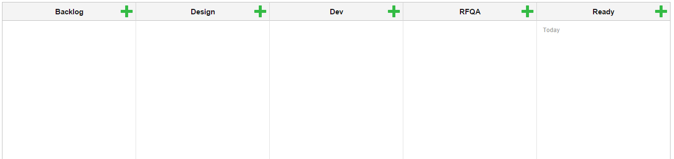
Integrating Security into Boards
Boards with no visible security activities:

Slide 20

Integrating Security into Boards
Adding security lanes:
Design ←→ Design review column
Dev ←→ Static analysis / CR column
QA ←→ Penetration testing
Invisibility = Problems

Slide 21
Measuring Security in Agile
What is different from Waterfall?
Building the big picture from small iterations
Collecting evidence of simultaneous activities
Vague control points – Should be every…
  Sprint?
  Group of sprints?
  Version release?

Slide 22
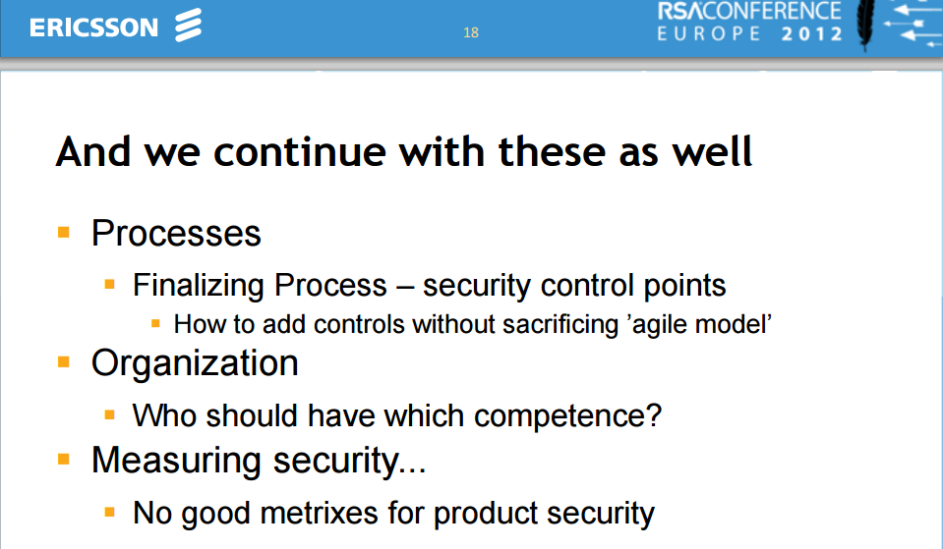
RSA EU Conference 2012

Slide 23
Measuring Security in Agile
Security cards on board – velocity, cycle time, etc.
From Grooming to Ready
  Each card gets a ‘security level’ score
  Each score gets different attention for security
  When card is ready, look for evidence
Automation, automation, automation

Slide 24
Questions?
Not all Agile theories help security
Adjustments implemented will prevent fails
Eliminate security bottlenecks
Empower others to execute more security activities

Slide 25

Thanks!

Slide 26
Pictures references
http://www.japanprobe.com/wp-content/uploads/hurdle-face.jpg
http://memegenerator.net
http://imgflip.com
https://www.microsoft.com/en-us/SDL/Discover/sdlagile.aspx
http://mascotdesigngallery.com

