Slide 1


Building an Effective SDLC Program:
Case Study
Guy Bejerano, CSO, LivePerson
Ofer Maor, CTO, Seeker Security
Notes:
1

Slide 2


The Next 45 Min
SDLC – Why Do We Bother?
Vendor Heaven – Sell All You Can Sell
Finding Your Path in The Jungle -
Assembling The Puzzle to Build a Robust SDLC Program
Data & Insights based on our experience @ LivePerson
Notes:
SDLC – What’s the incentive? – talk about LP and the importance of a best in class app security program (part of the business goals)
What the market has to offer (by ofer ☺)
Assembling the right solution for your business
2

Slide 3

Seeker Security
Identify, Demonstrate & Mitigate
Critical Application Business Risk
Formerly Hacktics® (Acquired by EY)
New Generation of Application Security Testing (IAST)
Recognized as Top 10 Most Innovative Companies at RSA® 2010.
Recognized as “Cool Vendor” by Gartner
Notes:
3

Slide 4





LivePerson
Monitor web visitor’s behavior
(Over 1.2 B visits each month)
Deploying code on customers’ websites
Providing Engagement platform
(Over 10 M chats each month)
Process and Store customers’ data on our systems
SAAS in a full Multi-tenancy environment
Notes:
4

Slide 5
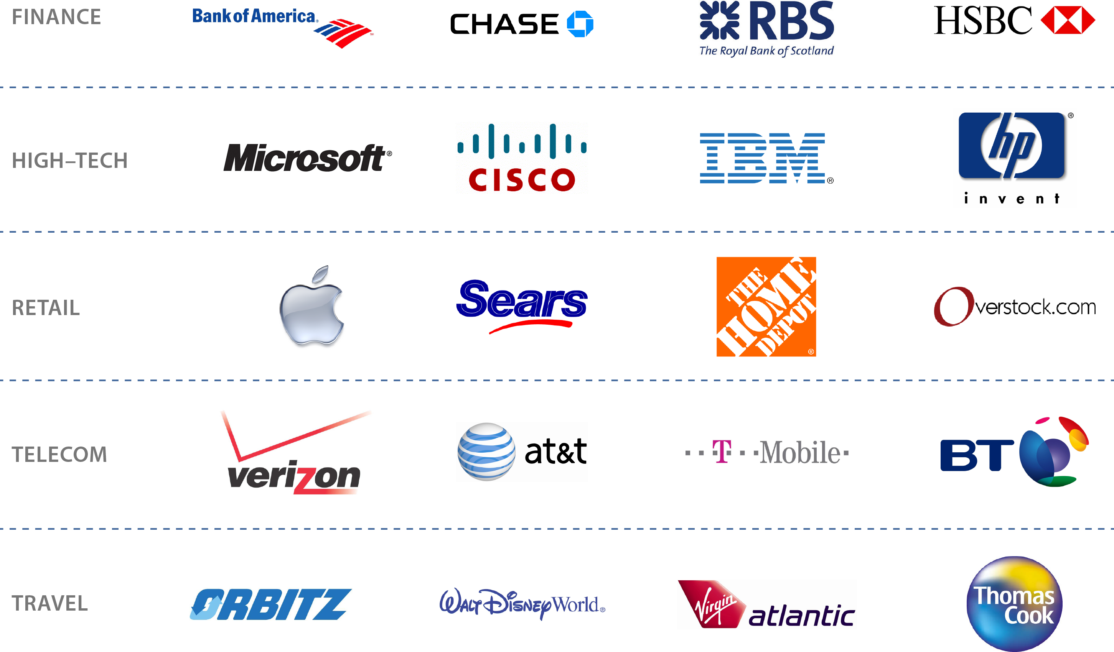

Providing Service to Some of the Biggest

Slide 6




Cloud Motivation for Building Secure Code
Risk Characteristics
Cyber Crime – Financial motivation
Systems are more accessible and Perimeter protection is not enough
Customers (over 15 application pen-tests in the past year)
Reputation in a social era
Legal liability and cost of non-compliance
Notes:
Lower the risk – Cloud systems are accessible and subjected to hacking attempts. Especially when branded customers are using them
Reputation in a very demanding environment – Customers’ radar are on full alert. We get more than dozens of customers’ security evaluations each year
Cost & Friction – security bugs in production are costly and create huge friction internally as well as with customers (this is a discussion you don’t want to have)
6

Slide 7


The Impact of Security Bugs in Production
Highly expensive to fix
(4X than during the dev process)
Creates friction – Externally and Internally
We are not focusing on the upside
Notes:
High cost – almost 4 times when in production. QA and rollout
Friction – 10% HF, customer interaction is on fixing problems (this is a discussion you don’t want to have)
Opportunity – to enable your business instead of troubleshooting
7

Slide 8

Back in the Waterfall Days
Security
Requirements
3rd party Pen-Testing
Customer Testing
Design
Development
QA
Bug Fixing
Rollout
Challenges
Accuracy of Testing
Same Findings Repeating
Internal Friction Still Exists
Notes:
Started with 3rd party on top of what we got from customers…to get a head start
Requirements as part of SOX/SAS70 and others
We became proactive and found most vulnerabilities before customers did
Downside – vulnerabilities repeted. The numbers didn’t
Moving to Agile – short cycles (big fixes didn’t get in), change in planning and design (while coding), change in test and bug fixing timelines
8

Slide 9
And Then We Moved to Agile
Security
Requirements
3rd party Pen-Testing
Customer Testing
Sprint
Plan
Sprint & Regression
Rollout
In Production
Challenges
Shorter Cycle (Design, Bug Fixing)
Greater Friction
Notes:
Started with 3rd party on top of what we got from customers…to get a head start
Requirements as part of SOX/SAS70 and others
We became proactive and found most vulnerabilities before customers did
Downside – vulnerabilities repeted. The numbers didn’t
Moving to Agile – short cycles (big fixes didn’t get in), change in planning and design (while coding), change in test and bug fixing timelines
9

Slide 10
The Solution Matrix
Vendor Heaven
Infinite Services, Products, Solutions & Combinations
In House / Outsourced
Services / Product / SaaS
Manual / Automated
Blackbox / Whitebox
Penetration Test / Code Review
DAST / SAST / IAST
Notes:
10

Slide 11

The Solution Matrix - Considerations
In-House/
Outsourced
Service/Product/SaaS (Manual/Automated)
Skills
Accuracy
Availability
False Positives
Cost
Ease of Use
False Negatives
Repeatability
Repeatability
Skills/Quality
SDLC Integration
SDLC Integration
Coverage
Intellectual Property
DAST/SAST/IAST
(PT/CR, Black/White Box)
Accuracy
False Positives
False Negatives
Quality of Results
Pinpointing Code
Validation
Ease of Operation
Data Handling
Scale
3rd Party Code
Notes:
11

Slide 12





How to Assemble All the Pieces?
Define Your Playground
Risk – Web, Data, Multi-Tenancy
Customers – SLA, Standards
Choose a Framework
Who Leads This Program
Highly Technical Organization (System Owners, Scrum Masters, Tech Leaders)
Knowledge – Who & How
Hands-On… QA First
On-going sessions
Notes:
Define your playground – customer expectation and standards, were should you put your focus, LP –SAAS, global web access & interactions, data validation
Choose methodology (language) – OWASP, NIST
Set ownership (managerial and tech) – Scrum masters, Tech leaders – not only security team
Dev champion – One person that helps you pave the way
12

Slide 13



How to Assemble All the Pieces?
Pen-Test Strategy
3rd Party
Blackbox
Pre-defined flows to check
Fitting Tools to Platform and Development Process
Java – Multi-Tier
Agile Methodology
JIRA (For bug tracking)
Define Operational cycle
Key Performance Indicators
Operational Review (by system owners)
Notes:
Define your playground – customer expectation and standards, were should you put your focus, LP –SAAS, global web access & interactions, data validation
Choose methodology (language) – OWASP, NIST
Set ownership (managerial and tech) – Scrum masters, Tech leaders – not only security team
Dev champion – One person that helps you pave the way
13

Slide 14

SDLC Take #2
Security
Design
Static Code Analysis
Runtime/Dynamic Code Analysis
3rd party Pen-Testing
Customer Testing
Sprint
Plan
Sprint & Regression
Rollout
In Production
Budgeted “Certification” Program
R&D / QA Ownership (Tech Leaders & System Owners)
Knowledge (Hands-On Training + On-Going Sessions)
Embedded Bug Tracking in Dev Tools
Notes:
Started with 3rd party on top of what we got from customers…to get a head start
Requirements as part of SOX/SAS70 and others
We became proactive and found most vulnerabilities before customers did
Downside – vulnerabilities repeted. The numbers didn’t
Moving to Agile – short cycles (big fixes didn’t get in), change in planning and design (while coding), change in test and bug fixing timelines
14

Slide 15
Thank You!
Q&A
Notes:
15

