Slide 1

Finding Security in Misery of Others
Amichai Shulman, CTO
The OWASP Foundation

Slide 2
Agenda
Quick Introduction
Motivation
Data Breach Headlines Examined
Summary
Q&A

Slide 3
Introduction

Slide 4

Imperva Overview
Our mission.
Protect the data that drives business
Our market segment.
Enterprise Data Security
Our global business.
Founded in 2002;
Global operations; HQ in Redwood Shores, CA
330+ employees
  Customers in 50+ countries
Our customers.
1,300+ direct; Thousands cloud-based
  4 of the top 5 global financial data service firms
  4 of the top 5 global telecommunications firms
  4 of the top 5 global computer hardware companies
  3 of the top 5 US commercial banks
  150+ government agencies and departments

Slide 5


Today’s Presenter
Amichai Shulman – CTO Imperva
Speaker at Industry Events
  RSA, Sybase Techwave, Info Security UK, Black Hat
Lecturer on Info Security
  Technion - Israel Institute of Technology
Former security consultant to banks & financial services firms
Leads the Application Defense Center (ADC)
  Discovered over 20 commercial application vulnerabilities
    Credited by Oracle, MS-SQL, IBM and others
Amichai Shulman one of InfoWorld’s “Top 25 CTOs”

Slide 6
Motivation & Methods

Slide 7

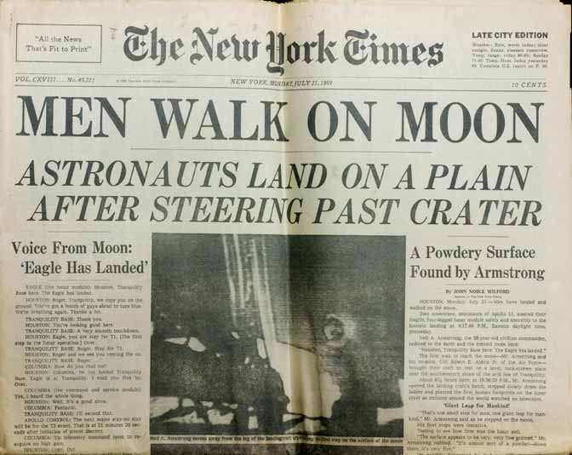

(The Wrong) Reasons for Analyzing Media Reports
They are 100% accurate
Gloating is always fun
  There is no joy like schadenfreude
I like science fiction

Slide 8
Reasons for Analyzing Media Reports
Learn from other people mistakes
Understand the root cause for incidents
Timely assessment of the risk to my systems
  What are attackers really going after
Plus…
  There are plenty of them
  They are for free

Slide 9
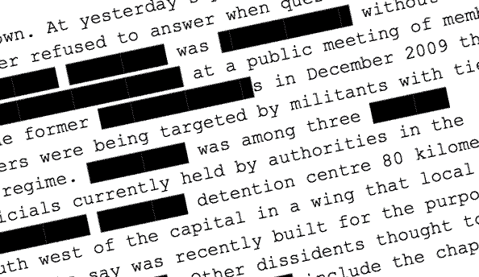
Analyzing Media Reports – Challenges
Challenges
  Disclosure acts only apply to describing the information at risk not how it was obtained
  Reports, press and official statements are usually vague – “to protect the individuals affected”
  Press if full of FUD and misinterpretations

Slide 10
Analyzing Media Reports – Methods
Examine various incidents in press
  Understand the language
  Point out the important failure points
  Suggest preventative measures
Extract details of the incident
  What was the mistake or attack source?
  If attack, what method was used?
  Was there an audit trail? Was it timely?
  Was audit, monitoring or security in place?

Slide 11
Disclaimer
Purpose of this session is to have fun

Slide 12
Data Breach Headlines Examined

Slide 13
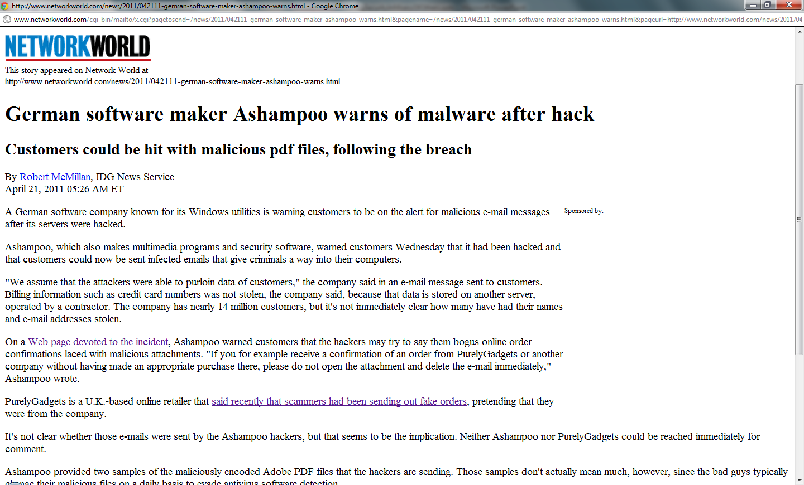
Beginners Exercise - AShampoo

Slide 14

Beginners Exercise - AShampoo
Audit?
Notes:
The Ashampoo message: http://www.ashampoo.com/en/usd/dth
The article: http://www.networkworld.com/news/2011/042111-german-software-maker-ashampoo-warns.html?source=nww_rss

Slide 15
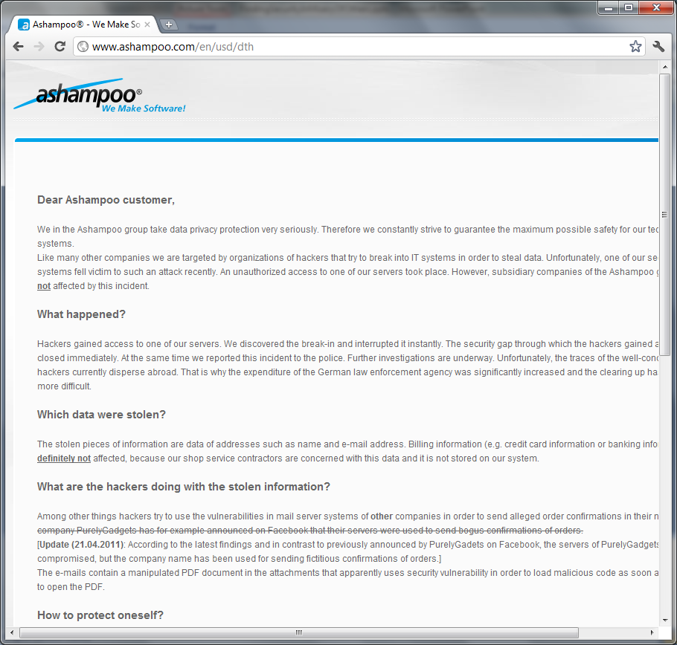
Beginners Exercise - AShampoo
Implications?

Slide 16
Beginners Exercise - AShampoo
Up side?

Slide 17
Beginners Exercise - AShampoo
Method
  Unknown
Audit
  None!
Implications
  Spear Phishing
Timely Detection
  Not!
Up side
  No payment details stored in house

Slide 18
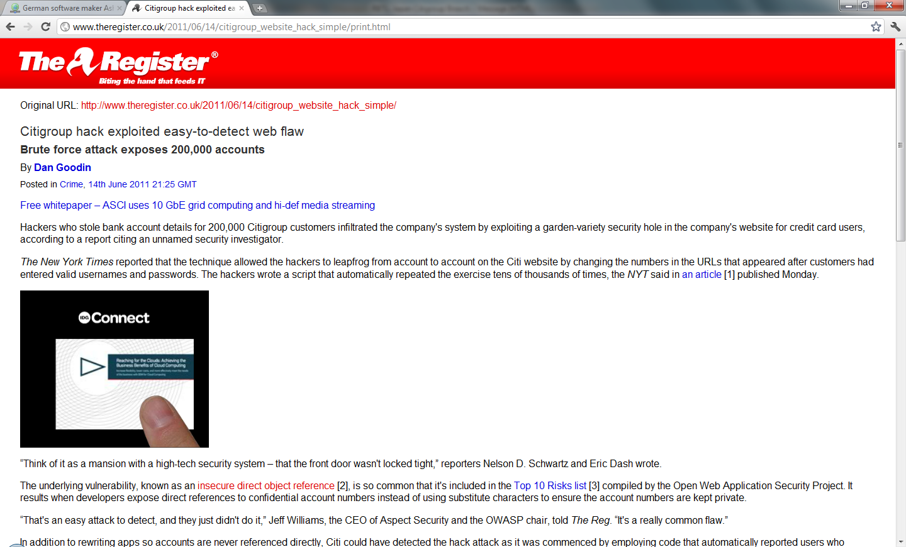
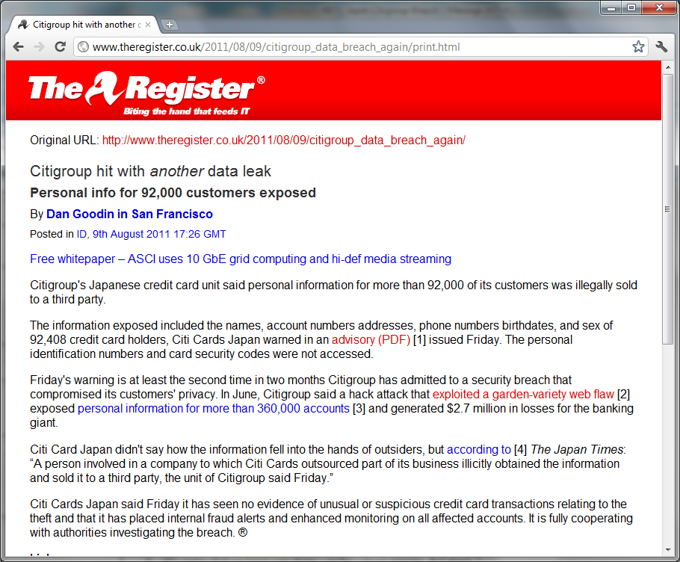
Lightning Can Strikes Twice - Citigroup
Notes:
Or more in Sony’s case

Slide 19
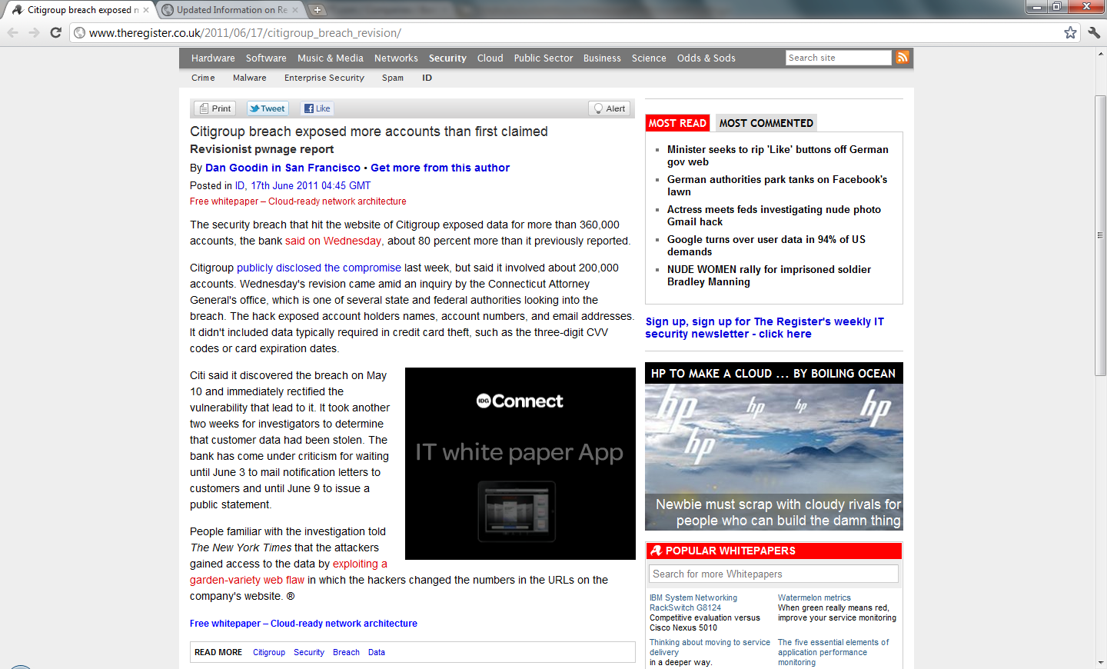
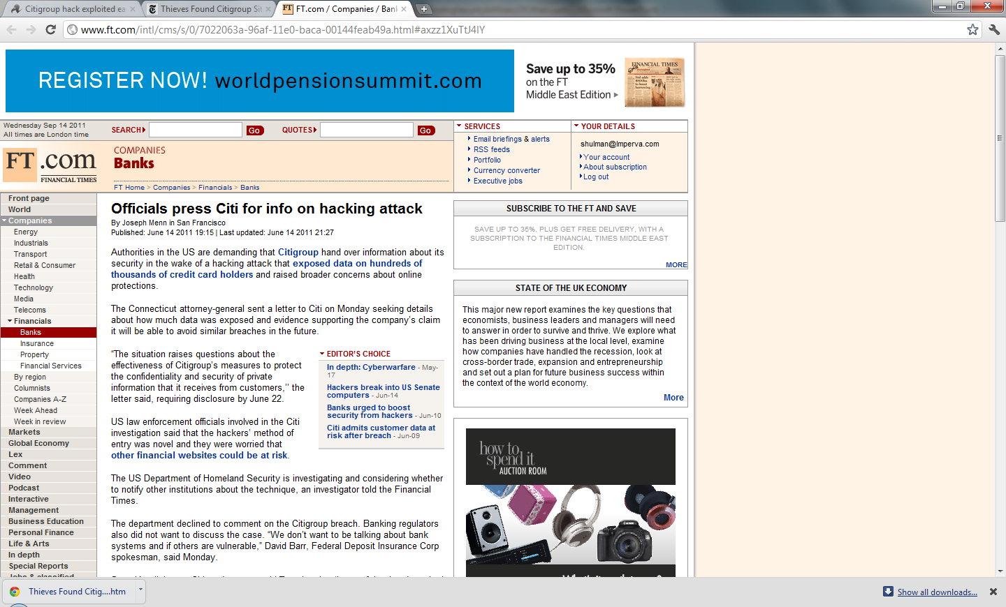
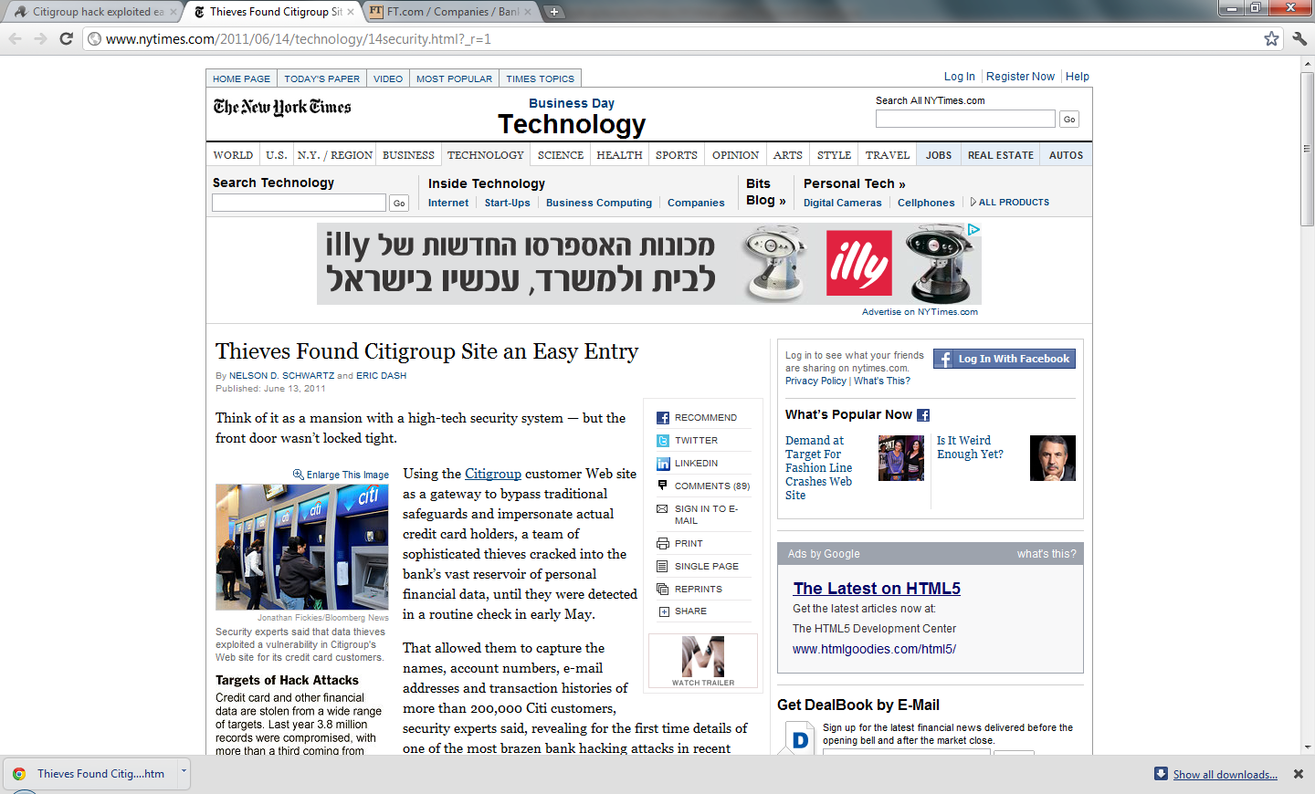
Citigroup - External Attack

Slide 20
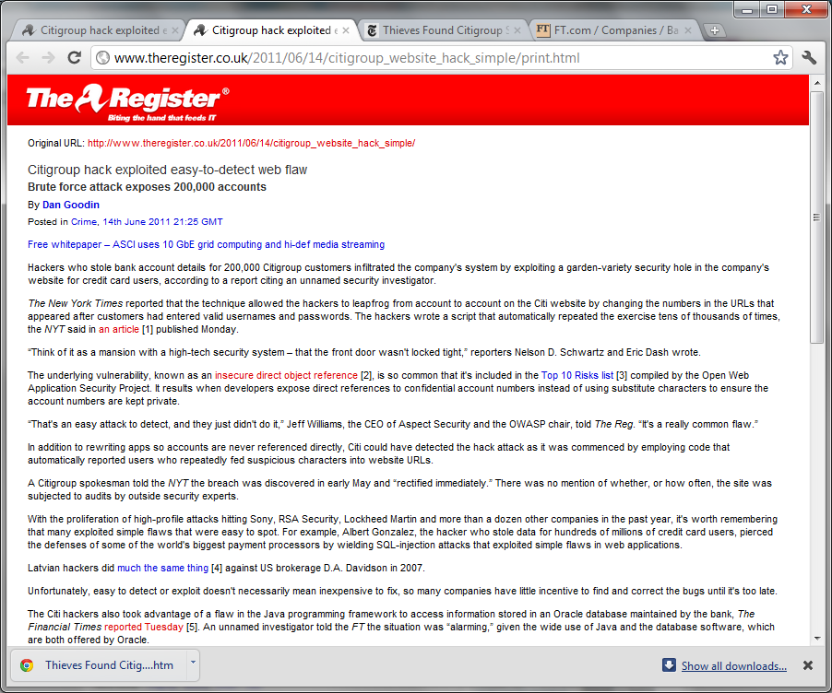
Citigroup - External Attack
Method?
Notes:
Method is “Insecure object reference” after log-in

Slide 21
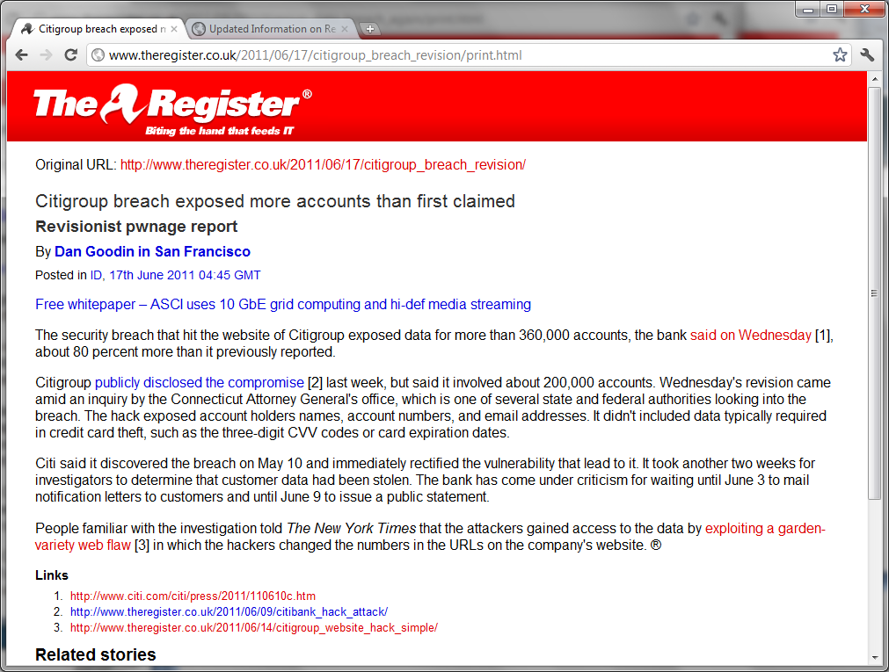
Citigroup - External Attack
Implication?
Notes:
In their statement CitiBank emphasized the fact that only 1% of accounts were compromised. It comes to show the different POV between the enterprise, victim and attacker. This is very similar to the passwords case from Rockyou. Citi are very proud of having only 1% of records compromised. A victim only cares about a single account (his own) and the hacker is happy with any substantial amount of data (and 360K is definitely substantial) regardless of its proportion in the general population (1%).
While Citi claims that “critical data is missing” we know for a fact (personal experience in more than one incident) that holding the PAN is enough for making transactions.
I think that the “account numbers” are actually “primary account numbers” better known as “credit card numbers”. What about PCI compliance?
Claimed 2.7M USD in loss.

Slide 22
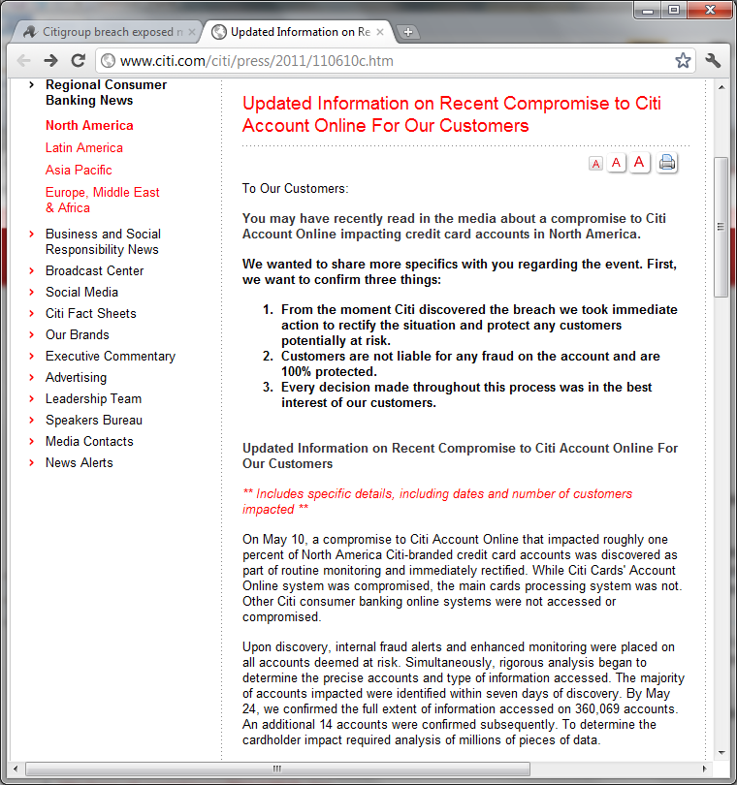
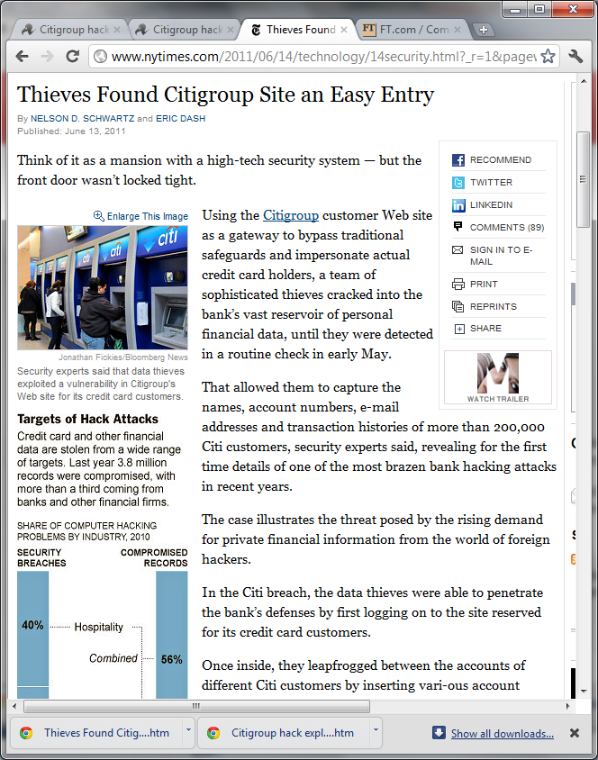


Citigroup - External Attack
Detection?
Notes:
What is a “routine check” or “routine monitoring”?
Why don’t they mention the date of the incident? As we’ll show later, they do know which records have been accessed.
Also the fact that implication information (number of affected accounts) was updated at least once, I suspect that there were at least three incidents (first they reported 200K, than 360K and admitted to later find 14 more – probably when attackers discovered the problem). Probably looking into different ranges of account numbers. First they look at the later incident and when going back in their records they found the second one.

Slide 23
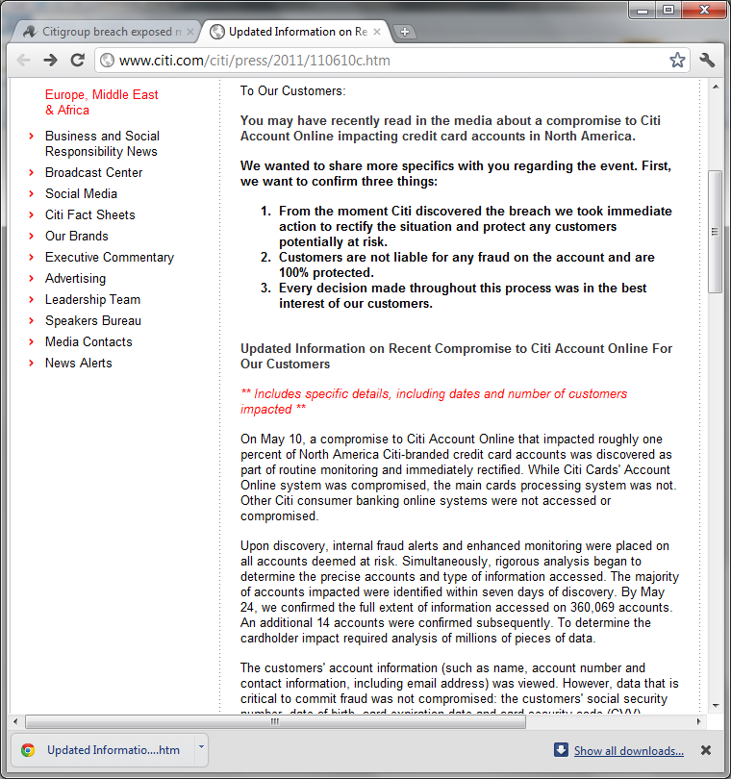
Citigroup - External Attack
Audit?
Notes:
It’s a bank. They always have audit. However, since this is not transaction data they couldn’t find it in the structured business log and probably had to sift and sort through piles of web server audit records. Most probably they had to track sessions whose logged in user was the perpetrator (or the originally compromised account).

Slide 24
Citigroup - External Attack
Method
  Insecure object reference
Implications
  Massive loss of (at least) customer details including account numbers
  Potential fraud
Audit
  Some
Timely detection
  Vaguely

Slide 25
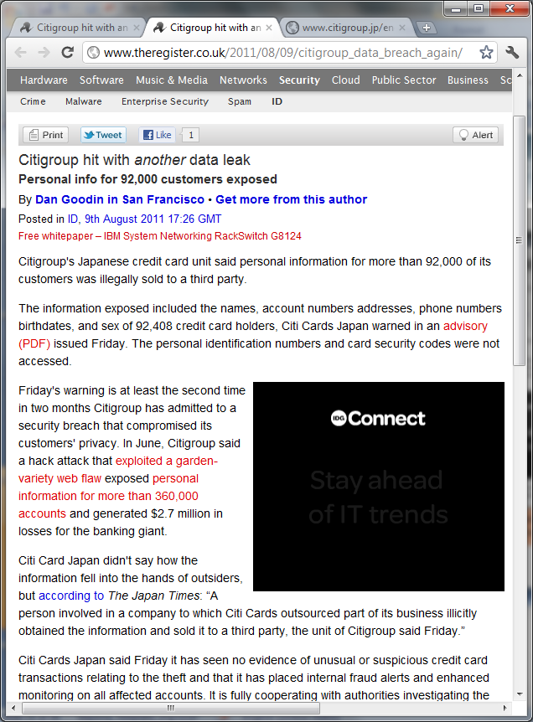
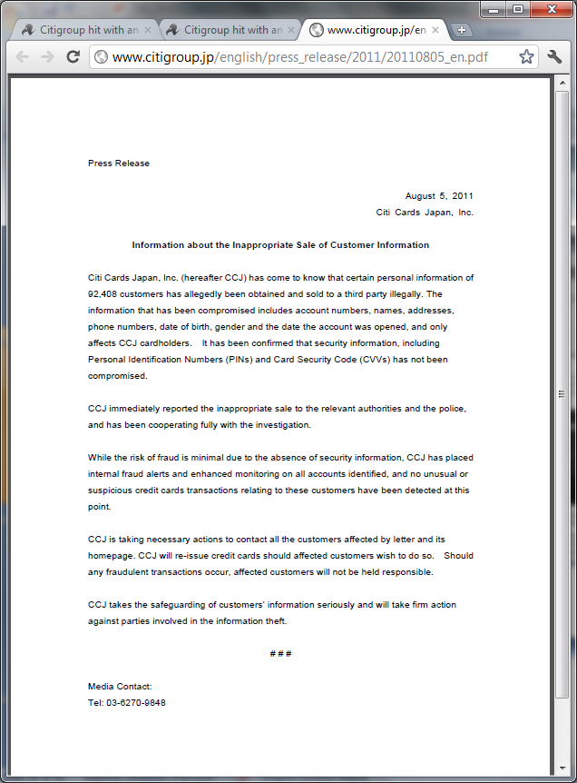

Citigroup – Internal Breach
Method?

Slide 26


Citigroup – Internal Breach
Implications?

Slide 27

Citigroup – Internal Breach
Detection?
Notes:
What kind of detection method is “has come to know”?
My guess is that it was either a whistleblower or someone who was apprehended by the police

Slide 28
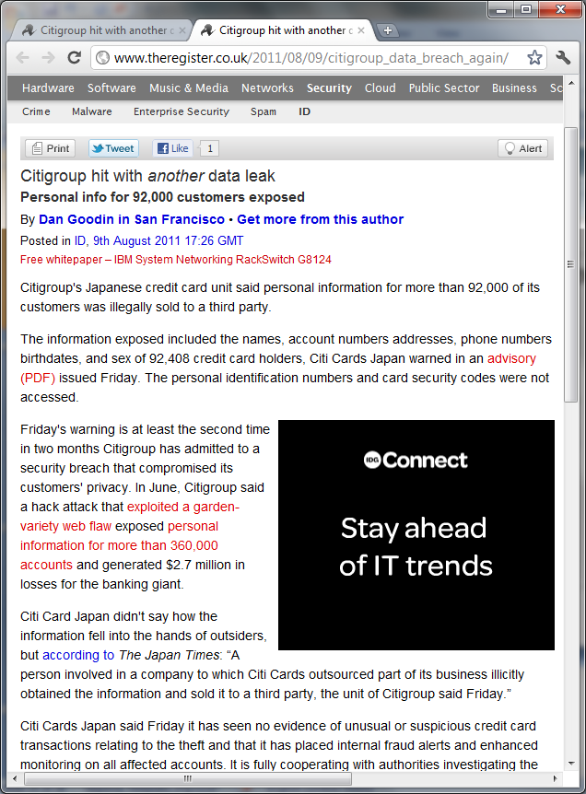
Citigroup – Internal Breach
Method
  Partner employee abusing legitimate access
Implications
  Massive loss of personal information
  Including account numbers
Detection
  Purely coincidental
Audit
  Irrelevant, occurred at 3rd party

Slide 29
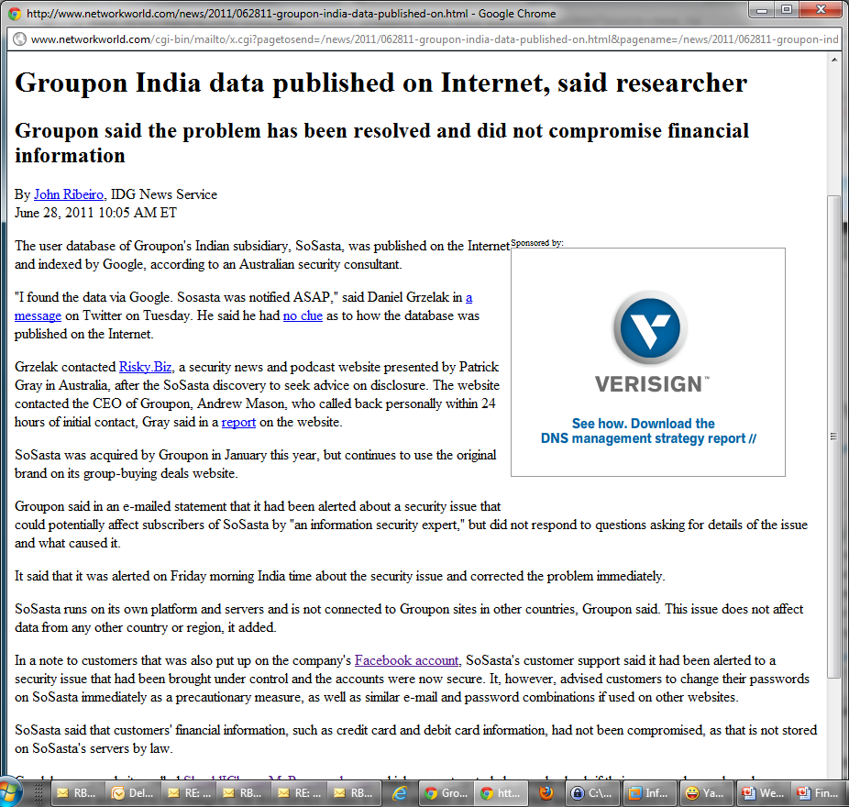
(Still) Playing Hide and Seek with Google
What
  360K authentication records
  Including cleartext password
Where
  SoSata’s own site
Implication
  Compromise of SoSata accounts
  Compromise of web mail accounts
Time of Exposure
  Unknown

Slide 30
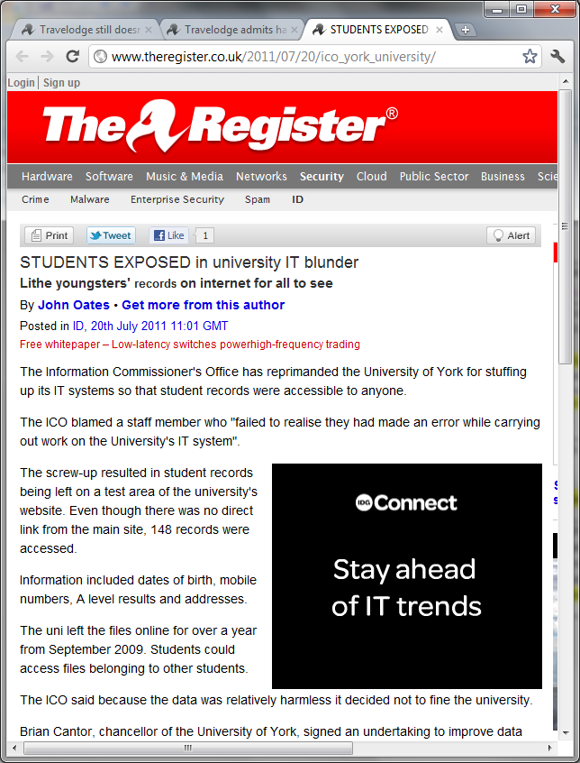


(Still) Playing Hide and Seek with Google
What
  Student records containing personal details
Where
  “Test” site
Implication
  Private records where actually accessed
Time of Exposure
  Over a year
Notes:
Authorities respond as though police would tell people to get used to wearing bulletproofs when leaving home.

Slide 31
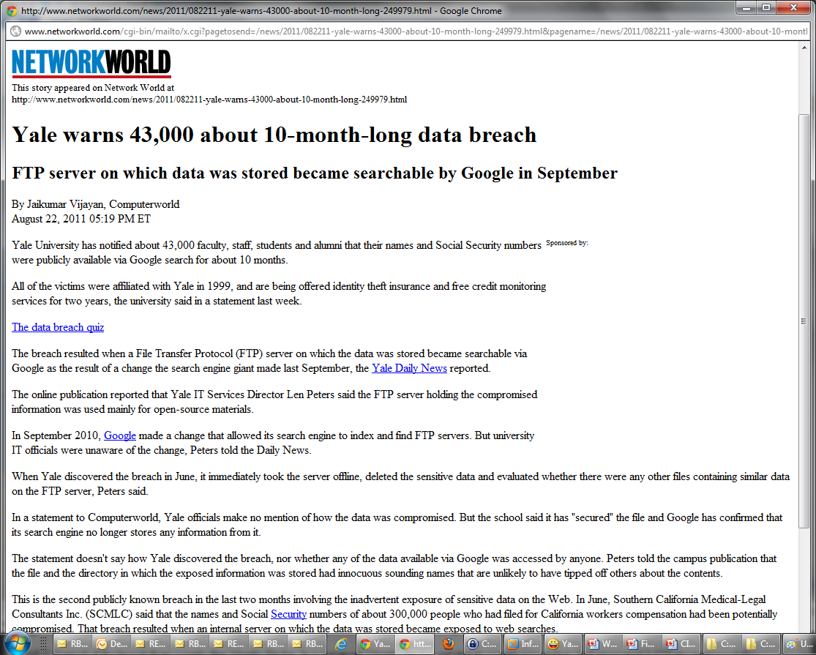
(Still) Playing Hide and Seek with Google
What
  43K student and staff personal records
  Including Social Security Numbers
Where
  Public FTP site
Implications
  Potential identity theft
Time of Exposure
  ~ 1 year (on Google)

Slide 32
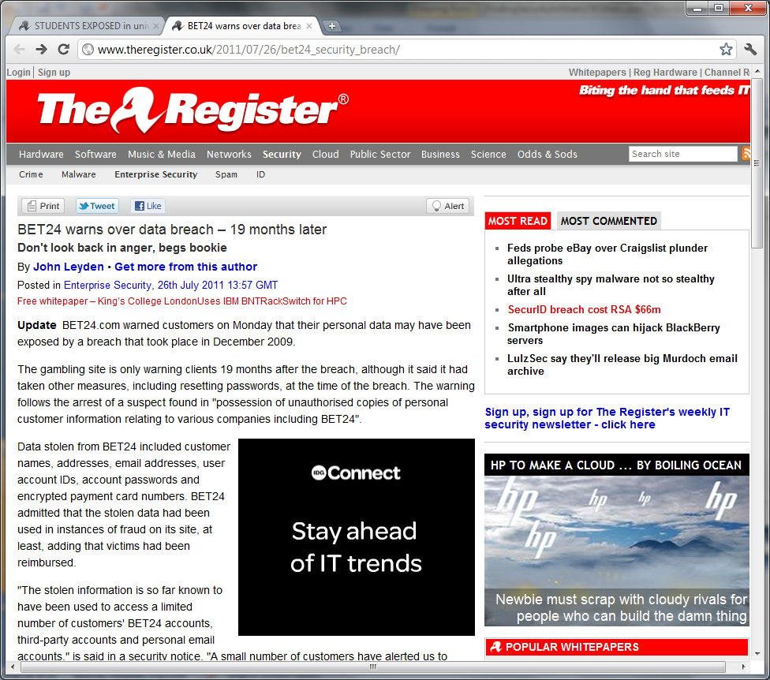
Betting Against All Odds – Bet24.COM Data Breach

Slide 33
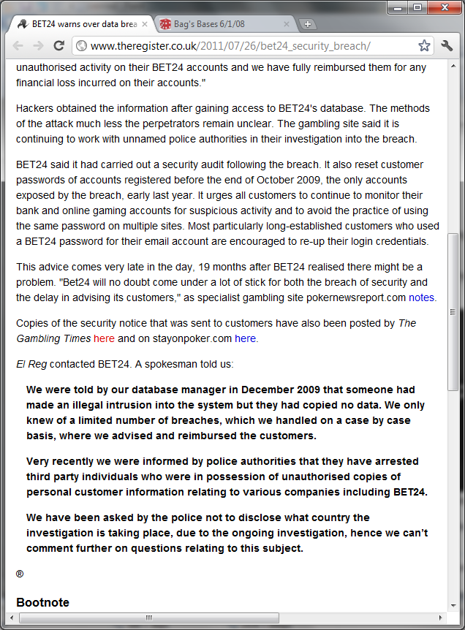
Betting Against All Odds – Bet24.COM Data Breach
Method?
Notes:
Most probably SQL injection. If that was an internal breach they would have identified the internal address and the culprit.

Slide 34


Betting Against All Odds – Bet24.COM Data Breach
Detection?
Notes:
Most accurate IDS in the world
Like the story with the priest waiting to be saved by God

Slide 35
Betting Against All Odds – Bet24.COM Data Breach
Audit?
Notes:
Probably had some basic database audit. Probably detect SQL errors in the audit trail.

Slide 36
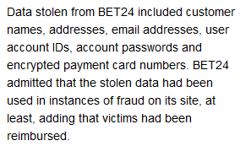
Betting Against All Odds – Bet24.COM Data Breach
Implications?

Slide 37
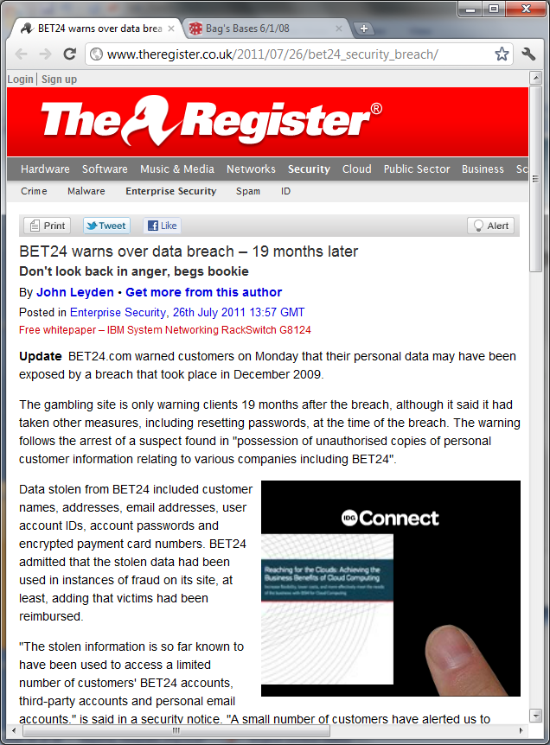
Betting Against All Odds – Bet24.COM Data Breach
Method
  Probably SQL injection
Implications
  Compromise of customer credentials
  Actual fraud
Audit
  Some
Timely detection
  Warnings were ignored

Slide 38
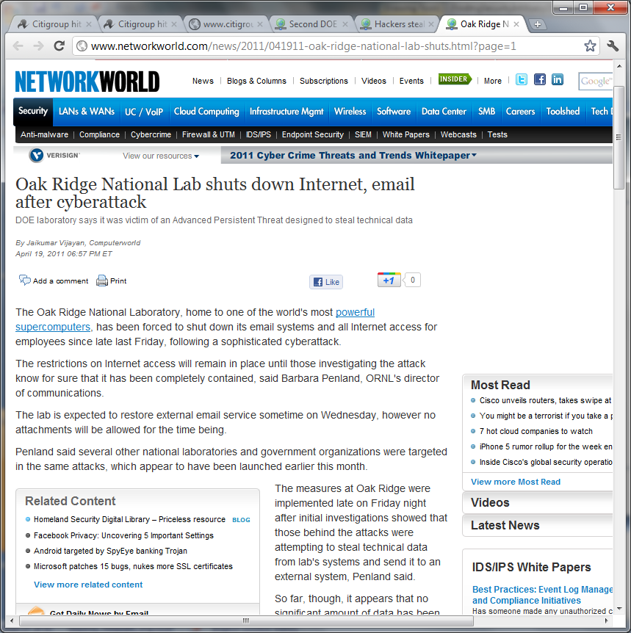
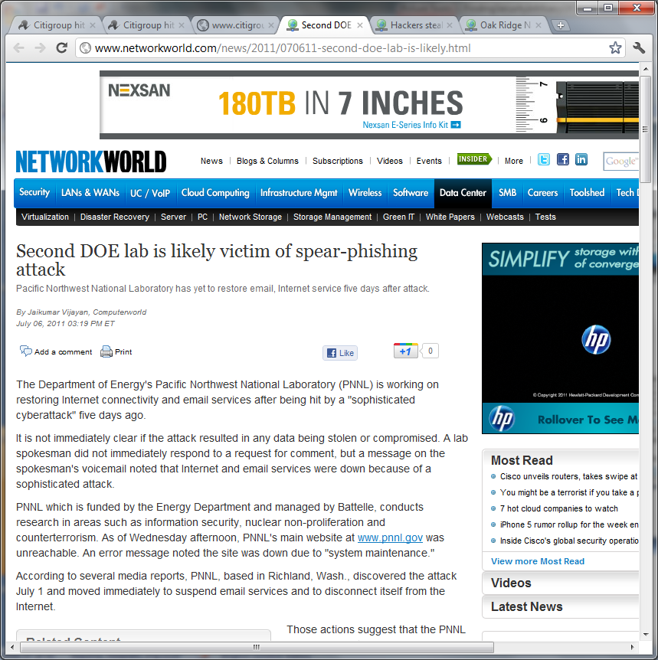

APT or APF?

Slide 39
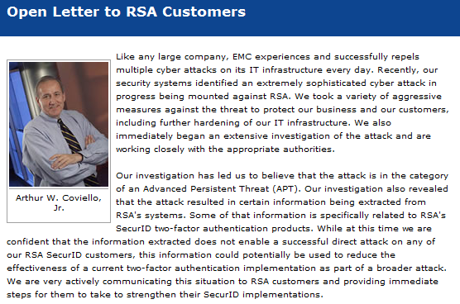

APT or APF?
Notes:
When it happens once I’m OK with it. When it happens twice it’s coincidence, when it happens all the time it’s FUD.
Imagine that every local bank heist would be tagged as “daring as sophisticated”.

Slide 40
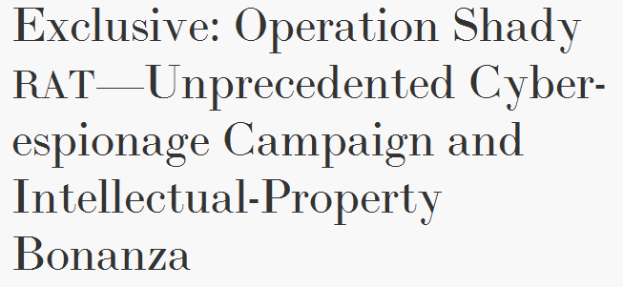

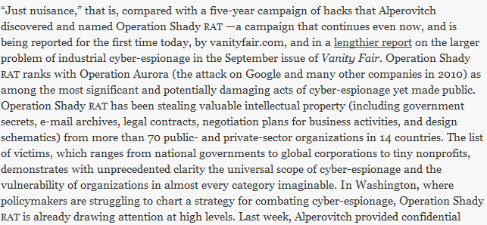

APT or APF?

Slide 41
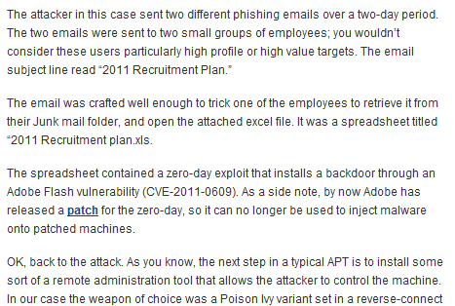
APT or APF?
RSA Blog, April 1 2011 - http://blogs.rsa.com/rivner/anatomy-of-an-attack/

Slide 42
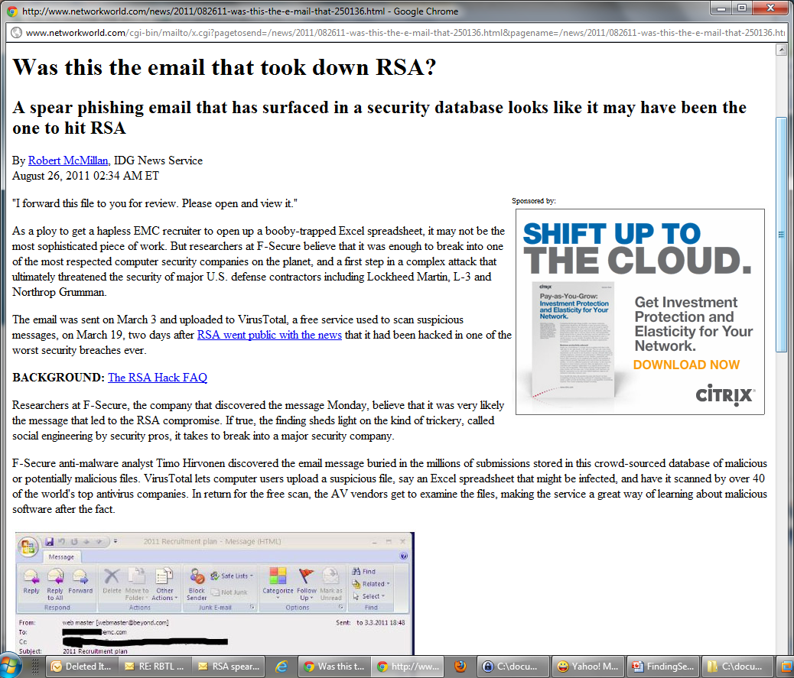
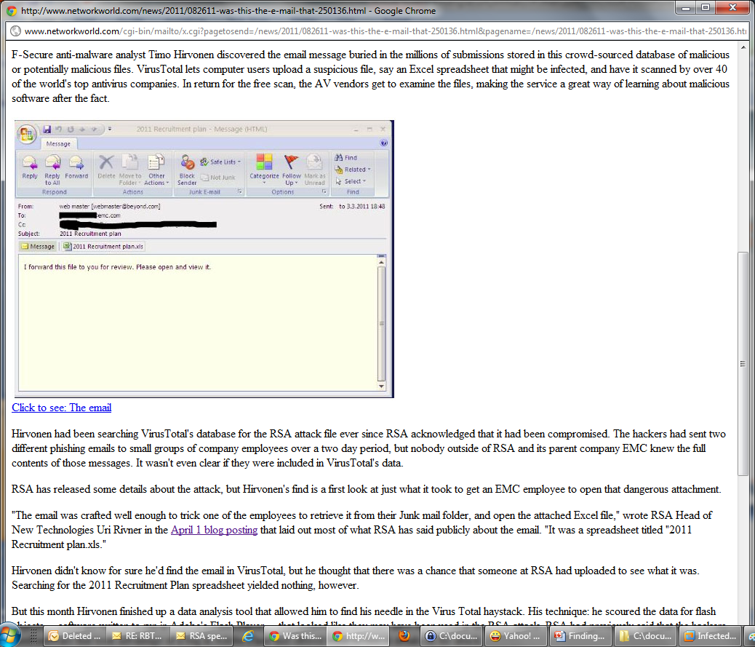
APT or APF?
Notes:
EMC (according to a later statement from VirusTotal) only uploaded the file in March 19th!

Slide 43
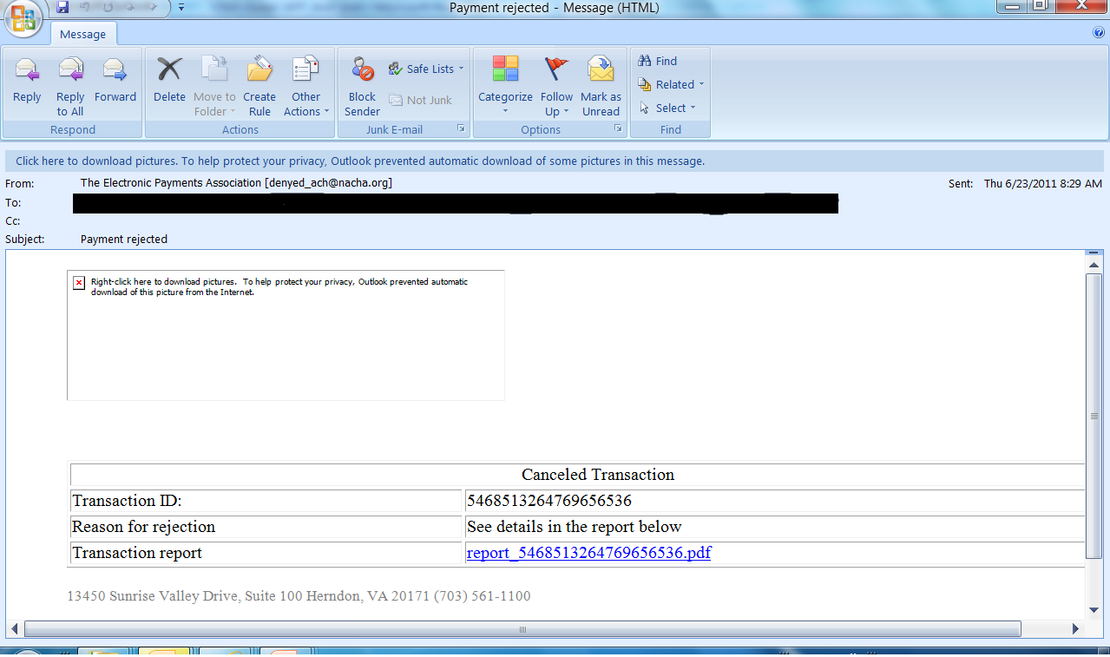
APT or APF?
Notes:
This is “spearphishing”.
I actually received a true “payment notification” email this week.

Slide 44
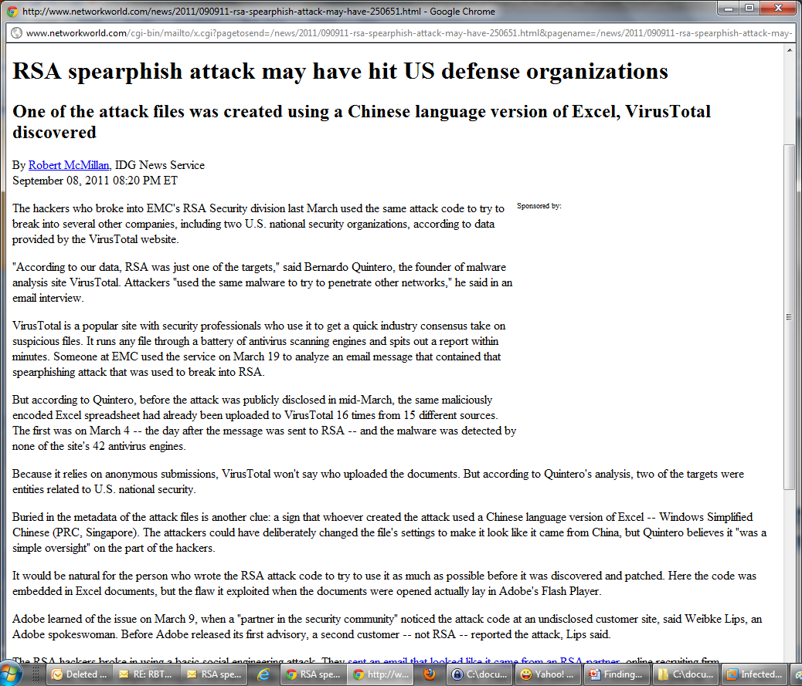
APT or APF?
Notes:
It does not look very “spearphishing” to me if it targeted at least 15 different organizations!
Notice that none of the antivirus engines was able to detect it as malware for quite some time, although it was available for them for inspection.

Slide 45
APT or APF?
APF = Advanced Persistent FUD

Slide 46
Summary

Slide 47
Reality Check
Attacks and attackers are for real
  You can see that in our WAAR
Attacks do succeed
  You can see that in the press ☹
It will eventually come out
  Someone will find it in Google
  Customers will complain
  Police may stumble upon it
Successful attacks to have consequences

Slide 48
Incidents are Inevitable but …
Most attackers are going for the low hanging fruit
  Most incidents are related to simple attack techniques
  Mitigation techniques and solutions do exist for those and can be easily deployed
  By deploying the proper solution an organization can ensure timely detection and mitigation for most attacks
When an incident is detected your best friend is the audit trail
  Quickly identify root cause
  Contain and scope the incident
  Track down perpetrator

Slide 49
Pay Attention
Web facing servers are just that
  Scan your web facing server for sensitive data
  Look yourself up in search engines frequently
Your partners are a potential channel for data leakage
  Put in procedures in place
  Frequently audit your partners per the set up policies
Don’t store data you don’t need (reduce scope)
Don’t store clear-text passwords

Slide 50



Targeted (Advanced) Criminal Hacking
Assume compromise
  Every decent sized organization must assume a certain amount of infected machines connected to its network
  It is not about technology it is about human nature
Re-define internal threat
  It is no longer “malicious insider” but rather “infected insider”
  More control is required around data sources
  Identify abusive access patterns using legitimate privileges

Slide 51
Questions

Slide 52
Thank You

