Slide 1

Cloud Computing Security: Mapping Concepts to Practical Techniques
Gilad Parann-Nissany
http://www.porticor.com
contact@porticor.com
September 6th, 2010

Slide 2

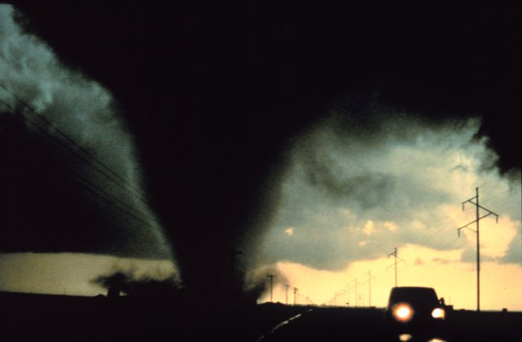
Earlier today, CSA talked about…
Pay as you go
Reasonable cost
On-demand
Self service
Elastic
Scale
My precious data in a public place?
Who do I trust?
How easy to hack?
Is encryption enough?
Can I control it?
Many considerations exist even before clouds
Some considerations really are new

Slide 3
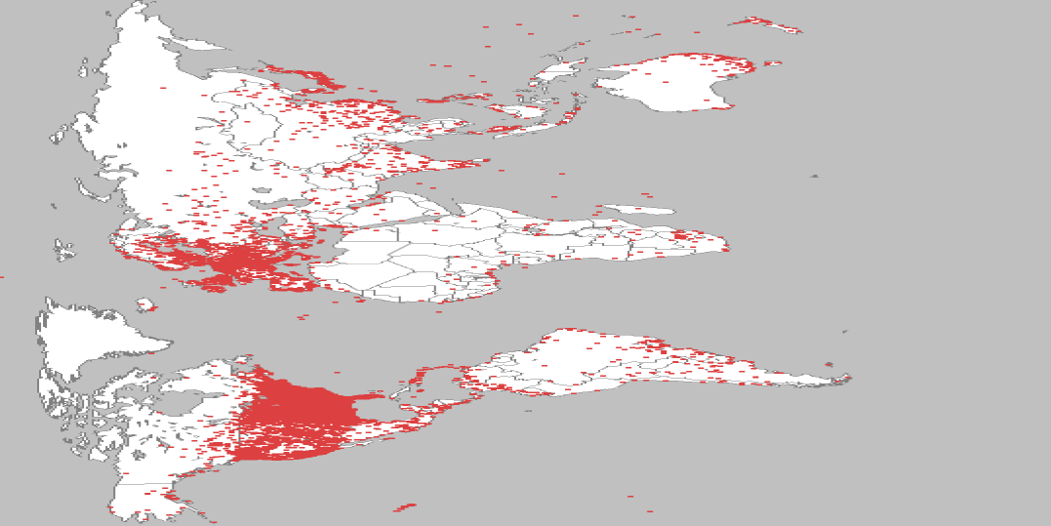
Modern threats…
Its far too easy to be a bad guy
Hacking is a business today, often involving professional criminals
Interesting fact: biggest cloud in the world belongs to the crooks
  Number of Systems: 6,400,000
  Number of CPUs: 18,000,000+
  Bandwidth: 28 Terabits
  Facilities: 230 Countries
  …the Conficker worm ☹
R. Joffe

Slide 4

How much (cloud) security do I really need?
Identify the asset for the cloud deployment
Data
Applications, Functions, Processes
Evaluate asset and attractiveness of target
Money value
Nuisance value
Evaluate service, functionality & data flow
Cloud providers, service models
Detailed analysis of where your data will be “at rest” and during communication
Draw your conclusions
Do I need security?
What needs most security (most valuable)?
Where do I need security most? (store, comm, …)
Non-monetary value
For whom? (pros? Insiders? kids?)

Slide 5
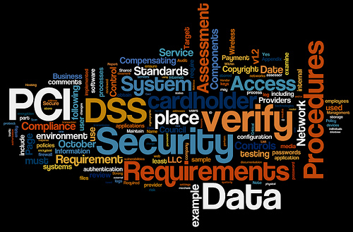
Security…
by clarity
Governance: managing security & compliance
Risk management
Ops in cloud
Cloud Arch.
Traditional Security
Compliance and Audit
Information life cycle
Legal and Electronic Discovery
Standards
Data Center
Incident Mgmt
Application Security
Encryption and Keys
Identity and Access
Virtualization
Application
Information
Management
Network
Trust
Storage
Physical
I/P/SaaS

Slide 6
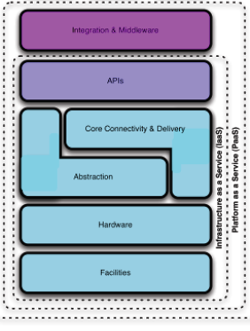
Applying Security Concepts to Public Clouds
Some pretty new stuff
Secure distributed data storage
Keys management
Hypervisors and virtual machines
Physical security of cloud environments
Role of encryption changes
New data protection measures emerge (i.e. fragmentation)
Some known concepts translate to cloud with a twist
APIs
SaaS security
Usage of IaaS
Identity Access Management Policy management Denial of Service prevention Web Application Firewall Firewall Virtual Private Networks Database Firewall | Intrusion Detection and Prevention (IDS/IPS) Logging and Log forensics Security Information Management Data Leak Prevention Scanning for exploits Scanning for virus
*courtesy CSA

Slide 7
Demo: known concepts that translate to cloud with a twist
Firewalls in AWS
Application firewall in AWS
Role of APIs
Role of IaaS

Slide 8
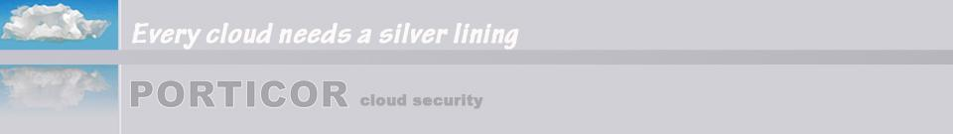

Understand the value of your data and service: sec should be cost effective
Understand your complete problem domain
  Governance & Measurement
  Architecture & Technology
  Specifics of your application
Answers
  Some take known concepts and add APIs, use SaaS and IaaS
  Some are truly new
  Cloud Operations really is new!
Map out – what’s relevant for you
Roll your own – or work with someone who has experience?

Slide 9

Thank you
Questions?
  http://www.porticor.com
  contact@porticor.com

