Slide 1

Passwords,
Rehashed All Over Again
Avi Douglen
AppSec Israel 2014
Notes:
Passwords suck.
It’s no secret – passwords are boring, passwords are weak, passwords are STOOPID. We all hate using them, we all hate building systems for them, we all hate breaking them, we all just hate dealing with them. Nevertheless, passwords are here to stay as the most common authentication mechanism. At least, passwords are a simple mechanism, and we all understand how to protect them well enough.
Then how come we keep getting them wrong?
Wait, whaaaat??
Not only are password protected sites usually flawed; not only are millions of passwords stolen more often than stupid cat pictures are posted to Facebook; not only does your mother reuse the same simple password everywhere – we, the security industry, keep giving bad password advice!
This talk will discuss popular misconceptions regarding how to secure passwords, even amongst security experts. We will also show some practical attacks against the common recommendations in this area. Finally, I will share the simple solutions that we should be recommending, and prove mathematically that they are correct.

Slide 2

About Me
Avi Douglen
  douglen@hotmail.com
  (972)-52-7891133
Security Research Lead, SourceClear
  Awesome security tools for developers
  Empowering developers to take back control of their software security
  Code should be written securely, not just reviewed
Chairman, OWASP Israel
… and I Too Have Given Bad Password Advice
Notes:
Speaker Bio
AviD always denies being a hipster, even while building the Code Security Research team at a hip young Silicon Valley startup. That said, when it comes to password misuse he is a downright cranky neckbeard.
During his many years as a developer, security lead, and consultant, he has been party to some pretty poor password practices. (Pretty poor password practice parties are not as much fun as you might think). Now, he is attempting to atone for that, and throws a hissy fit every time he encounters a site with counter-productive password practices. Stay on his good side and do the right thing.

Slide 3
Why do smart people give bad advice?
Status Quo – “This is what we’ve always done!”
“Best” Practices – “This is what everybody else is doing!”
Laziness – “Too much work to change this now!”
Regulations – “We don’t really have any choice…”
Wrong Risks – “I assume it’s the right problem to solve!”
Faulty Mitigation – “I assume this solves the problem!”
Lack of Alternatives – “I assume there is nothing better!”

Slide 4
Password Threats and Risks
Sociological Weaknesses
  Phishing
  Chocolate
  Sticky notes
  Password Reuse
Indirect Technical Attacks
  Interception
  Man-in-the-Middle
  Malware (e.g. Rootkits / keyloggers)
Direct Technical Attacks
  Brute Force / Guessing
  Database Leak + Cracking

Slide 5
Agenda:
Password Selection
Password Storage

Slide 6
A Word About Brute Force Protection…
ENTROPY

Slide 7
Wikipedia Definition of Entropy:
“… entropy is the average amount of information contained in each message received.”

Slide 8
Wikipedia Definition of Entropy:
“…it makes sense to define information as the negative of the logarithm of the probability distribution.”

Slide 9
Wikipedia Definition of Entropy:

Slide 10
NIST Definition of Entropy:
“… an estimate of the average amount of work required to guess the password of a selected user.”

Slide 11
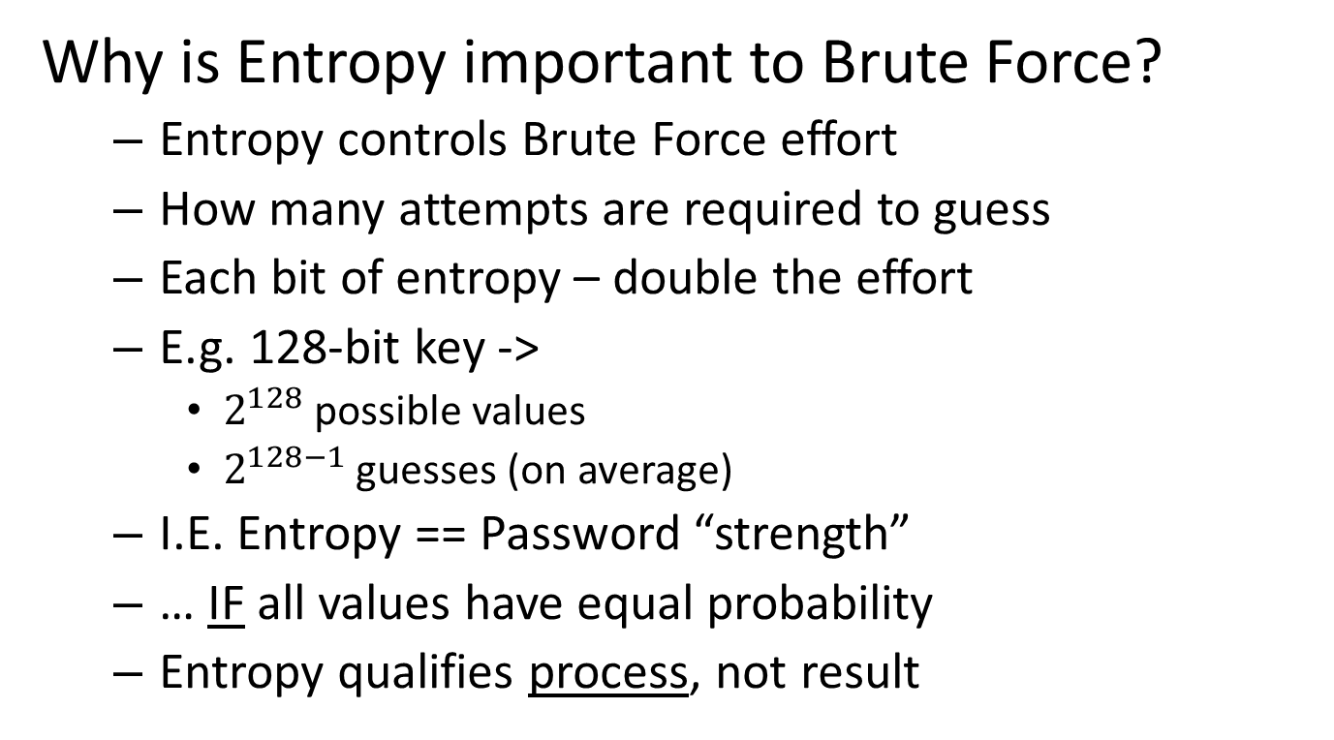

Slide 12
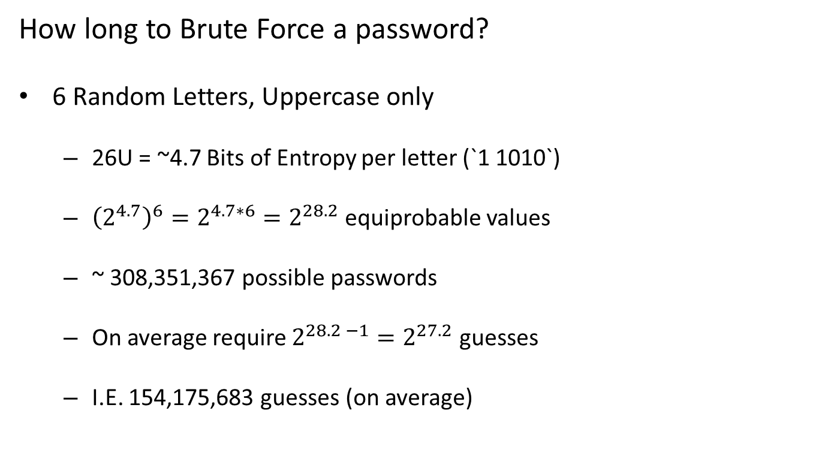

Slide 13
How long to Brute Force a password?
“Complex” password (4 types of chars - ULNP)
Assuming uniform distribution
26U + 26L + 10N + 32P = 94 equiprobable possibilities
94 values = ~ 6.5 bits of Entropy
    94 is `101 1110` in binary

Slide 14
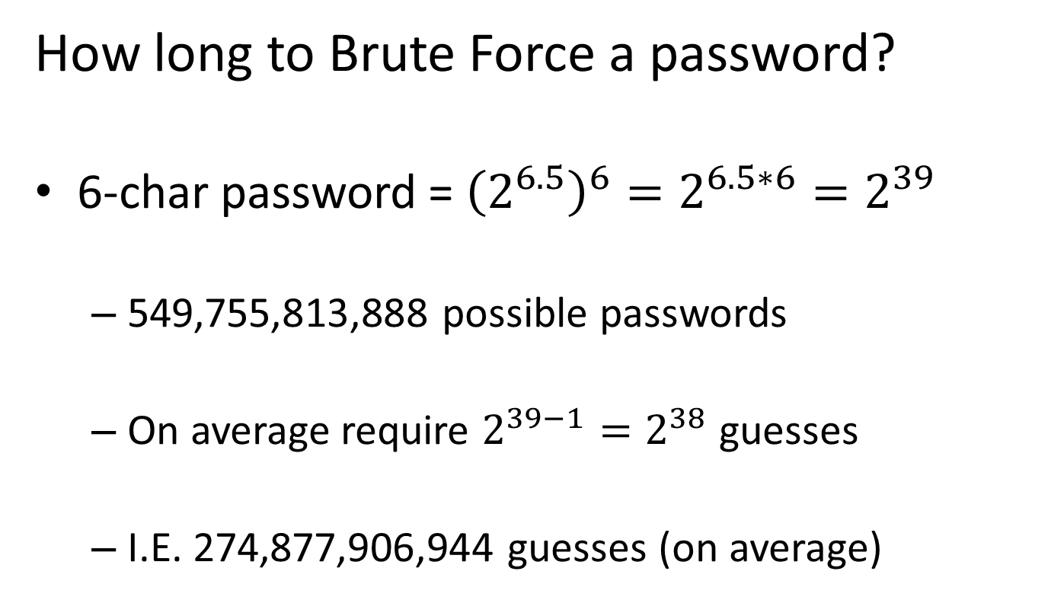

Slide 15
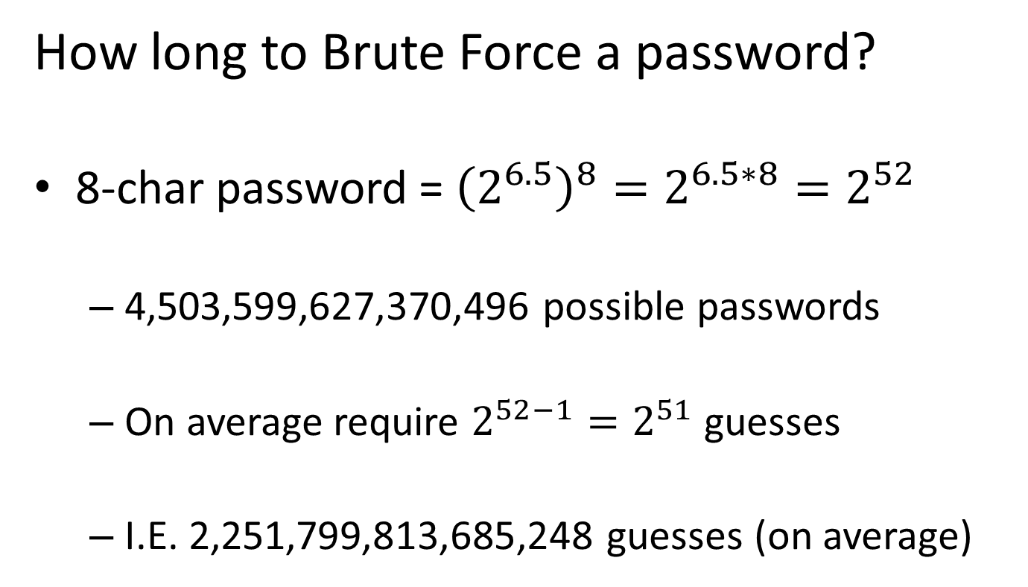

Slide 16
But let’s be honest…
Realistically:
Password != 100% Random
How long BF takes depends on how random
  i.e. How much Entropy
Usually much, much, MUCH lower…

Slide 17
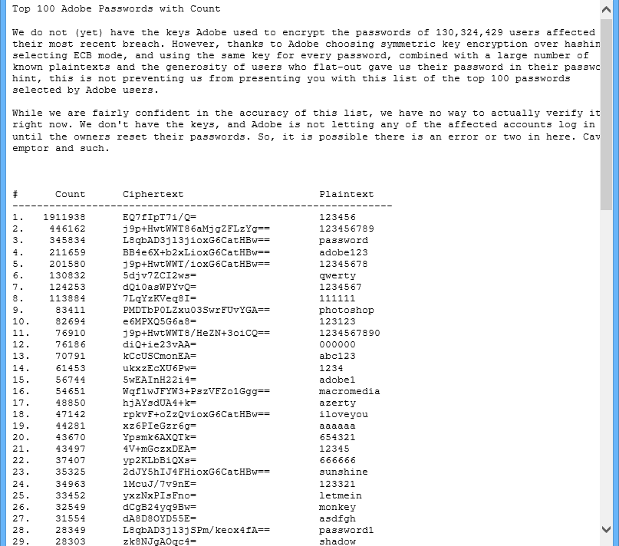
How long to Brute Force a password?
Most Common Passwords
  E.g. Top 100 Passwords from Adobe Hack
  Total Entropy: ~ 6.65
  On average require 50 guesses

Slide 18
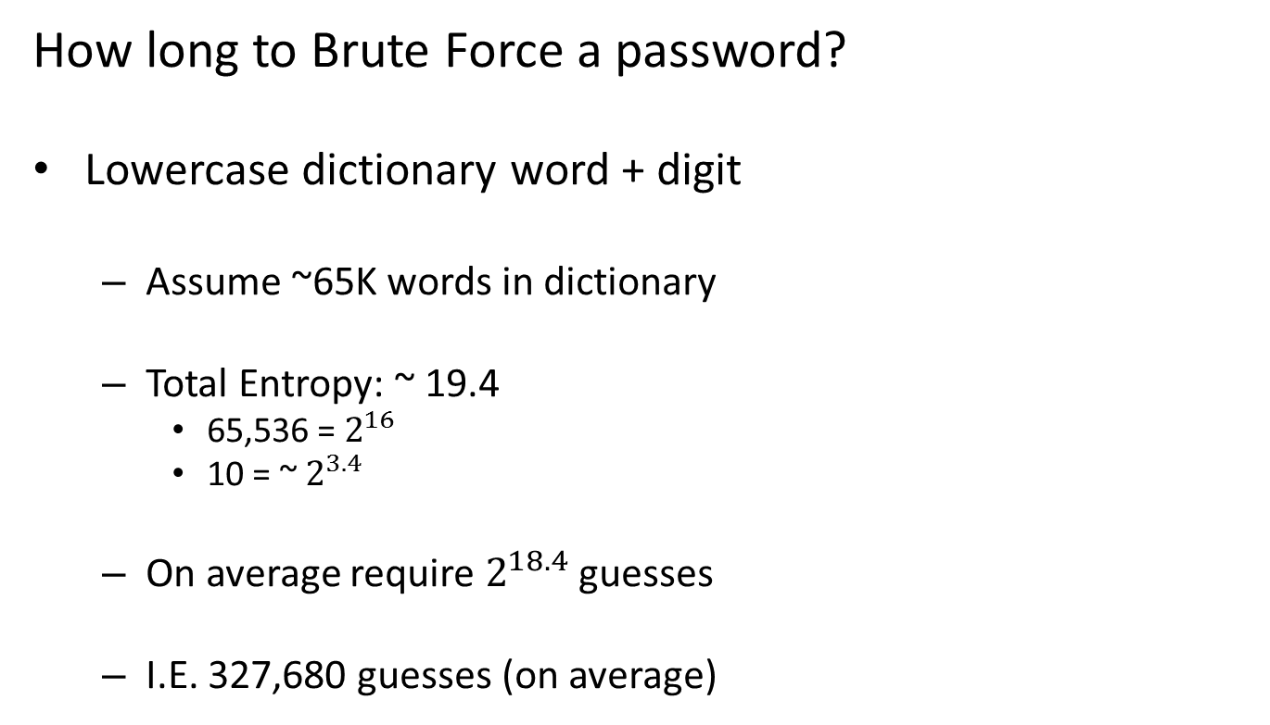

Slide 19
PASSWORD SELECTION

Slide 20
How can we…
Create Our Own Strong Passwords?
Convince Our Users To Use Strong Passwords?
Check That Users Chose Strong Passwords?

Slide 21
Typical Password Policy:
Minimum Length (e.g. at least 6 characters)
Maximum Length? (less than 12 characters)
Character sets (at least 3 out of U + L + N +P)
Password should not match username
Password should not be common
Password Expiration (e.g. after 30 days)
Password History

Slide 22
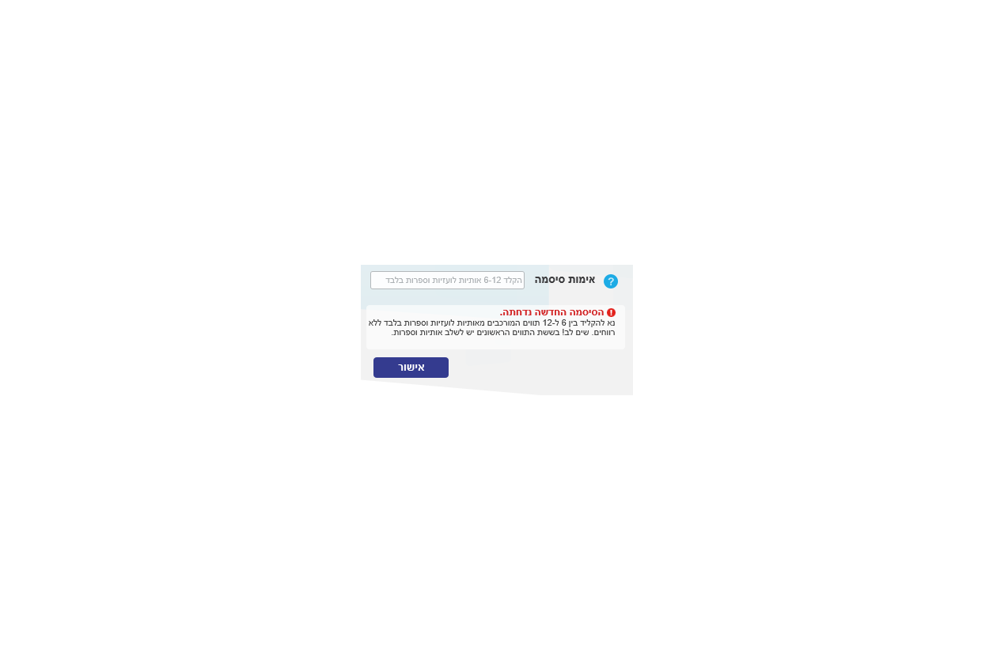
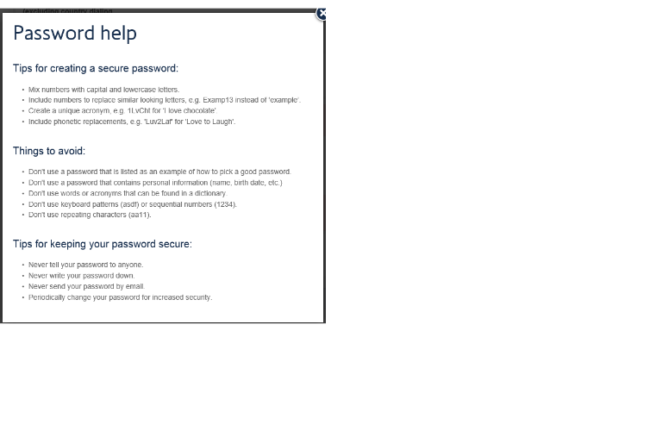
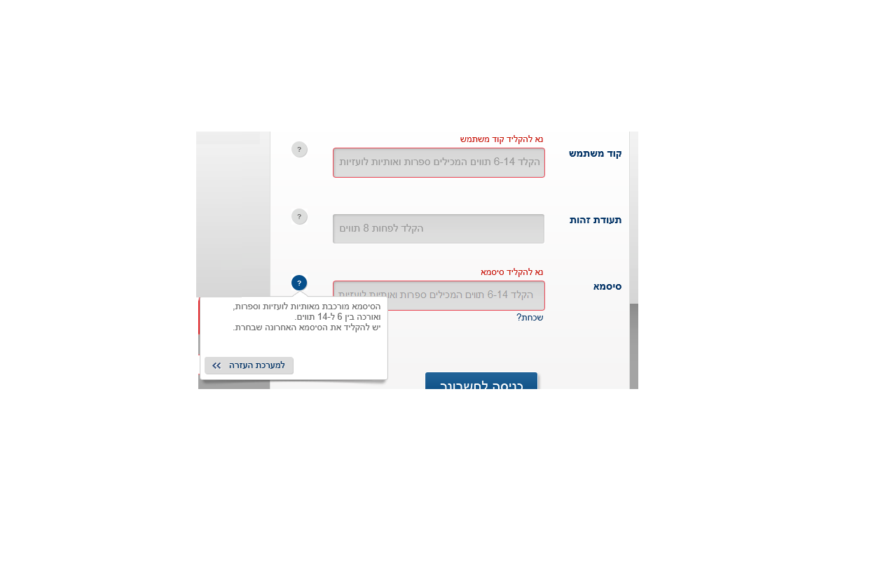

Slide 23
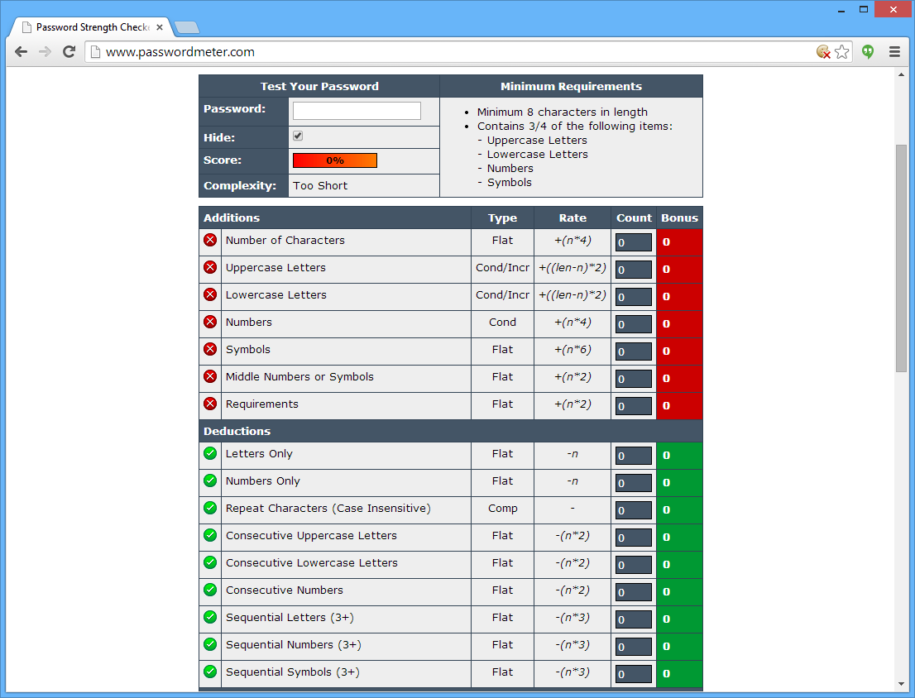

Slide 24
Something Important is Missing!
Password Policy Does Not Ensure “Strength”
Which is more important for strength:
  Complexity?
  Length?

Slide 25
Both are wrong!
  1qaz@WSX <==> aaaaaaabbbaaaaaababa
  10 Digits would still only have ~ 34 bits entropy
Password “Strength” == Entropy
  Complexity squeezes more entropy
  Length gives room for more entropy
  But RANDOMNESS is where entropy comes from

Slide 26
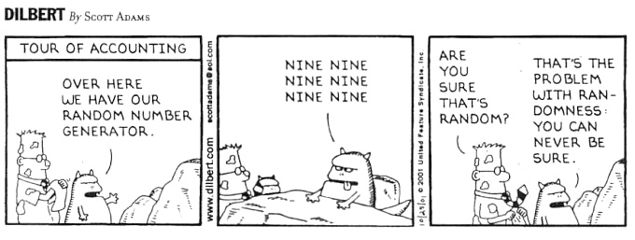
Solution: Check Passwords for Randomness

Slide 27
Entropy is a property of the PROCESS
Impossible to measure entropy of the result
Requires secure generation process
“Classic” Password Policies != strong passwords
We need to enable a secure process
HOW?
And there is still something missing…

Slide 28
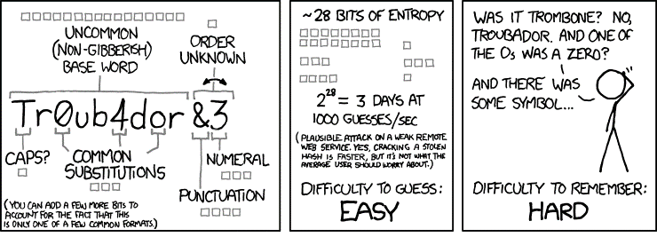

Slide 29
Sociological Weaknesses
  Phishing
  Chocolate
  Sticky notes
  Password Reuse
Root Cause:
Complex Passwords are HARD to Remember!

Slide 30
Solution #1:
PASSPHRASES

Slide 31
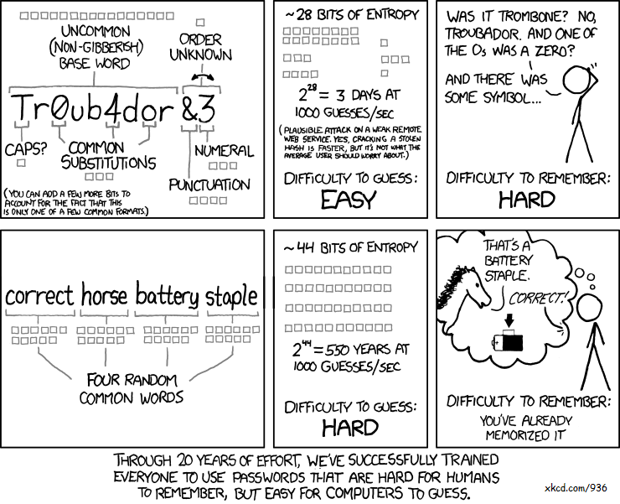

Slide 32
Good Passwords are not just about “Strength”
Difficult to Guess <==> Difficult to Remember
Computer Aspect <==> Human Aspect
AviD’s Maxim of Usability:
  Security at the expense of usability, comes at the expense of security.

Slide 33
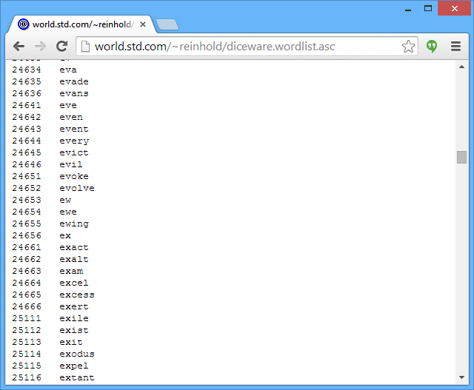
Passphrases must be random
  Your favorite quote or song is weak
How do we create strong PassPhrases?
Random Selection from Limited Dictionary
  E.g. Diceware.com

Slide 34
Passphrases are easy to remember…
Easier to type!
Especially on mobile…
Easier to Share when needed
  E.g. ZIP password
  E.g. Nuclear bomb deactivation codes
But are they strong?

Slide 35
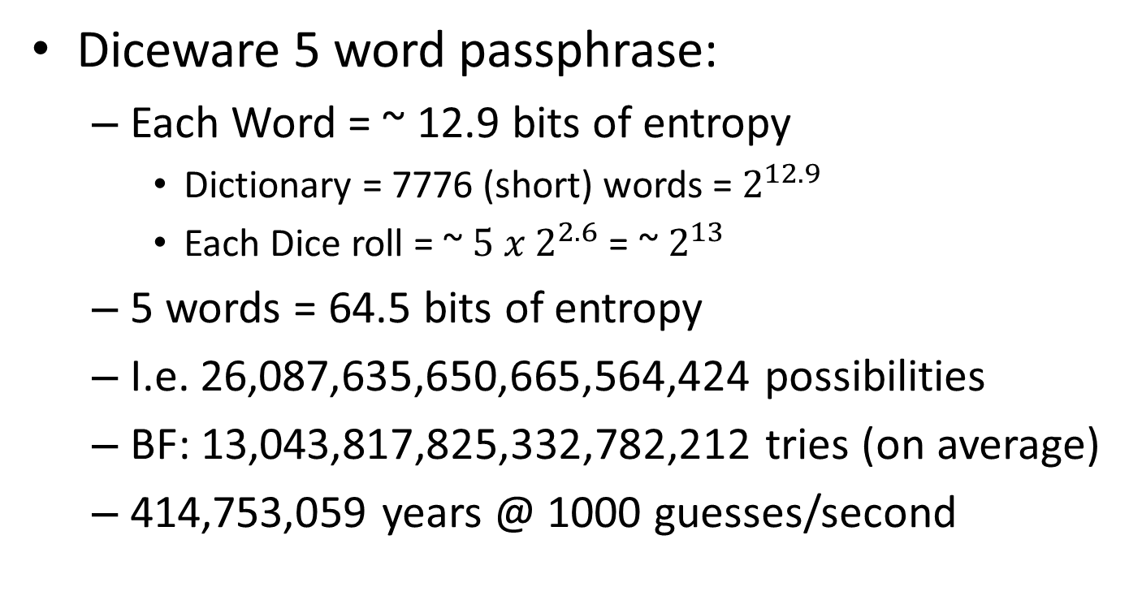

Slide 36
Solution #2:
PASSWORD MANAGERS

Slide 37
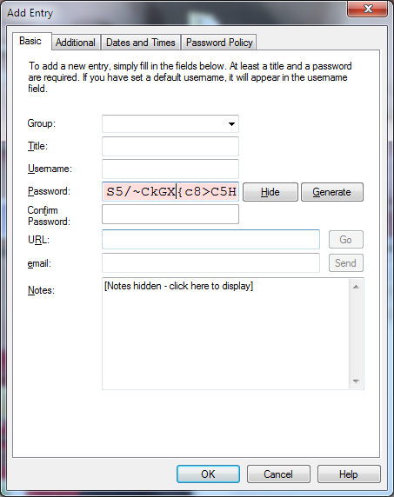
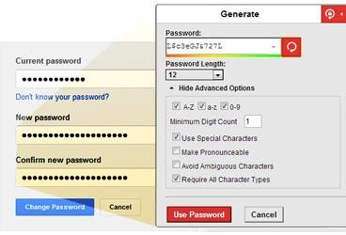
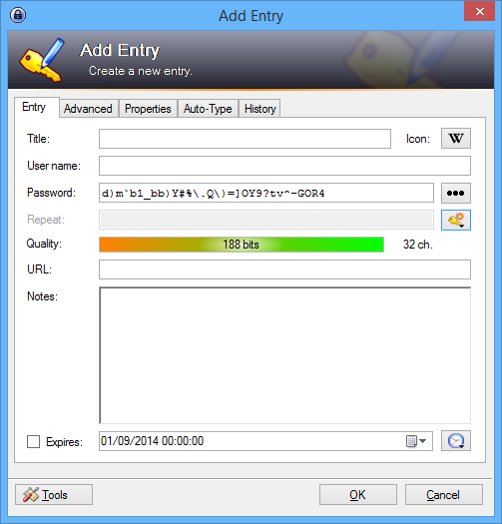
ONE PASSWORD TO RULE THEM ALL

Slide 38
Very strong passwords
  Higher risk? Make it longer
Randomly generated
Very high entropy
User does not need to remember passwords
Passwords are encrypted with ONE master key

Slide 39
What about Browsers’ Passwords Feature?
Blocked by many policies and regulations
  AUTOCOMPLETE=“OFF”
Some “security” products block in JavaScript
  Won’t mention any names….
Should users be allowed to save their password in their browser?

Slide 40
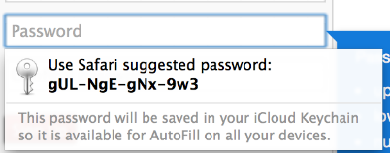
All modern browsers encrypt user passwords
Tied (usually) to the user’s OS password
If Malware can read it – Game Over anyway
User wont need to remember password
→ User can select a stronger password!
WIN
  Main weakness is shared computers

Slide 41
What Should Secure Applications Do?
Enable strong passwords & pass phrases
No short limits – 40-50 chars is common
No Autocomplete – Allow the user to choose
  With very specific exceptions
No blocking Copy/Paste in passwords
Encourage good password habits
Consider generating passwords for the user
  Instead of trying to measure entropy after the fact

Slide 42
PASSWORD STORAGE

Slide 43
Password Storage
What is the best way to store passwords?
Operating Assumptions:
  Attacker has stolen database file
  Attacker now has offline access to all data
  Most users’ passwords are weak (or very weak)
  Attacker does not have 0-day crypto flaw
  Attacker wants as many passwords as possible
  Attacker will use hardware according to value
  Attacker has all the time in the world (well…)

Slide 44
Password Storage
What is the best way to store passwords?
Bad Advice:
Plain Text! -> Obviously not
Base 64! -> Useless
Symmetric Encryption! -> Bad Idea
  Attacker has encryption key
  You don’t need to decrypt it
Cryptographic Hash! -> Rainbow Tables!
(MD5, SHA-1, SHA-256)

Slide 45
Password Storage
What is the best way to store passwords?
Better Advice:
Salted Hash (SHA) -> AHA!
  No Rainbow Tables
  Cannot be precomputed
  Attacker would need to BF each individually
    Wait, is… is that even possible?

Slide 46
Q: Is it possible to BF password hashes?
Q: Will it be possible in a few years?
Q: Even if it is possible – is it feasible?

Slide 47
8-char random password
  2,251,799,813,685,248 guesses (on average)
Ridiculously high number
Can this be brute forced?

Slide 48
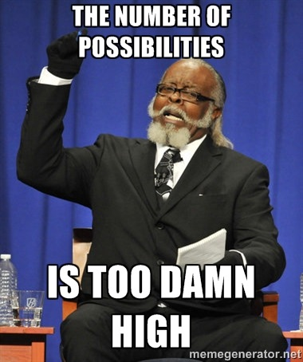

Slide 49
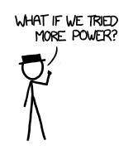
BUT WAIT!

Slide 50
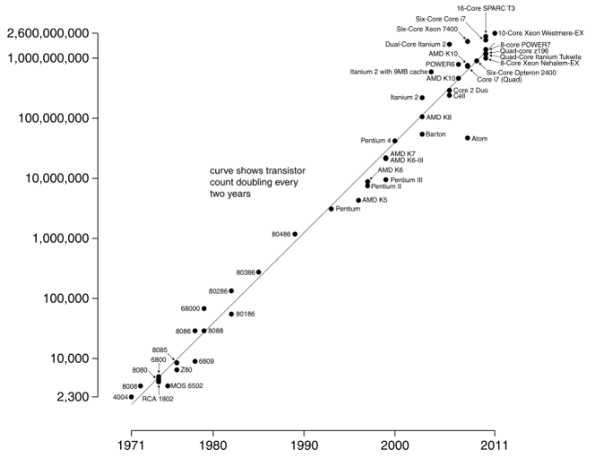
What about Moore’s Law?

Slide 51
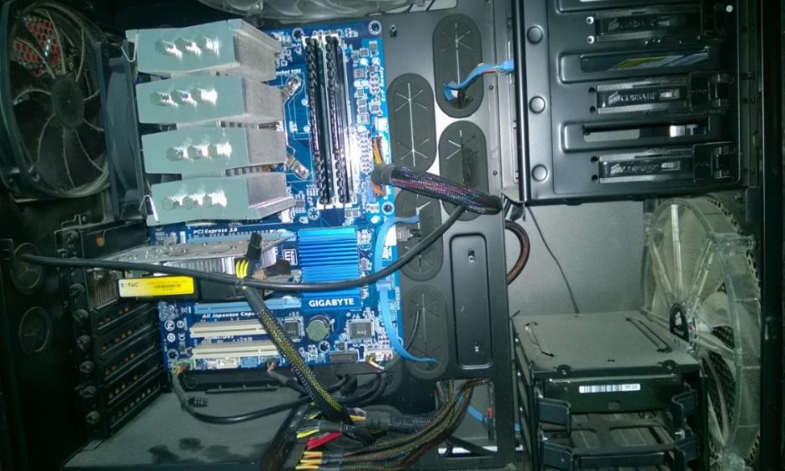

Slide 52
CPU: i7-3770K (Ivy Bridge) - Mild Overclock
RAM: 16 GB DDR3 - Optimized Timings
Hash Brute Forcing Tool: Hashcat
Speed: ~ 75 Million Hashes / Second

Slide 53
Easy: xkcd-style Tr0ub4dor&3 policy passwords
Provides ~28 bits of entropy
Requires 134,217,728 guesses (average)
Salted SHA-1 – No Rainbow Tables
Around 2-3 seconds per password !!

Slide 54
Medium: 6-char random passwords
Provides ~ 39 bits of Entropy
Requires 274,877,906,944 guesses (average)
Salted SHA-1 – No Rainbow Tables
Just about 1 hour per password

Slide 55
Stronger: take 8-char random passwords
Requires 2,251,799,813,685,248 guesses
Salted SHA-1
Just about 10 months for a single password…
Moore’s Law did not pay off… and won’t for years

Slide 56
BUT WAIT!

Slide 57
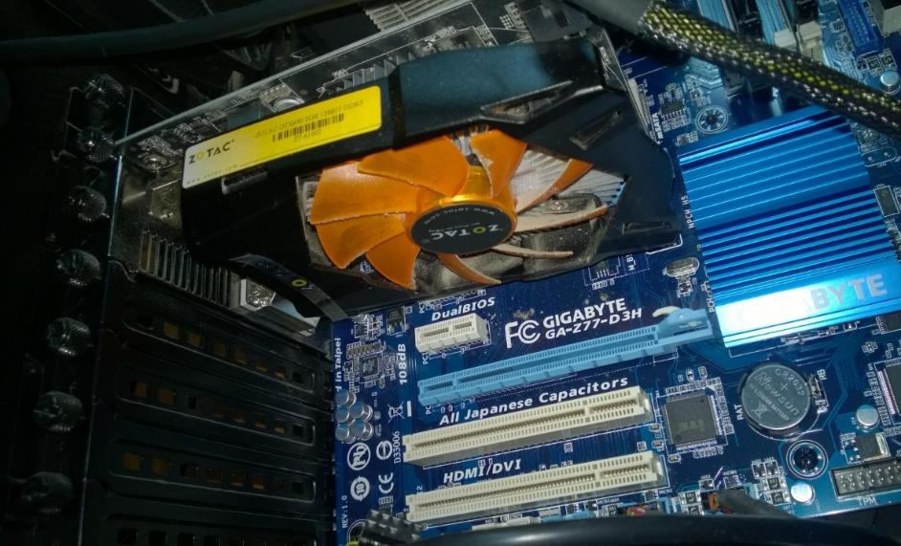

Slide 58
CPU is not the fastest block in the case
  Typically 4-16 cores per computer
More efficient ways to BF hashes…
E.g. GPGPU…
  100’s or even 1000’s of cores per card
  Multiple cards per PC
Dedicated Hardware
  ASIC
  FPGA
  Bitcoin Miners…

Slide 59
Last year’s Mid-range GPU card
  NVIDIA based
  < 200 $ (last year’s prices)
Speed: ~ 2,000 Million Hashes / Second
  That’s 2 BILLION hashes per second
  “B” as in BLOODY HELL that’s a lot
6 char passwords - forced in under 5 minutes
8 char passwords - under 2 weeks
… On a single mid-range card

Slide 60
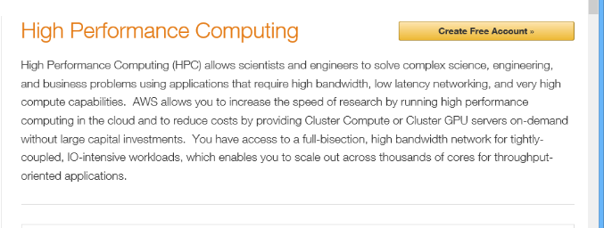
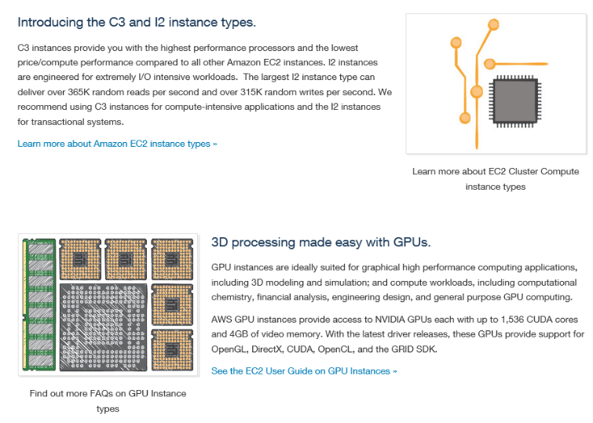


Slide 61
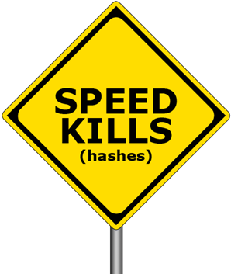
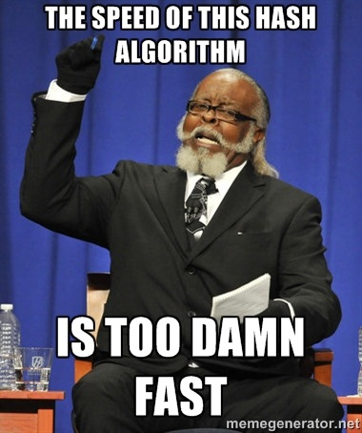
The problem is:
SPEED
Hash Algorithms are designed to be FAST
TOO damn fast…
The solution: SLOWNESS

Slide 62
Theoretically, what if we hashed 100 times?
  1000 times?
  100,000 times?
Changes the attack by order of magnitude
Trivial Effect on System Performance
Of course, crypto is complicated…
SO DON’T ROLL YOUR OWN

Slide 63
Good Password Hashing Functions:
bcrypt
PBKDF2
scrypt
Tuned and Tested:
  Set Work Factor as high as server can support
  Adaptive algorithms, continue to tune over time

Slide 64
Bad Password Hashing Functions:
EVERYTHING ELSE
Complexity is bad
Homemade is bad
New is bad
Seriously, just use bcrypt.

Slide 65
SUmmary

Slide 66
Understand Your Risk Model Before Implementing Controls
Passwords are HAAAARRRD
  Password “Strength” Depends on Entropy
  Password “Quality” Also Depends on Usability
Enable Strong Passwords:
  Long Pass Phrases
  Password Manager
Store Passwords with SLOW Password Hash
  Salted SHA is near useless
  Just use bcrypt
  PBKDF2 or scrypt are also OK
  https://password-hashing.net/

