Slide 1

Static Analysis Improved Fuzzing
Under the supervision of Dr. David Movshovitz
Moti Cohen
AppSec Israel 2014

Slide 2
About Me
M.sc. in CS from IDC
Programmer and Team Leader at IDF
Data Scientist and Programmer at Elbit Systems

Slide 3
Agenda
Background
Framework description
Limitations
Implementation and Experimental Results
Conclusions

Slide 4
Thesis Scope
Use Static Analysis techniques to acquire knowledge on software structure and behavior to improve the performance of existing Fuzzing methods

Slide 5
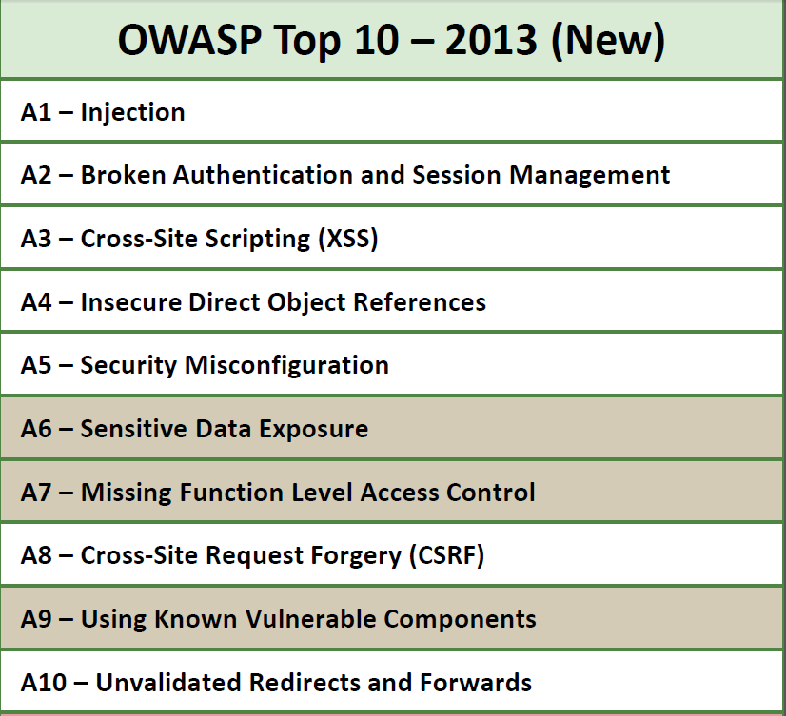
Vulnerability Scope

Slide 6
Injection Attacks
Injection flaws occur when an application sends untrusted data to an interpreter
Injection flaws are easy to discover when examining code, but frequently hard to discover via testing. Scanners and fuzzers can help attackers find injection flaws.

Slide 7
OWASP Recommendation
Am I Vulnerable To Injection?
The best way to find out if an application is vulnerable to injection is to verify that all use of interpreters clearly separates untrusted data from the command or query

Slide 8
Existing Solutions - BlackBox
Perform application testing “from outside” – no knowledge of internals
Generate different kinds of inputs
Examples
  Appscan
  WebInspect
  …

Slide 9
Existing Solutions- WhiteBox
Search for vulnerabilities in the source code – Static Code Analysis
Examples
  Fortify
  Checkmarx
  …

Slide 10
SAF Framework

Slide 11
SAF Solution Philosophy
Black and White box solutions have their advantages – So why not combine?
The idea:
  Learn software structure with Whitebox techniques
  Improve Blackbox technique with the acquired knowledge – Improve Fuzzing capabilities

Slide 12
Fuzzing Problems and proposal
Fuzzing is limited due to lack of program structure knowledge
If we can categorize each parameter, we can guide Fuzzing tools to better test the application
So what we need is to locate the real use of each web request parameter

Slide 13
SAF General Idea
Perform a Source to Sink Dataflow analysis
  Source : A request parameter read
  Sink: A call to a sensitive resource
    DB, Command Execution, etc.
The result is a possible use for each request parameter

Slide 14
Example
Source
Function f()
{
query = buildQuery();
sqlStatement.execute(query);
}
Function string buildQuery()
{
String p1 = request.getParam(“P1”);
return p1;
}
Sink

Slide 15
Solution Overview
Sink locator
Data flow analysis
Request Parameter Locating
SAF
Parameter
Categories
Source Code
Int a = 5;…
P1 – SQL
P2 – XSS
…

Slide 16
Sinks
Finds method calls over the entire program to sensitive resources – Sinks
Each sensitive resource is predefined as a method signature (java.sql.Statement.executeQuery(…))
Sinks are categorized
Examples: SQL command execution, XSS, etc..

Slide 17
SAF Dataflow Analysis
This section is the heart of our work
The goal is to find a possible dataflow from a user input to one of the sinks found in the previous analysis phase
We analyze the dataflow backwards, from the sink to the user input

Slide 18
Dataflow Highlights
Traverse Def-Use chains for Intraprocedural data flow
Traverse Method Calls with a pre built Call Graph
Use Points-To Analysis to locate objects

Slide 19
Dataflow Highlights – Cont.
Analyze Field Access
Treat String manipulation mechanisms
  StringBuilder, StringBuffer
Locate real request parameter names

Slide 20
Limitations
Non String parameters and constant request parameter names
Lack of Array object types handling
Limited Reflection handling

Slide 21
Implementation +
Experimental
Results

Slide 22
SAF Implementation
We Implemented the analysis described in the previous slides
The implementations was targeted for Java web applications (Servlets)
We used an open source framework (WALA) as a basis to our analysis

Slide 23

IBM WALA
A Java implemented Static Analysis and instrumentation framework
Provide many standard algorithms and data structures
  AST, Call Graph, Points-to Analysis, etc.

Slide 24
Experimental Results
We have performed an experimental run of the SAF framework on three applications, taken from the Securibench benchmark
We selected three medium sized web applications to analyze

Slide 25
Experimental Results
Webgoat – an educational web application, with many hidden vulnerabilities
BlueBlog – web blog, has File System related vulnerabilities
Personal blog – web blog, has Hibernate related Vulnerabilities

Slide 26
Experimental Results
The applications we selected were vulnerable to these attack types:
  SQL Injection
  Path Traversal
  Command Injection
  HQL Injection

Slide 27
Experimental Results
For each category we analyzed we managed to reduce the needed tests by 50-95%
When looking at all categories together, we were able to drop total # of tests needed by up to 98%

Slide 28
Experimental Results
False positive results when using less accurate Call Graph construction
Increasing Call Graph precision increases significantly the running time

Slide 29
Conclusions
We’ve seen the complexity of web application security these days
Given the limitations of existing solutions, our approach is taking a different path
We showed there is advantage in using Static Analysis techniques to improve Fuzz testing

Slide 30
Conclusions
We managed to reduce the amount of tests needed by up to 90%
These results can also be used to not reduce tests, but increase testing in relevant locations

Slide 31
Questions?

