Slide 1


Play, Hack and Track
Amit Ashbel
Product Evangelist
www.gameofhacks.com

Slide 2

How I am about to spend your time?
About Us
The Problem
What is GoH?
What's behind it?
Not so wet T-Shirt contest
Takeaways

Slide 3
About Us
Checkmarx
  Founded in 2006
  Enterprise Grade Application Security Solutions:
SAST | RASP | Application Security Education
  Hundreds of Fortune 500 and SMB Customers
  Fanatical support

Slide 4

The Problem
37 Million

Slide 5


The Problem
5.6 Million

Slide 6
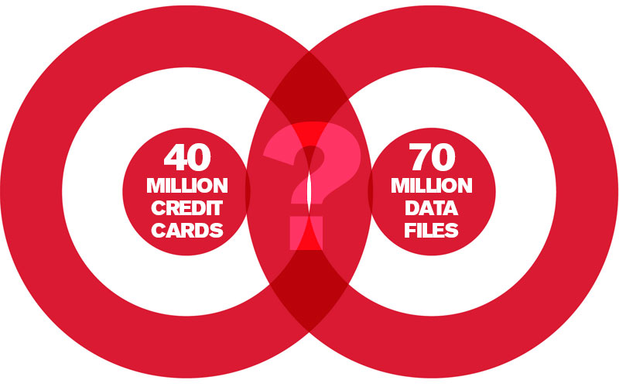

The Problem
40 Million

Slide 7
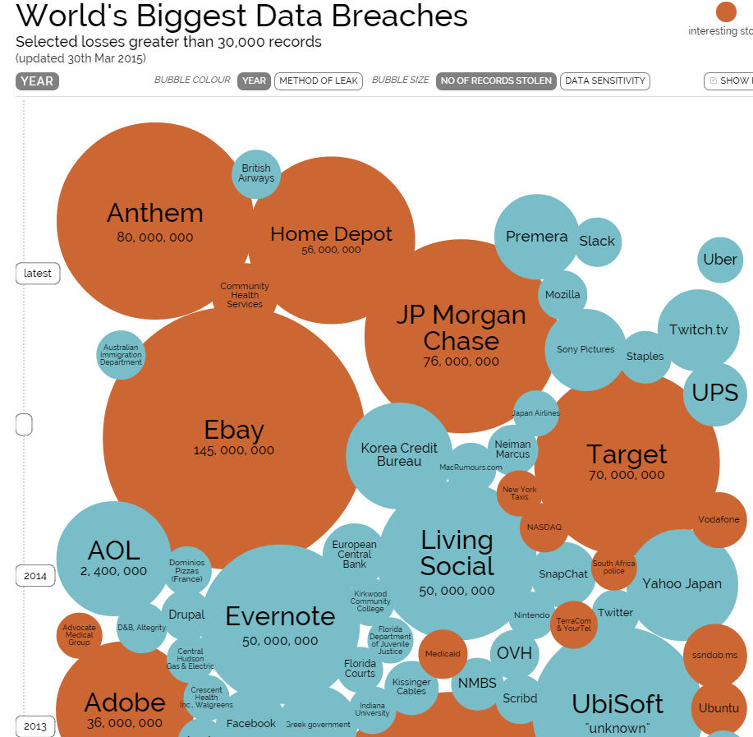
The Problem

Slide 8

The Problem
~90% of Applications are vulnerable
Network solutions are not designed to protect the Application level
Application are designed to run on browsers multiplying the threats every day
Developers are not educated

Slide 9

Game of Hacks – An idea is born
using System;
using System.Security.Cryptography;
class Program
{
static void Main()
{
using (RNGCryptoServiceProvider rng = new RNGCryptoServiceProvider())
{
// Buffer storage.
byte[] data = new byte[4];
// Ten iterations.
for (int i = 0; i < 10; i++)
{
// Fill buffer.
rng.GetBytes(data);
// Convert to int 32.
int value = BitConverter.ToInt32(data, 0);
Console.WriteLine(value);
}
// other Random Generation method
Random otherRandomGenerator = new Random();
double otherRandomNumber = otherRandomGenerator.NextDouble();
Spot The
Vulnerability

Slide 10
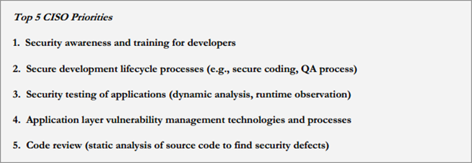

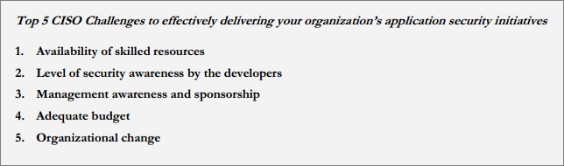
CISO Concerns – Education and Awareness
(https://www.owasp.org/images/2/28/Owasp-ciso-report-2013-1.0.pdf

Slide 11
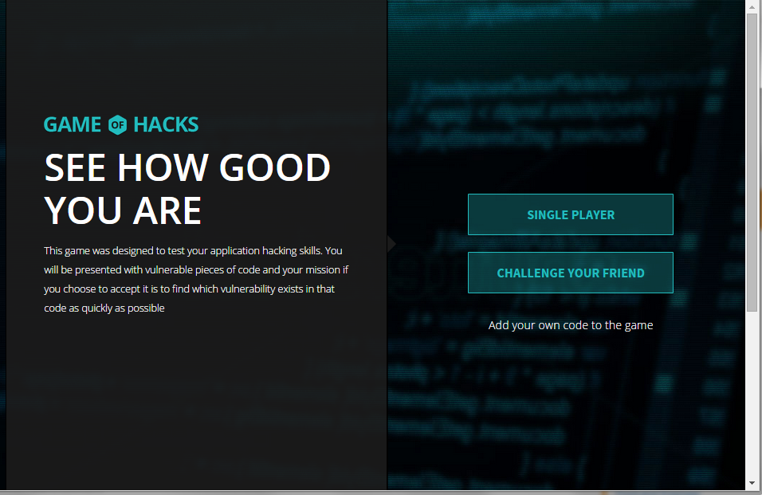
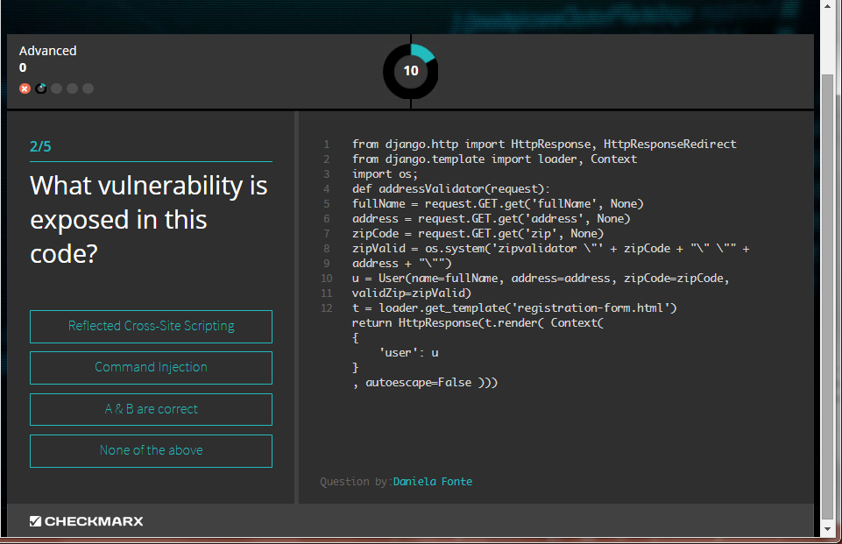
1+1=?
Launched on August
More than 100,000 games were played since

Slide 12
Let’s take a look at the game www.Gameofhacks.com
Notes:
resolution

Slide 13

What was behind GoH?

Slide 14
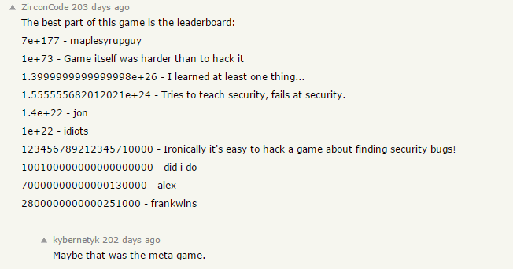


Honeypot
We assumed the game would be attacked
We might as well learn from it
Vulnerabilities were left exposed and patched along the way

Slide 15

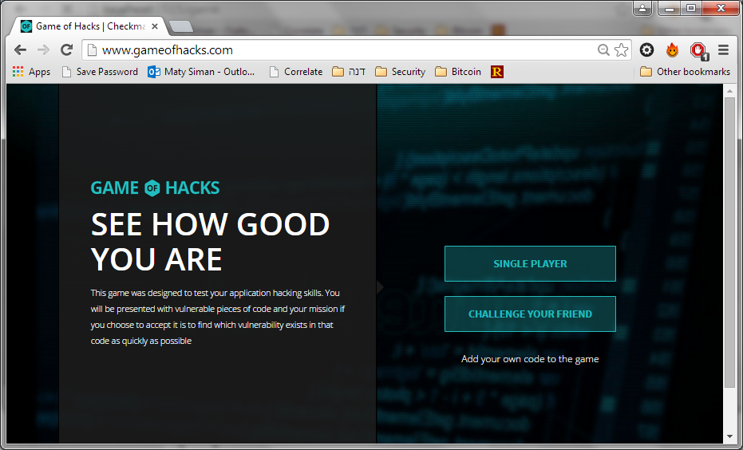


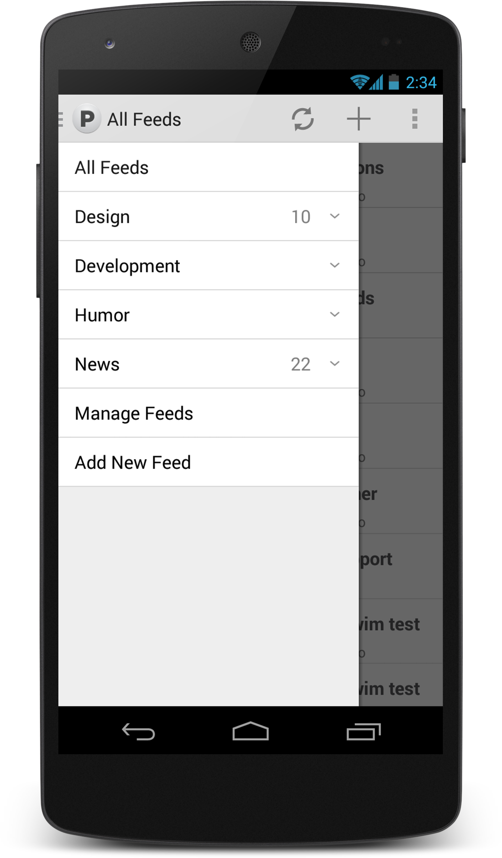
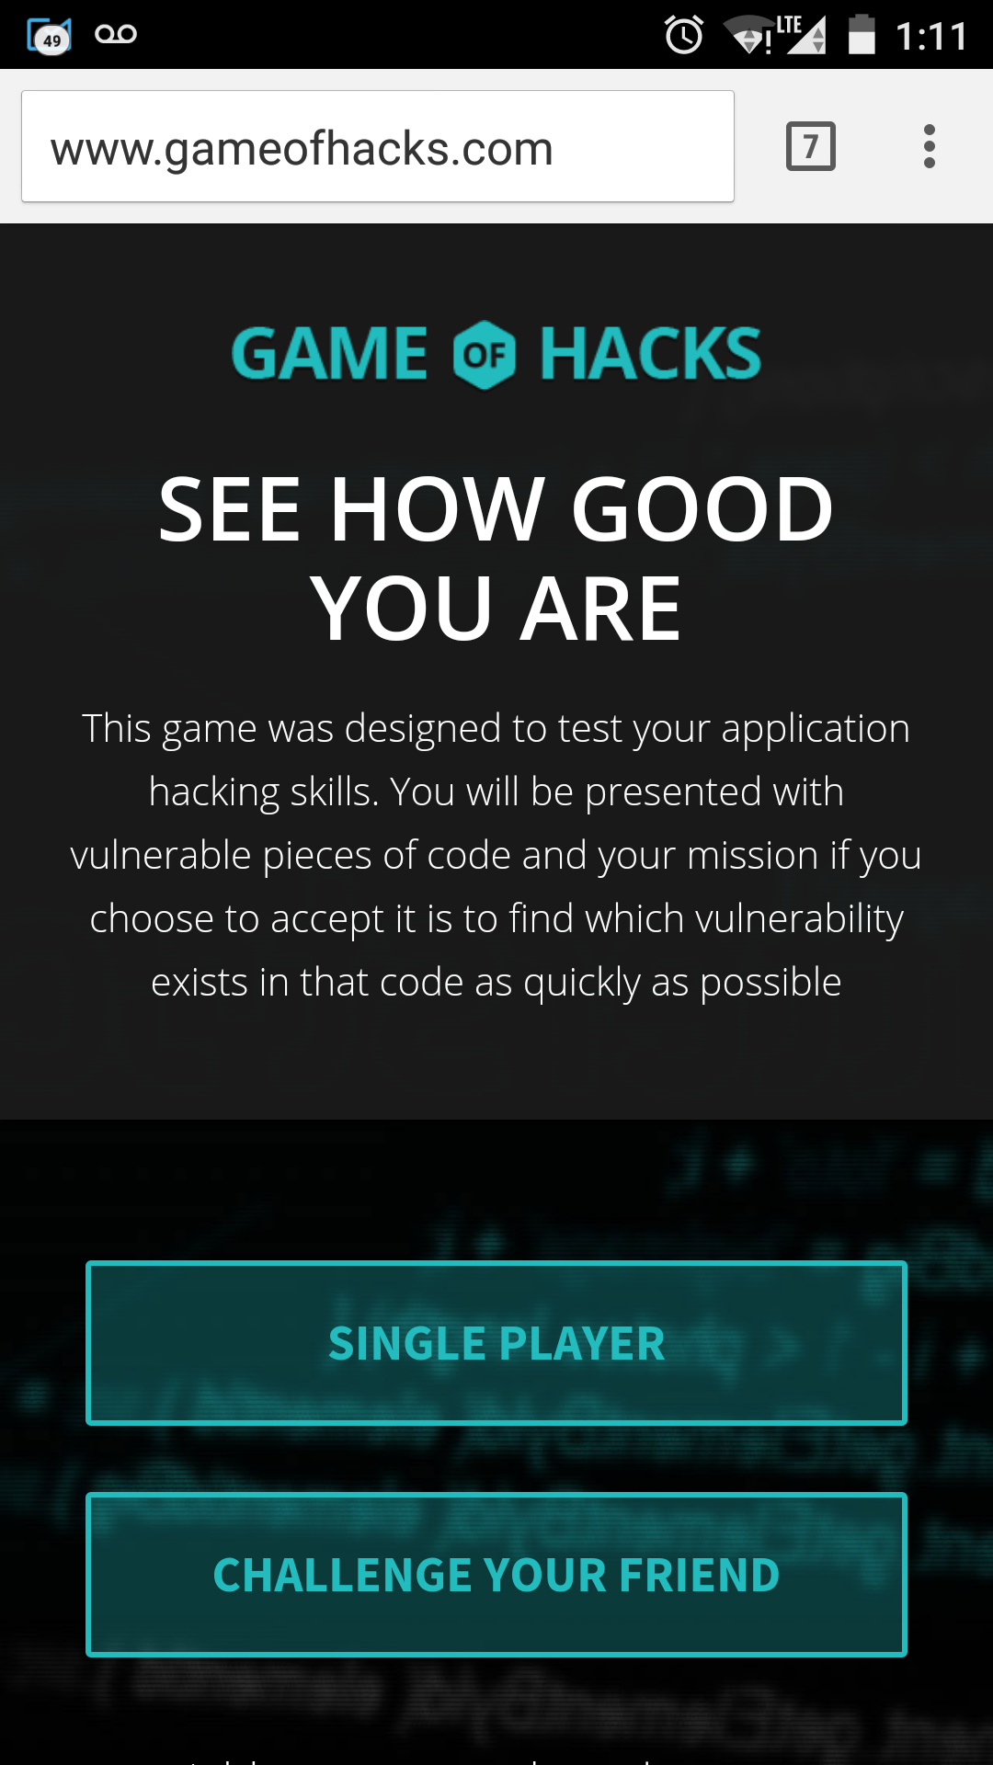
GoH Architecture
Server
Client

Slide 16
Node.js architeture
Single Thread Architecture - Event Loop
Register Callback
Event Queue
File System
Event Loop
Single Thread
Database
Network
Operation Complete
Trigger Callback

Slide 17
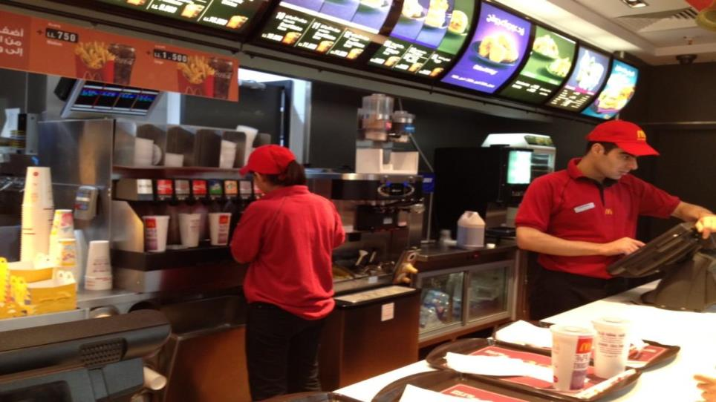
Event Driven
Single Thread
Events handler
Code.DanYork.Com

Slide 18

Game Entities
Difficulty Level
60-Second
Timer
Score
Question #
Code Snippet
Question
Answers

Slide 19
Answered Question
Initially users initiated app.sendAnswers multiple times, until they got “Correct answer” response.
This allowed malicious users to systematically locate the correct answer – and to gain points over and over for the same question.
Solutions
  “Question Already Answered” flag added

Slide 20


Timer
GoH Version 1
  Timer handled by client
  User forced to go to next question when time ends
  Client sends to server Answer + Time spent
So what?
  Players stopped timer by modifying JS code
GoH 2
  Time is now computed at the server with minor traffic influence

Slide 21
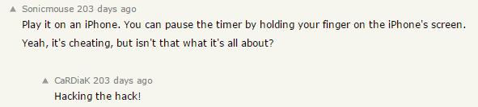
Timer
What else?

Slide 22

Get your Browsers ready!
Checkmarx@AppsecIL 2015
Turn your mobile devices ON!
Go to: www.kahoot.it

Slide 23
More Node.js points to remember

Slide 24
Event Driven - remember?
Single Thread
Events handler
Code.DanYork.Com

Slide 25

Denial of Service
Function sum (p)
for (i=1;i<=p;++i)
{
f=f+i;
}

Slide 26
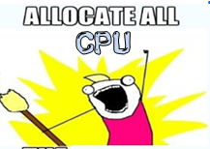
Demo
http://localhost:49090/sum?p=5
http://localhost:49090/sum?p=100000000
http://localhost:49090/sum?p=5

Slide 27
JSON-based SQL Injection
Node.JS, being a JSON based language, can accept JSON values for the .find method:
A user can bypass it by sending
http:///server/page?user[$gt]=a&pass[$gt]=a
http://blog.websecurify.com/2014/08/hacking-nodejs-and-mongodb.html
27

Slide 28
JSON-base SQL Injection
db.users.find({username: username});
This can lead to Regular Expression Denial of Service through the {“username”: {“$regex”: “……..}}
So always validate the input length, structure and permitted characters
Remembering that Node.js is highly sensitive to CPU-intensive tasks, and there’s a single thread for user-code – ReDoS is really bad
bcrypt.compare(candidatePassword, password, cb);

Slide 29
Re-Dos Demo
http://localhost:49090/?user=admin&pass[$regex]=^(a|a|a|a|a|a|a|a|a|a|a|a|a|a|a|a|a|a|a|a|a|a|a|a|a|a|a|a|a|a|a|a|a|a|a|a|a|a|a|a|a|a|a|a|a|a|a|a|a|a|a|a|a|a|a|a|a|a|a|a|a|a|a|a|a|a|a|a|a|a|a|a|a|a|a|a|a|a|a|a|a|a|a|a|a|a|a|a|a|a|a|a|a|a|a|a|a|a|a|a|a|a|a|a|a|a|a|a|a|a|a|a|a|a|a|a|a|a|a|a|a|a|a|a|a|a|a|a|a|a|a|a|a|a|a|a|a|a|a|a|a|a|a|a|a|a|a|a|a|a|a|a|a|a|a|a|a|a|a|a|a|a|a|a|a|a|a|a|a|a|a|a|a|a|a|a|a|a|a|a|a|a|a|a|a|a|a|a|a|a|a|a|a|a|a|a|a|a|a|a|a|a|a|a|a|a|a|a|a|a|a|a|a|a|a|a|a|a|a|a|a|a|a|a|a|a|a|a|a|a|a|a|a|a|a|a|a|a|a|a|a|a|a|a|a|a|a|a|a|a|a|a|a|a|a|a|a|a|a|a|a|a|a|a|a|a|a|a|a|a|a|a|a|a|a|a|a|a|a|a|a|a|a|a|a|a|a|a|a|a|a|a|a|a|a|a|a|a|a|a|a|a|a|a|a|a|a|a|a|a|a|a|a|a|a|a|a|a|a|a|a|a|a|a|a|a|a|a|a|a|a|a|a|a|a|a|a|a|a|a|a|a|a|a|a|a|a|a|a|a|a|a|a|a|a|a|a|a|a|a|a|a|a|a|a|a|a|a|a|a|a|a|a|a|a|a|a|a|a|a|a|a|a|a|a|a|a|a|a|a|a|a|a|a|a|a|a|a|a|a|a|a|a|a|a|a|a|a|a|a|a|a|a|a|a|a|a|a|a|a|a|a|a|a|a|a|a|a|a|a|a|a|a|a|a|a|a|a|a|a|a|a|a|a|a|a|a|a|a|a|a|a|a|a|a|a|a|a|a|a|a|a|a|a|a|a|a|a|a|a|a|a|a|a|a|a|a|a|a|a|a|a|a|a|a|a|a|a|a|a|a|a|a|a|a|a|a|a|a|a|a|a|a|a|a|a|a|a|a|a|a)(d|d|d|d|d|d|d|d|d|d|d|d|d|d|d|d|d|d|d|d|d|d|d|d|d|d|d|d|d|d|d|d|d|d|d|d|d|d|d|d|d|d|d|d|d|d|d|d|d|d|d|d|d|d|d|d|d|d|d|d|d|d|d|d|d|d|d|d|d|d|d|d|d|d|d|d|d|d|d|d|d|d|d|d|d|d|d|d|d|d|d|d|d|d|d|d|d|d|d|d|d|d|d|d|d|d|d|d|d|d|d|d|d|d|d|d|d|d|d|d|d|d|d|d|d|d|d|d|d|d|d|d|d|d|d|d|d|d|d|d|d|d|d|d|d|d|d|d|d|d|d|d|d|d|d|d|d|d|d|d|d|d|d|d|d|d|d|d|d|d|d|d|d|d|d|d|d|d|d|d|d|d|d|d|d|d|d|d|d|d|d|d|d|d|d|d|d|d|d|d|d|d|d|d|d|d|d|d|d|d|d|d|d|d|d|d|d|d|d|d|d|d|d|d|d|d|d|d|d|d|d|d|d|d|d|d|d|d|d|d|d|d|d|d|d|d|d|d|d|d|d|d|d|d|d|d|d|d|d|d|d|d|d|d|d|d|d|d|d|d|d|d|d|d|d|d|d|d|d|d|d|d|d|d|d|d|d|d|d|d|d|d|d|d|d|d|d|d|d|d|d|d|d|d|d|d|d|d|d|d|d|d|d|d|d|d|d|d|d|d|d|d|d|d|d|d|d|d|d|d|d|d|d|d|d|d|d|d|d|d|d|d|d|d|d|d|d|d|d|d|d|d|d|d|d|d|d|d|d|d|d|d|d|d|d|d|d|d|d|d|d|d|d|d|d|d|d|d|d|d|d|d|d|d|d|d|d|d|d|d|d|d|d|d|d|d|d|d|d|d|d|d|d|d|d|d|d|d|d|d|d|d|d|d|d|d|d|d|d|d|d|d|d|d|d|d|d|d|d|d|d|d|d|d|d|d|d|d|d|d|d|d|d|d|d|d|d|d|d|d|d|d|d|d|d|d|d|d|d|d|d|d|d|d|d|d|d|d|d|d|d|d|d|d|d|d|d|d|d|d|d|d|d|d|d|d|d|d|d|d|d|d|d|d|d|d|d|d|d|d|d|d|d|d|d|d|d|d|d|d|d|d|d|d|d|d|d|d|d|d|d|d|d|d|d|d|d|d|d|d|d|d|d|d|d|d|d|d|d|d|d|d|d|d|d|d|d|d|d|d|d|d|d|d|d|d|d|d|d|d|d|d|d|d|d|d|d|d|d|d|d|d|d|d|d|d|d|d|d|d|d|d|d|d|d|d|d|d|d|d|d|d|d|d|d|d|d|d|d|d|d|d|d|d|d|d|d|d|d|d|d|d|d|d|d|d|d|d|d|d|d|d|d|d|d|d|d|d|d|d|d|d|d|d|d|d|d|d|d|d|d|d|d|d|d|d|d|d|d|d|d|d|d|d|d|d|d|d|d|d|d|d|d|d|d|d|d|d|d|d|d|d|d|d|d|d|d|d|d|d|d|d|d|d|d|d|d|d|d|d|d|d|d|d|d|d|d|d|d|d|d|d|d|d|d|d|d|d|d|d|d|d|d|d|d|d|d|d|d|d|d|d|d|d|d|d|d|d|d|d|d|d|d|d|d|d|d|d|d|d|d|d|d|d|d|d|d|d|d|d|d|d|d|d|d|d|d|d|d|d|d|d|d|d|d|d|d|d|d|d|d|d|d|d|d|d)$

Slide 30
Some Key Takeaways
Gamification of education
Knowledge is key to deliver secure code
Students (of all ages) absorb and retain information better when its delivered as a game
Anytime you have a chance to make learning a fun experience you should do it

Slide 31

www.Securedevkit.com

Slide 32



Thank You
Questions?
amit.ashbel@checkmarx.com
Amit Ashbel
@aashbel

