Slide 1
15 years of Web Security
The Rebellious Teenage Years
Jeremiah Grossman
Founder
WhiteHat Security, Inc.
Twitter: @jeremiahg

Slide 2
Jeremiah Grossman
Hacker
OWASP WebAppSec Person of the Year (2015)
Brazilian Jiu-Jitsu Black Belt

Slide 3
WhiteHat Security
Active Customers: ~1000
Fortune 500: 63
Commercial Banks
7 of the Top 18
Largest Banks
10 of the Top 50
Software
6 of the Top 16
Consumer Financial Services
4 of the Top 8
We help secure the Web by finding application vulnerabilities, in the source code all the way through to production, and help companies get them fixed, before the bad guys exploit them.
Founded: 2001
Headquarters: Santa Clara, CA
Employees: 300+

Slide 4
My Areas of Focus
Threat Actors: Innovating, scaling, or both?
Intersection of security guarantees and cyber-insurance
Vulnerability Remediation: Lowering costs, easing the burden, and prioritization.
SDLC processes that measurably improve software security
Addressing the application security skill shortage

Slide 5
Threat Actors
Hacktivists
Organized Crime
Nation-State
Terrorists(?)

Slide 6
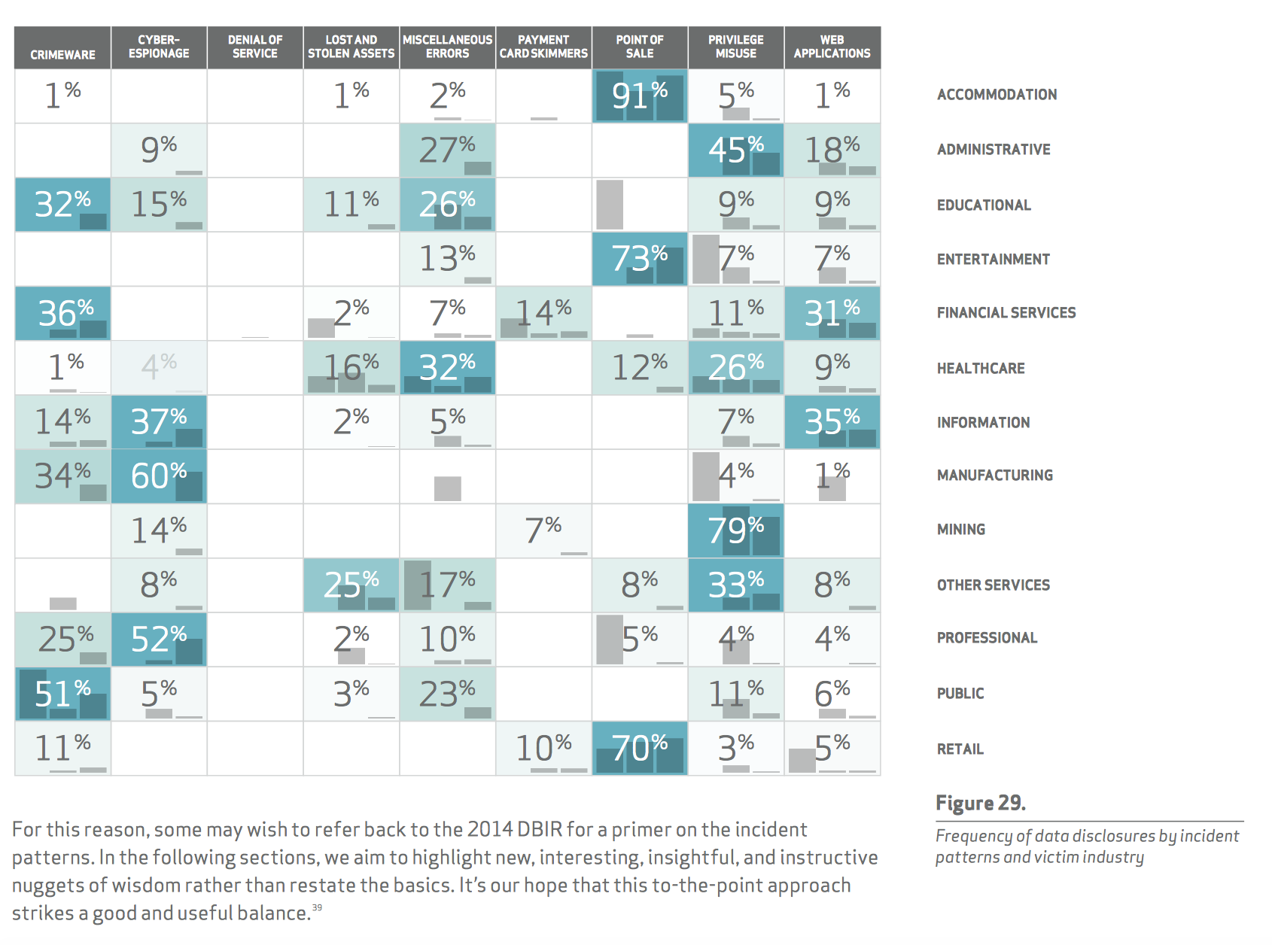

Slide 7
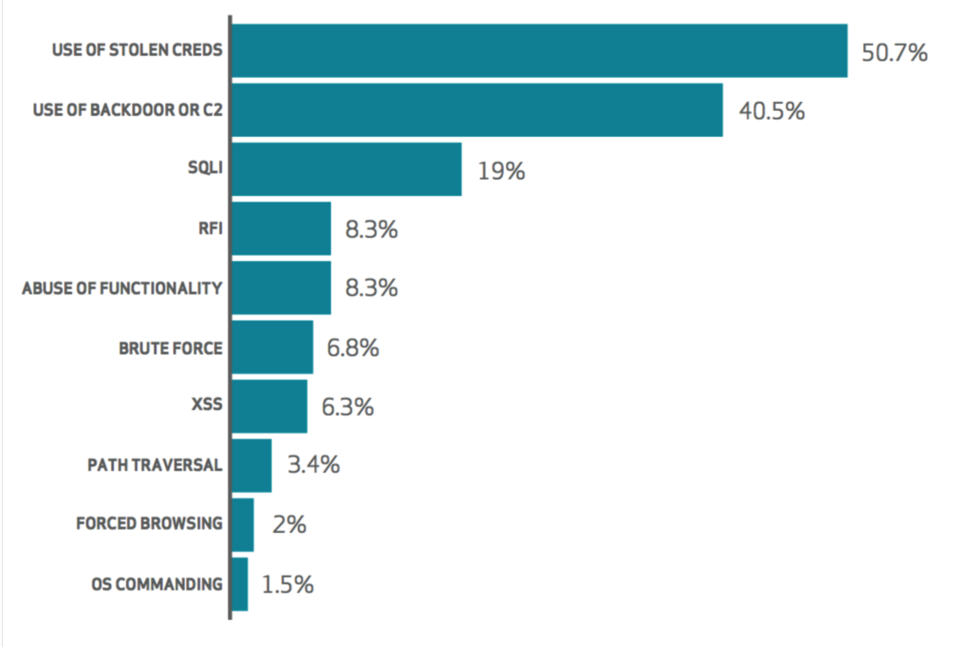
WebApp Attacks Adversaries Use
“This year, organized crime became the most frequently seen threat actor for Web App Attacks.”
Verizon 2015 Data Breach
Investigations Report
Notes:
http://www.verizonenterprise.com/resources/reports/rp_data-breach-investigation-report-2015-insider_en_xg.pdf

Slide 8
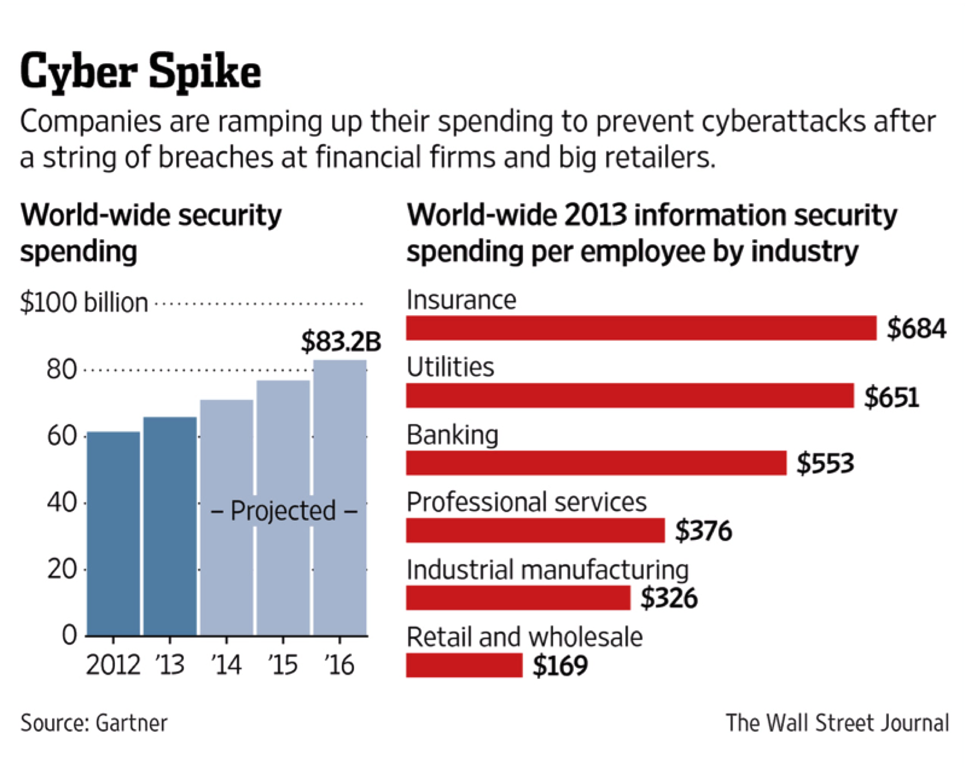
Security Industry Spends Billions
“2015 Global spending on information security is set to grow by close to 5% this year to top $75bn, according to the latest figures from Gartner.”
Notes:
http://www.infosecurity-magazine.com/news/global-security-spend-set-to-top/
http://www.securityweek.com/global-cybersecurity-spending-reach-769-billion-2015-gartner
http://www.gartner.com/newsroom/id/2828722
http://www.wsj.com/articles/financial-firms-bolster-cybersecurity-budgets-1416182536
http://mspmentor.net/managed-security-services/100314/pwc-cybersecurity-costs-rise-budgets-decrease

Slide 9
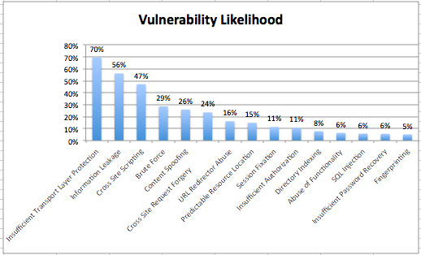
Vulnerability Likelihood

Slide 10
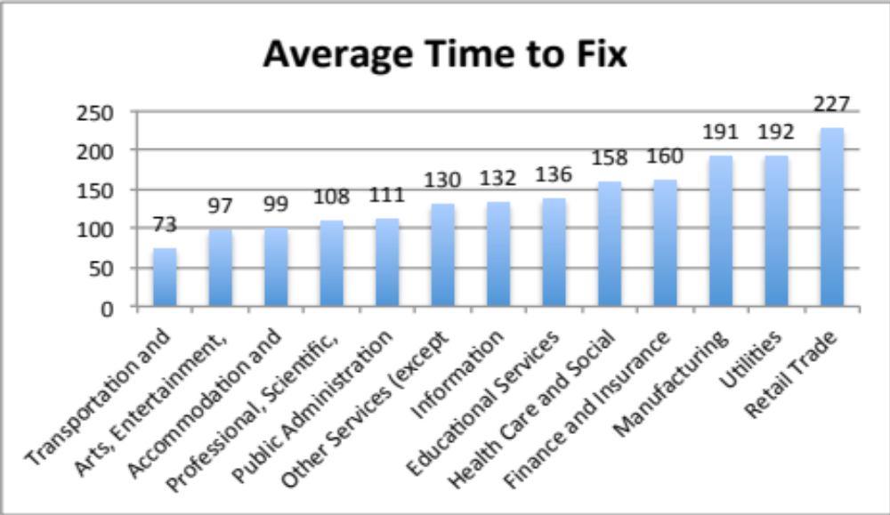
Average Time-to-Fix (Days)

Slide 11
Windows of Exposure
A large % of websites are always vulnerable
60% of all Retail are always vulnerable
52% of all Healthcare and Social Assistance sites are always vulnerable
38% of all Information Technology websites are always vulnerable
39% of all Finance and Insurance websites are always vulnerable

Slide 12
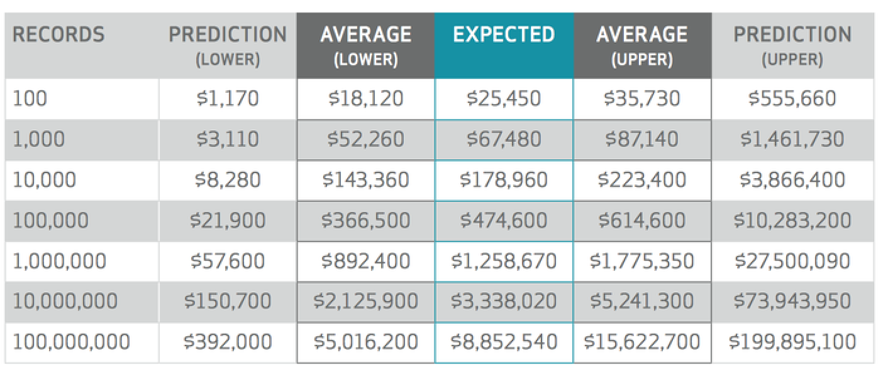
Ranges of Expected Loss by # of Records
Verizon 2015 Data Breach Investigations Report
Notes:
http://www.verizonenterprise.com/resources/reports/rp_data-breach-investigation-report-2015-insider_en_xg.pdf

Slide 13
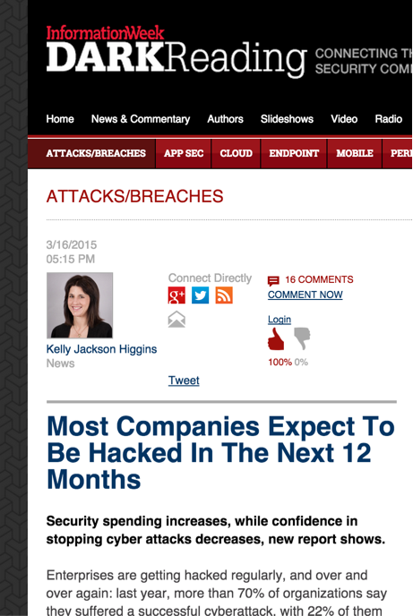
Result: Every Year is the Year of the Hack
“In 2014, 71% of security professionals
said their networks were breached.
22% of them victimized 6 or more times.
This increased from 62% and 16% respectively from 2013. 52% said their organizations will likely be successfully hacked in the next 12 months.
This is up from 39% in 2013.”
Survey of security professionals by CyberEdge
Notes:
http://www.darkreading.com/attacks-breaches/most-companies-expect-to-be-hacked-in-the-next-12-months/d/d-id/1319497?

Slide 14
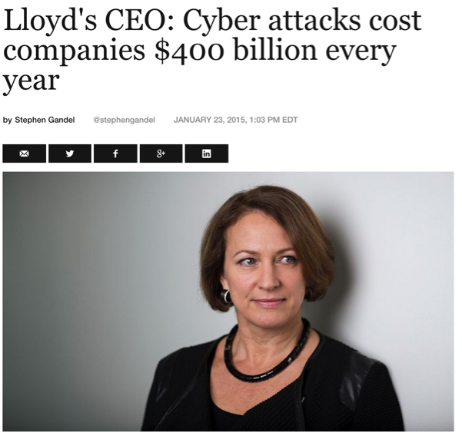
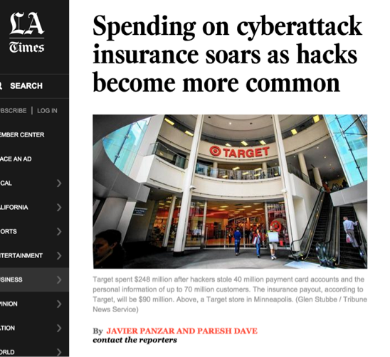
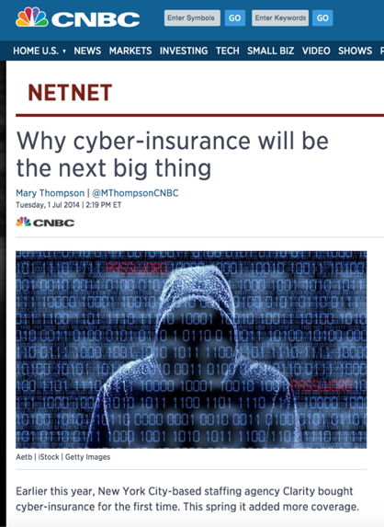
Downside protection
As of 2014, American businesses were expected to pay up to $2 billion on cyber-insurance premiums, a 67% spike from $1.2 billion spent in 2013.
Current expectations by one industry watcher suggest 100% growth in insurance premium activity, possibly 130% growth.
It’s usually the firms that are best prepared for cyber attacks that wind up buying insurance.
Notes:
http://fortune.com/2015/01/23/cyber-attack-insurance-lloyds/
http://www.techtimes.com/articles/27454/20150120/cyber-insurance-forefront-companies-minds.htm
http://www.latimes.com/business/la-fi-hacking-insurance-20150210-story.html
http://www.cnbc.com/id/101804150
http://www.darkreading.com/risk/the-problem-with-cyber-insurance/a/d-id/1269682?#ftag=YHF87e0214

Slide 15
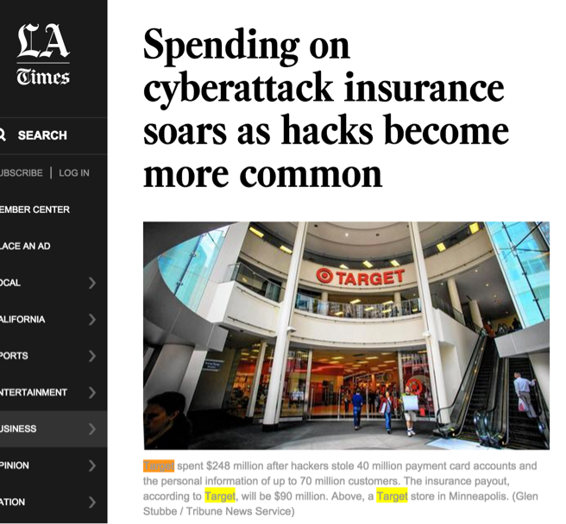
Downside protection
“Target spent $248 million after hackers stole 40 million payment card accounts and the personal information of up to 70 million customers. The insurance payout, according to Target, will be $90 million.”
“Home Depot reported $43 million in expenses related to its September 2014 hack, which affected 56 million credit and debit card holders. Insurance covered only $15 million.”
Notes:
http://www.insurancejournal.com/news/national/2014/02/26/321638.htm
http://www.latimes.com/business/la-fi-hacking-insurance-20150210-story.html

Slide 16
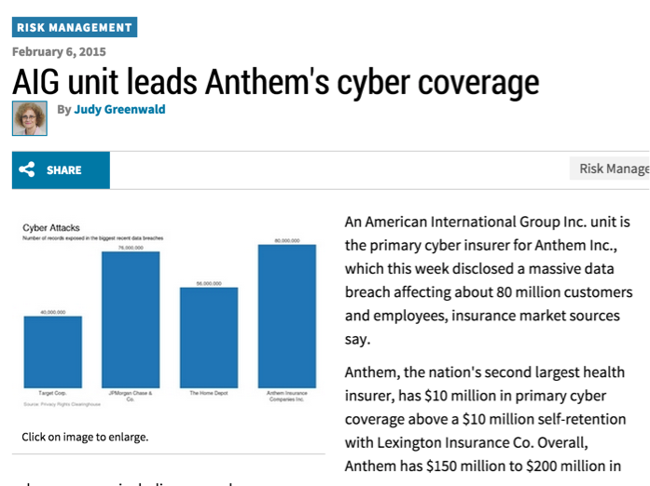
Downside protection
“Anthem has $150 million to $200 million in cyber coverage, including excess layers, sources say.”
Insurers providing excess layers of cyber coverage include: Lloyd's of London syndicates; operating units of Liberty Mutual Holding Co.; Zurich Insurance Group; and CNA Financial Corp., sources say.”
Notes:
http://www.businessinsurance.com/article/20150206/NEWS06/150209857/aig-unit-leads-anthems-cyber-coverage?tags=%7C83%7C299%7C302%7C329

Slide 17
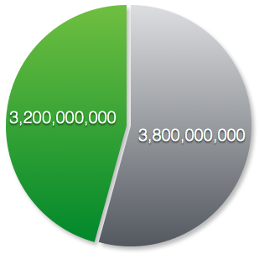
2014 – 2015
New Security Investment vs. Cyber-Insurance
Information Security Spending (Global)
~$3.8 billion in new spending (+4.7%)
(Gartner: Oct, 2015)
Cyber-Security Insurance
~$3.2 Billion in new spending (+67%)

Slide 18
Ever notice how everything in the information security industry is sold “as is”?
No Guarantees
No Warrantees
No Return Policies

Slide 19
No More Snake Oil

Slide 20
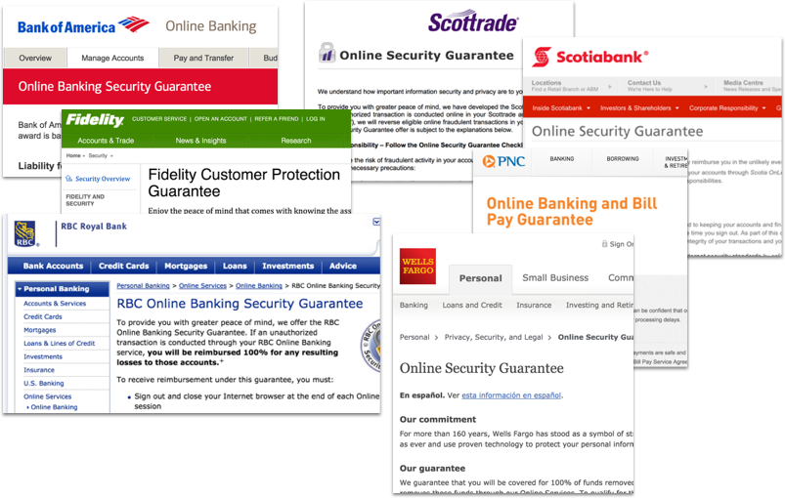

Slide 21

“The only two products not covered by product liability are religion and software, and software shall not escape much longer.”
Dan Geer (CISO, In-Q-Tel)
Notes:
https://www.youtube.com/watch?v=nT-TGvYOBpI&list=UUJ6q9Ie29ajGqKApbLqfBOg

Slide 22
Software Security
Maturity Metrics Analysis
The analysis is based on 118 responses on a survey sent to security professionals to measure maturity models of application security programs at various organizations.
The responses obtained in the survey are correlated with the data available in Sentinel to get deeper insights. Statistics pulled from Sentinel are for 2014 timeframe.

Slide 23
If an organization experiences a website(s) data or system breach, which part of the organization is held accountable and what is it’s performance?
56% of all respondents did not have any part of the organization held accountable in case of data or system breach.

Slide 24
If an organization experiences a website(s) data or system breach, which part of the organization is held accountable and what is it’s performance?

Slide 25
Please rank your organization’s drivers for resolving website vulnerabilities. 1 lowest priority, 5 highest.
15% of the respondents cite Compliance as the primary reason for resolving website vulnerabilities
6% of the respondents cite Corporate Policy as the primary reason for resolving website vulnerabilities
35% of the respondents cite Risk Reduction as the primary reason for resolving website vulnerabilities
19% of the respondents cite Customer or Partner Demand as the primary reason for resolving website vulnerabilities
25% of the respondents cite other reasons for resolving website vulnerabilities

Slide 26
Please rank your organization’s drivers for resolving website vulnerabilities. 1 the lowest priority, 5 the highest.

Slide 27
Security Controls | # of Open Vulns | Time-to-Fix | Remediation Rate
Automated static analysis during the code review process
QA performs basic adversarial tests
Defects identified through operations monitoring fed back to development
Share results from security reviews with the QA

Slide 28
There Are No
Best-Practices

Slide 29
Questions?
Thank you!
Jeremiah Grossman
Founder
WhiteHat Security, Inc.
Twitter: @jeremiahg

