Slide 1

Accelerating Multi-Pattern Matching on
Compressed HTTP Traffic
Yaron Koral (IDC)
Joint work with Dr. Anat Bremler-Barr (IDC) Infocom[2009]

Slide 2
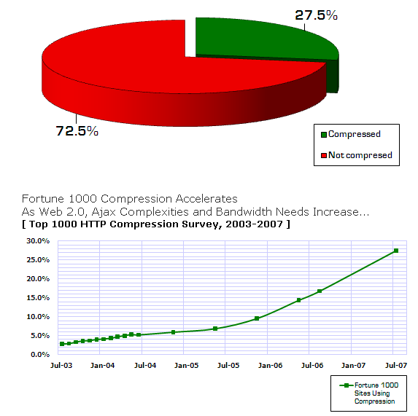
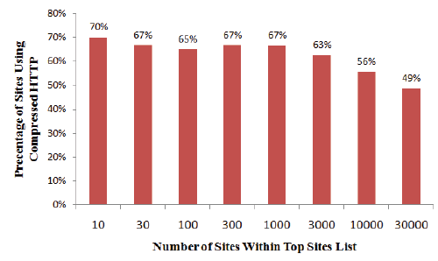





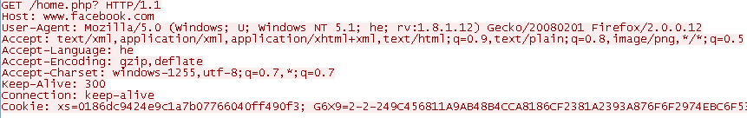
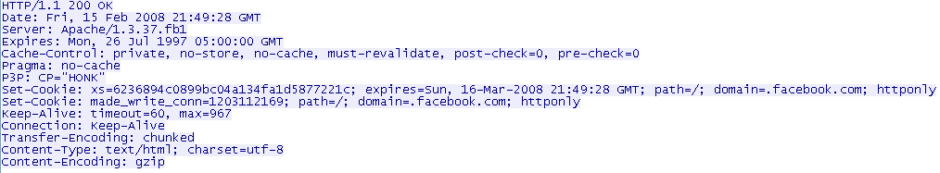

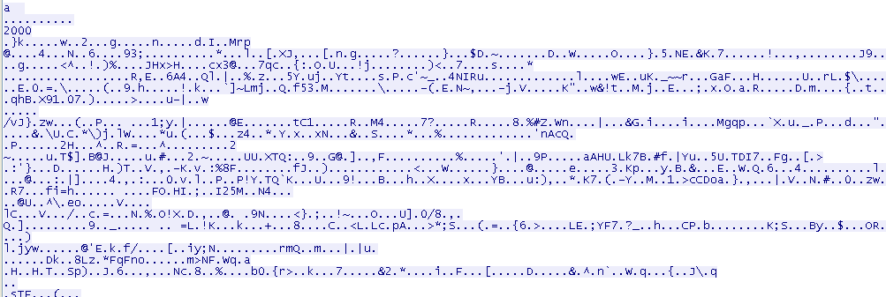

Motivation: Compressed Http
Compressed HTTP is common
  Reduce Bandwidth !
Client
Server
2
2
Notes:
Increasing line-rates: GE, OC48, 10GE, OC192, OC768…
2

Slide 3



Motivation: Pattern Matching
Security tools: signature (pattern) based
  Focus on server response side
    Web Application FW (leakage prevention), Content Filtering
  Challenges:
    Thousands of known malicious patterns
    Real time, link rate
      One pass, Few memory references
  Security tools performance is dominated by the pattern matching engine (Fisk & Varghese 2002)
Server
Http compressed
Client
3
Security tool
Notes:
Increasing line-rates: GE, OC48, 10GE, OC192, OC768…
3

Slide 4


Our contribution:
Accelerator Algorithm
Security Tools Bypass Gzip
General belief:
This work shows:
Decompression + pattern matching >> pattern matching
Accelerating the pattern matching using compression information
Decompression + pattern matching < pattern matching
4

Slide 5

Accelerator Algorithm Idea
Compression is done by compressing repeated sequences of bytes
Store information about the pattern matching results
No need to fully perform pattern matching on repeated sequence of bytes that were already scanned for patterns !
5

Slide 6

Related Work
Many papers about pattern matching over compressed files
This problem is something completely different: compressed traffic
  Must use GZIP: HTTP compression algorithm
  On line scanning (1-Pass)
As far as we know this is the first work on this subject!
6

Slide 7

Background:
Compressed HTTP uses GZIP
7
Combined from two compression algorithms:
  Stage 1: LZ77
    Goal: reduce string presentation size
    Technique: repeated strings compression
  Stage 2: Huffman Coding
    Goal: reduce the symbol coding size
    Technique: frequent symbols → fewer bits

Slide 8
Background: LZ77 Compression
Compress repeated strings
  Last 32KB window
Encode repeated strings by pointer: {distance,length}
ABCDEFABCD →
Note: Pointers may be recursive (i.e. pointer that points to a pointer area)
ABCDEF
{6,4}
8

Slide 9
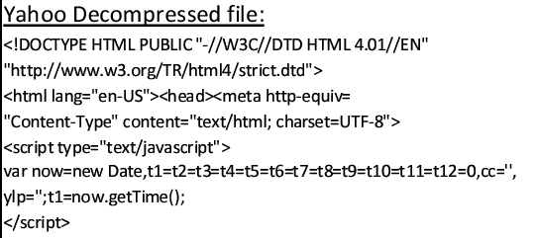
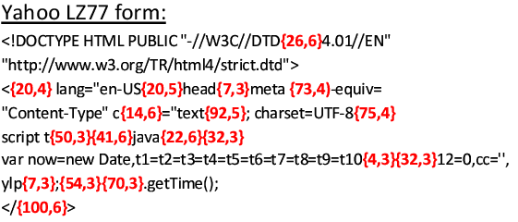
LZ77 Statistics
Using real life DB of traffic from corporate FW 808MB of HTTP traffic (14,078 responses)
  Compressed / Uncompressed ~ 19.8%
  Average pointer length ~ 16.7 Bytes
  Bytes represented by pointers / Total bytes ~ 92%

Slide 10
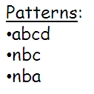
Background: Pattern Matching
Aho-Corasick Algorithm
Deterministic Finite Automata (DFA)
  Regular state, and accepting state
O(n) search time, n = text size
  For each byte traverse one step
High memory requirement
  Snort: 6.5K patterns → 73MB DFA
  Most states not in the cache
a
n
b
b
c
b
a
c
d
10
Notes:
There are several families of pattern matching algorithms used on network security tools.
We chose the Aho-Corasick Algorithm. It’s a pretty common algorithm since it is deterministic.
Generally it is a FSM. It works on a linear time where for each byte in the input text it performs one step.
For that to happen the FSM holds forward transitions like shown in the example, we can see for those 3 patterns how the FSM is built.
For each possible input, each state also holds failure transitions.
The main problem with this algorithm is that the FSM requires a lot of memory because of all the failure transitions.
That means that AC usually uses main memory and not cache. For Each step it requires two memory references.
So at the bottom line AC is pretty expansive.

Slide 11

Challenge:
Decompression vs. Pattern Matching
Decompression: Relatively Fast
  Store last 32KB sliding window per connection→ temporal locality
  Copy consecutive bytes - Cache very useful→ spatial locality
  Relatively fast - Need only a few cache accesses per byte
Pattern Matching: Relatively Slow
  High memory requirement→ Most states not in the cache
  Relatively slow - 2 memory references per byte:
      next state, “is pattern” check
LZ77
AC
Decompression
Pattern matching
11

Slide 12
Observations:
Decompression vs. Pattern Matching
Observation 1: Need to decompress prior to pattern matching
  LZ77 – adaptive compression
    The same string will be encoded differently depending on its location in the text
Observation 2: Pattern Matching is more computation intensive than decompression
Conclusion: So decompress all – but accelerate the pattern matching !
LZ77
AC
Decompression
Pattern matching
12

Slide 13
Aho-Corasick based algorithm for Compressed HTTP (ACCH)
Main observation:
LZ77 pointers point to an already scanned bytes
  Add status: some information about the state we reach at the DFA after scanning that byte
In the case of a pointer: use the status information on the referred bytes in order to skip calling Aho-Corasick scan
13

Slide 14
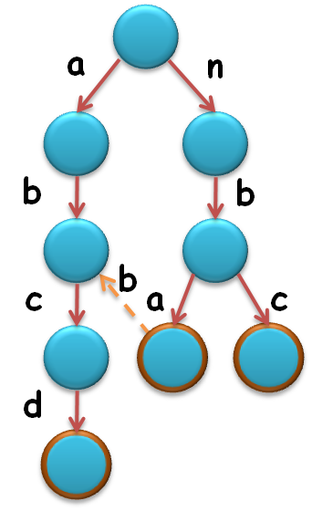
ACCH Details:
DFA characteristics:
If depth=d than
the state of the DFA is determined only by d last bytes
For start we define status:
  Match : match (accept) state at the DFA
  Unmatch : otherwise
Assume for now: no match in referred bytes
Still there may be a pattern within the boundaries
  We can skip scan internal bytes in the pointer
Redefine status
  Should help us to determine how many bytes to skip
  Requirements: Minimum space, loose enough to maintain
Traffic =
 |  |  |  | a | b | } | 8 | , | 8 | { | n | e | c | d | c | e | c | b | e
 |  |  |  |  |  |  |  |  |  |  | u | u | u | u | u | u | u | u | u
 | a | b | n | e | c | d | c | e | c | b | n | e | c | d | c | e | c | b | e
Status =
Uncompressed=
14

Slide 15
ACCH Details: status
Status – approximate depth
CDepth constant parameter of the ACCH algorithm
  The depth that interest us…
Status three options:
  Match: Match state at the DFA
  Uncheck: Depth < CDepth
  Check: Suspicion → Depth ≥ CDepth
Status (2bits) for each byte in the sliding window
0
CDepth
1
1
2
2
3
3
3
4
15

Slide 16

ACCH Details:
Left Boundary
Scan with Aho-Corasick, until the j^{th} byte where the depth of the byte is less or equal to j
0
1
1
Traffic =
 |  |  |  | a | b | } | 8 | , | 8 | { | n | e | c | d | c | e | c | b | e
 | a | b | n | e | c | d | c | e | c | b | n | e | c | d | c | e | c | b | e
 |  |  |  |  |  |  |  | 0 | 3 | 2 | 1 | 0 | 0 | 0 | 0 | 0 | 0 | 0 | 0
 |  |  |  |  |  |  |  | u | m | c | u | u | u | u | u | u | u | u | u
2
2
Uncompressed=
3
3
3
Depth=
4
Status=
Left
scanned chars within pointer 3
Depth 0
scanned chars within pointer 0
Depth 1
scanned chars within pointer 1
Depth 2
scanned chars within pointer 2
Depth 3
16

Slide 17

ACCH Details: Internal-Skipped bytes
We can skip bytes, since:
  If there is a pattern within the pointer area it must be fully contained → must be a Match within the referred bytes.
  No Match in the referred bytes → skip pointer internal area
Traffic =
 |  |  |  | a | b | } | 8 | , | 8 | { | n | e | c | d | c | e | c | b | e
 | a | b | n | e | c | d | c | e | c | b | n | e | c | d | c | e | c | b | e
 |  |  |  |  |  |  |  | 0 | 3 | 2 | 1 | 0 | 0 | 0 | 0 | 0 | 0 | 0 | 0
 |  |  |  |  |  |  |  | u | m | c | u | u | u | u | u | u | u | u | u
Uncompressed=
Depth=
Status=
Left
17

Slide 18

ACCH Details:
Right Boundary
DFA characteristics:
If depth=d than
the state of the DFA is determined only by d last bytes
Let unchkPos = index of the last byte before the end of pointer area that its corresponding byte in the referred bytes has Uncheck status.
→ Skip all bytes up to unchkPos+1-(CDepth-1)
CDepth = 2
0
unchkPos
1
1
Traffic =
 |  |  |  | a | b | } | 8 | , | 8 | { | n | e | c | d | c | e | c | b | e
 | a | b | n | e | c | d | c | e | c | b | n | e | c | d | c | e | c | b | e
 |  |  |  |  |  |  |  | 0 | 3 | 2 | 1 | 0 | 0 | 0 | 0 | 0 | 0 | 0 | 0
 |  |  |  |  |  |  |  | u | m | c | u | u | u | u | u | u | u | u | u
Uncompressed=
2
2
Depth=
3
3
3
Status=
4
18

Slide 19
ACCH Details:
Right Boundary
Significant amount is skipped!!! Based on the observation that most of the bytes have an Uncheck status and DFA resides close to root
At the end of a pointer area the algorithm is synchronized with the DFA that scanned all the bytes
Traffic =
 |  |  |  | a | b | } | 8 | , | 8 | { | n | e | c | d | c | e | c | b | e
 | a | b | n | e | c | d | c | e | c | b | n | e | c | d | c | e | c | b | e
 | 3 | 2 | 1 |  |  |  |  | 0 | 3 | 2 | 1 | 0 | 0 | 0 | 0 | 0 | 0 | 0 | 0
 | m | c | u |  |  |  |  | u | m | c | u | u | u | u | u | u | u | u | u
Uncompressed=
Depth=
Status=
Left
Internal (Skip)
Right
CDepth = 2
19

Slide 20
ACCH Details:
Internal -Skipped bytes
Status of skipped bytes is maintained from the referred bytes area
Depth(byte in pointer) ≤ Depth(byte in referred bytes)
  The depth in the referred bytes might be larger due to prefix of a pattern that starts before the referred bytes
Copied Uncheck status is correct, Check may be false…
  Correct result ! But may cause additional unnecessary scans.
Traffic =
 |  |  |  | a | b | } | 8 | , | 8 | { | n | e | c | d | c | e | c | b | e
 | a | b | n | e | c | d | c | e | c | b | n | e | c | d | c | e | c | b | e
 | 3 | 2 | 1 | ? | ? | ? | ? | 0 | 3 | 2 | 1 | 0 | 0 | 0 | 0 | 0 | 0 | 0 | 0
 | m | c | u | u | u | u | u | u | m | c | u | u | u | u | u | u | u | u | u
Uncompressed=
Depth=
Status=
Left
Internal (Skip)
Right

Slide 21
ACCH Details:
Internal Matches
Left Scan
Right Scan
matches
Right Scan (end of Match Section)
In case of internal Matches:
    Slice pointer into sections using the byte with status Match as section right boundary
    For each section, perform “right boundary scan” in order to re-sync with DFA
    Fully copied pattern would be detected

Slide 22
Optimization I
Maintain a list of Match occurrences and the corresponding pattern/s
Match in the referred bytes → Check if the matched pattern is fully contained in the pointer area → if so we have a match!
  Just compare the pattern length with the pointer area
Offset
Pattern list
Pro’s:
  Scans only pointer’s borders
  Great for data with many matches
Con’s
  Extra memory used for handling data structure
  ~2KB per open session (for snort pattern set)
xxxxx
‘abcd’
yyyyy
‘xyz’;’klmxyz’
zzzzzz
‘000’;’00000’

Slide 23
Experimental Results
Data Set:
  14,078 compressed HTTP responses (list from alexa.org TOP 1M)
  808MB in an uncompressed form
  160MB in compressed form
  92.1% represented by pointers
  16.7 average pointer length
Pattern Set:
  ModSecurity: 124 patterns (655 hits)
  Snort: 8K patterns (14M hits)
  1.2K textual
23

Slide 24
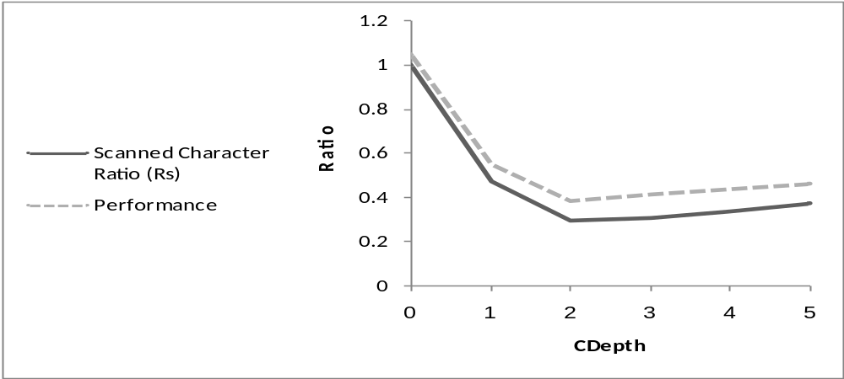
Experimental Results: Snort
Scanned bytes ratio
Memory references ratio
CDepth = 2 is optimal
Gain: Snort - 0.27 scanned bytes ratio and 0.4 memory references ratio
ModSecurity – 0.18 scanned bytes ratio and 0.3 memory references ratio
24

Slide 25
Wrap-up
25
First paper that addresses the multi pattern matching over compressed HTTP problem
Accelerating the pattern matching using compression information
Surprisingly, we show that it is faster
to do pattern matching on the compressed data, with the penalty of decompression, than running pattern matching on regular traffic
  Experiment: 2.4 times faster with Snort patterns!

Slide 26
Questions ?
26
Notes:
26

