Slide 1
Temporal Session
Race Conditions
Shay Chen
Senior Manager, CTO
Hacktics ASC, Ernst & Young
15th September 2011
Notes:
The Input area of the Beam is a shape with a picture fill. To change this, ensure you have the image you wish to use (ideally a .jpg or a .png file) in an accessible folder. The image should have a ratio of 1:1 to ensure it does not appear distorted.
When choosing an Input image, follow the principles on The Branding Zone. Customize the Input area of the Beam as described below.
In the View tab, click Slide Master from the Presentation Views group.
Right-click on the Input graphic and select Format Picture.
From the Fill menu, select Picture or texture fill and click Insert from file.
Navigate to the folder containing the image you wish to insert in the Input area. Highlight the image and click Insert.
You can now preview the image before continuing. If you are happy with how it looks, click OK to continue. Otherwise, repeat the process until you are happy with your selected image.
To exit from Slide Master View, click Normal from the Presentation Views group in the View tab.
The change you made to the Input graphic should now be visible on the slide.

Slide 2

Agenda
TSRC – From theory to practice
  Overview – Race Conditions and Latency
The Challenge
Initial Background
  Sessions and Session Puzzling
The solution
  Intentional Latency Increment
  Race Conditions and Layer Targeted ADoS
  Sample TSRC Attack Vectors
  Analyzing source code vulnerable to TSRC
Demonstration and Overview

Slide 3
Temporal Session Race Conditions
From Theory to Practice
Notes:
The graphic on the divider slide is an AutoShape with a solid fill. To insert an appropriate image, ensure you have the image you wish to use (ideally a .jpg or a .png file) in an accessible folder. The image should have a ratio of 2:1 to ensure it does not appear distorted.
In the View tab, click Slide Master from the Presentation Views group.
Right-click on the graphic and select Format Shape.
From the Fill menu, select Picture or texture fill and click Insert from file.
Navigate to the folder containing the image you wish to insert in the divider slide graphic. Highlight the image and click Insert.
You can now preview the image before continuing. If you are happy with how it looks, click OK to continue. Otherwise, repeat the process until you are happy with your selected image.
To exit from Slide Master View, click Normal from the Presentation Views group in the View tab.
The change you made to the divider slide graphic should now be visible on the slide.

Slide 4

Race Conditions
“A race condition occurs when a pair of routine programming calls in an application do not perform in the sequential manner that was intended per business rules.” (The definition of RC in the OWASP Vulnerability List).
1
2
Balance Verification
3
4
Withdraw Transaction

Slide 5
Race Conditions With Inherent Latency
The detection and exploitation of race conditions is very efficient when the vulnerable module has inherent latency
  Database transactions
  SOA multiphase operations
  Backend operations
  Etc.

Slide 6
Race Conditions in Session Operations
Detecting and exploiting race conditions without inherent latency is something entirely different:
  The detection will be less consistent and harder to reproduce
  Detecting these instances in black box tests using the standard testing approach is very difficult, sometimes even theoretical
Race conditions in session validations fall into the second category, and therefore are rarely reported.

Slide 7
The Challenge
Abusing Temporary Server Side Variables
Notes:
The graphic on the divider slide is an AutoShape with a solid fill. To insert an appropriate image, ensure you have the image you wish to use (ideally a .jpg or a .png file) in an accessible folder. The image should have a ratio of 2:1 to ensure it does not appear distorted.
In the View tab, click Slide Master from the Presentation Views group.
Right-click on the graphic and select Format Shape.
From the Fill menu, select Picture or texture fill and click Insert from file.
Navigate to the folder containing the image you wish to insert in the divider slide graphic. Highlight the image and click Insert.
You can now preview the image before continuing. If you are happy with how it looks, click OK to continue. Otherwise, repeat the process until you are happy with your selected image.
To exit from Slide Master View, click Normal from the Presentation Views group in the View tab.
The change you made to the divider slide graphic should now be visible on the slide.

Slide 8
The Challenge
The Session Puzzling attack vector was introduced in
May 2011, in a local chapter meeting of OWASP.
Session Puzzles can be used to perform a variety of attacks by abusing the existence of common session variables.
However, the attack was only effective for abusing session variables with a consistent lifespan, and was not effective for exploiting session variables with an extremely limited lifespan (milliseconds)… Until Now.

Slide 9
Temporal Session Race Conditions
But if latency is the key, can it be artificially created?
Recent research proves that by combining the effects of several different attacks, it is possible to abuse session variables with an extremely limited lifespan.
But before we demonstrate this attack, let’s first understand the basics…

Slide 10
Background
Sessions and Session Puzzling
Notes:
The graphic on the divider slide is an AutoShape with a solid fill. To insert an appropriate image, ensure you have the image you wish to use (ideally a .jpg or a .png file) in an accessible folder. The image should have a ratio of 2:1 to ensure it does not appear distorted.
In the View tab, click Slide Master from the Presentation Views group.
Right-click on the graphic and select Format Shape.
From the Fill menu, select Picture or texture fill and click Insert from file.
Navigate to the folder containing the image you wish to insert in the divider slide graphic. Highlight the image and click Insert.
You can now preview the image before continuing. If you are happy with how it looks, click OK to continue. Otherwise, repeat the process until you are happy with your selected image.
To exit from Slide Master View, click Normal from the Presentation Views group in the View tab.
The change you made to the divider slide graphic should now be visible on the slide.

Slide 11
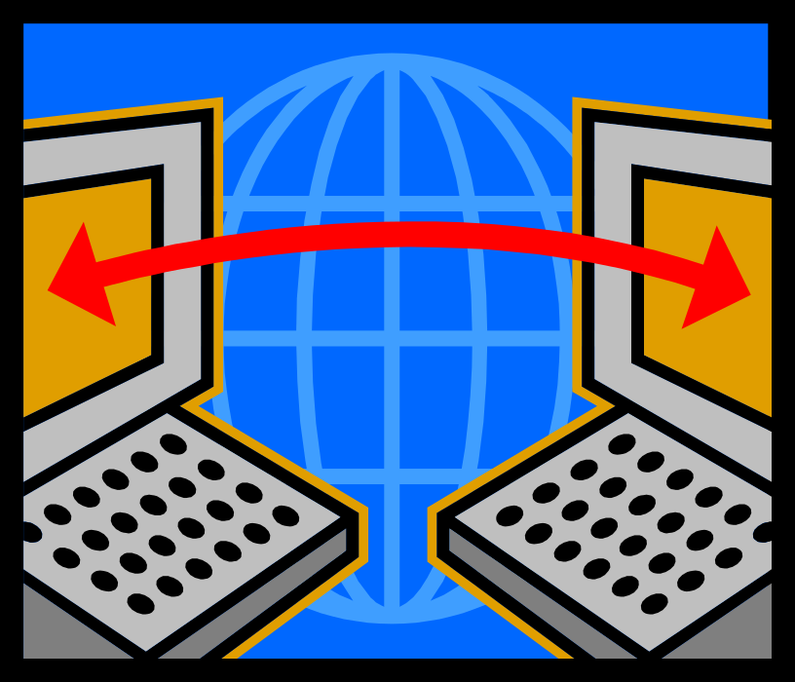
The Session Mechanism

Slide 12
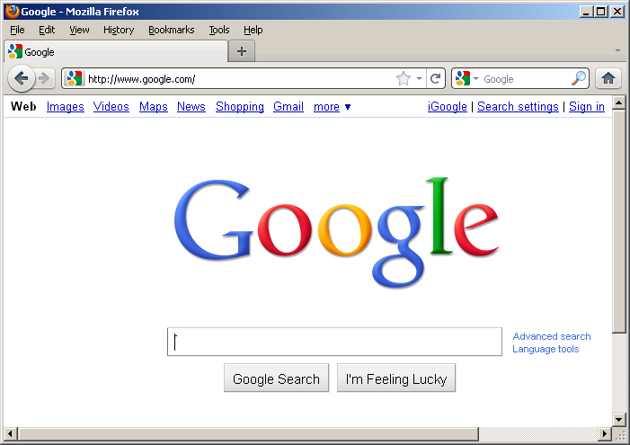

The Session Mechanism
The process of session identifier generation and association
Web Server
Initial Access to the Domain
Session ID
Abcd123
Cbcr321
Memory Allocation
0xAA…
0xBB…
Set-cookie: SID=abcd123
Initial Browser Access
Session Memory Association
Session Identifier Storage
Session Identifier Reuse
Session Identifier Generation
Cookie: SID=abcd123
Session Memory
Domain Cookie
SID=Abcd123

Slide 13
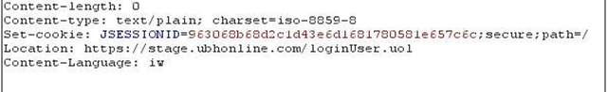
The Session Lifespan in Web Applications
When the application server is initially accessed by a browser, a new, unique session identifier is generated and associated to a server side memory allocation.
The session identifier is returned to the browser, usually in a “set-cookie” response header.

Slide 14
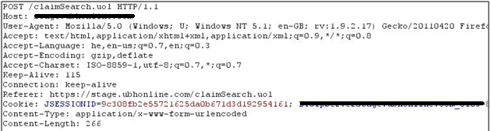
The Session Lifespan in Web Applications
The browser stores the identifier in a domain-specific cookie, and since the content of domain-specific cookies is sent to the domain in every request, so does the session identifier.
The server uses the session identifier to “associate” the browser instance with the memory allocation, which can store flags, identities, and browser instance specific data.

Slide 15

Session Puzzles

Slide 16

Session Puzzles – What’s That?
Session Puzzles are application-level vulnerabilities that could enable attackers to perform a variety of malicious actions, by abusing the existence of session variables:
  Bypass the authentication and authorization enforcement
  Elevate privileges and Impersonate legitimate users
  Bypass restrictions in multiphase processes
  Execute “traditional attacks” (such as injections) in locations that were previously considered safe
  Affect content delivery destination
  Etc.

Slide 17
Session Puzzling – How Does It Work?
Session Puzzles might be caused due to one or more of the following conditions:
  Premature “population” of session objects in publically accessible entry points.
  Unnecessary storage of values in the session memory.
  Identical session variables used by multiple processes.
  Consistent usage of session flags in legitimate features.
  Lack of validation to “trusted” session originating values which are used by the application.
  Inefficient or Incomplete authentication and authorization enforcement mechanisms.
  Erroneous scenarios that populate or prevent the deletion of session variables.

Slide 18
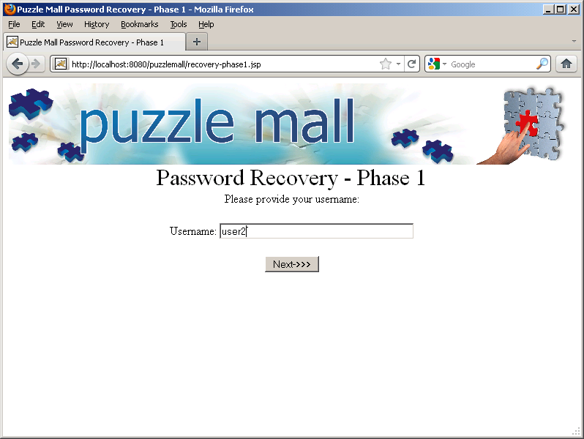
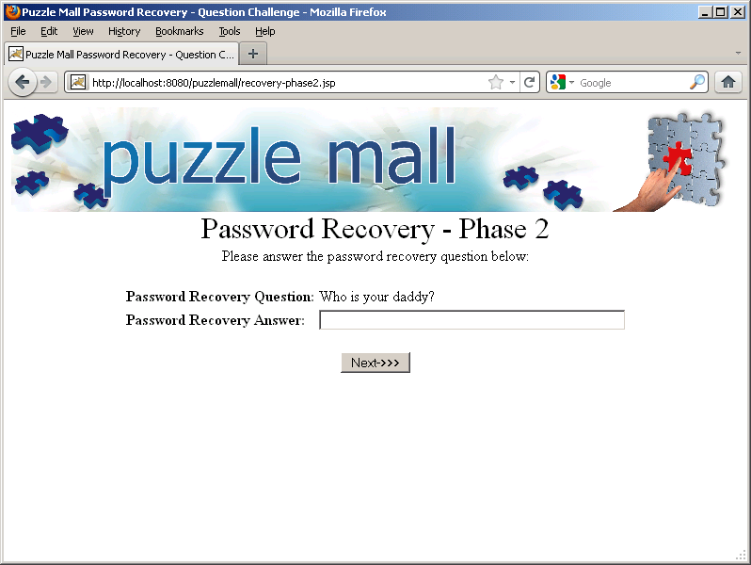
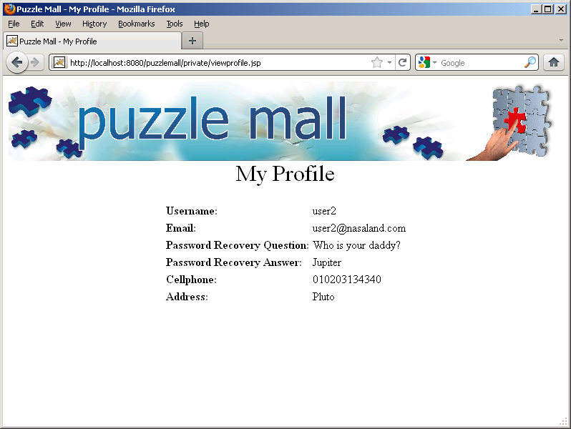
Session Puzzling – A Simple Example
Authentication Bypass via the password recovery module:

Slide 19
Session Puzzling – Demonstration Movies
Authentication Bypass via the password recovery module:
http://www.youtube.com/watch?v=-DackF8HsIE
User Impersonation via session puzzling:
http://www.youtube.com/watch?v=ikIyInm0wAg
Bypassing restrictions in multiphase processes:
http://www.youtube.com/watch?v=HeP54b52IeQ

Slide 20
The Solution
Notes:
The graphic on the divider slide is an AutoShape with a solid fill. To insert an appropriate image, ensure you have the image you wish to use (ideally a .jpg or a .png file) in an accessible folder. The image should have a ratio of 2:1 to ensure it does not appear distorted.
In the View tab, click Slide Master from the Presentation Views group.
Right-click on the graphic and select Format Shape.
From the Fill menu, select Picture or texture fill and click Insert from file.
Navigate to the folder containing the image you wish to insert in the divider slide graphic. Highlight the image and click Insert.
You can now preview the image before continuing. If you are happy with how it looks, click OK to continue. Otherwise, repeat the process until you are happy with your selected image.
To exit from Slide Master View, click Normal from the Presentation Views group in the View tab.
The change you made to the divider slide graphic should now be visible on the slide.

Slide 21
The Lifespan of Session “Leftovers”
The lifespan of session variables might vary in the context of a module:
  The content of the session might be initialized in the beginning of the module, a typical behavior in the following:
    Logout modules
    Login modules
  The content of the session might be initialized at the end or the middle of the module:
    Logout modules
    The code sections of security mechanisms that deal with failures (including login failures, security events, etc.)
  The entire session

Slide 22
The Lifespan of Session “Leftovers”
Furthermore, in addition to the previously described scenarios, the lifespan of specific session variables might be limited in additional ways:
  The content of a session variable might be initialized in certain phases of a multiphase process:
    State flags
    Variables used for calculation, identity storage, etc.
  The content of a session variable might be initialized if a certain criteria is met (the process failed or successfully completed, exceptions did not occur, etc.).

Slide 23
TSRC Exploitation
Definition: a combination of attacks meant to enhance the consistency of exploiting session-level race conditions.
  In order to make the exploitation consistent, we will need to artificially create that which is missing… Latency.
  Abusing the session variables will still require the exploitation request to be sent immediately after the request/s meant to populate the session and cause the latency.

Slide 24
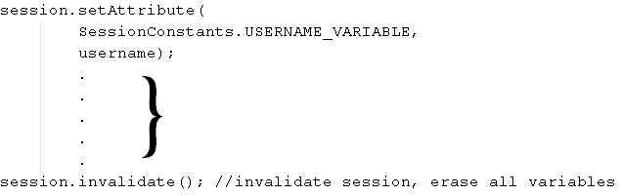
Intentional Latency Increment
The solution to exploiting session race conditions with consistency lies in extending the productive latency, artificially increasing the odds for the session manipulation success.
Productive Latency

Slide 25
Intentional Latency Increment, Cont.
An increment in the length of the session variable lifespan will directly increase the chances of abusing it…
But how can we cause an increment in the execution latency of specific lines of code?
?
++

Slide 26

Layer Targeted ADoS

Slide 27
Layer Targeted Denial Of Service
Different lines of code might access different digital layers, such as:
  Databases
  Web Services
  External Servers
  File Operations.
Furthermore, malicious payloads can be used to increase the latency of code sections:
  Regular Expressions
  Loops
  Search Criteria.

Slide 28
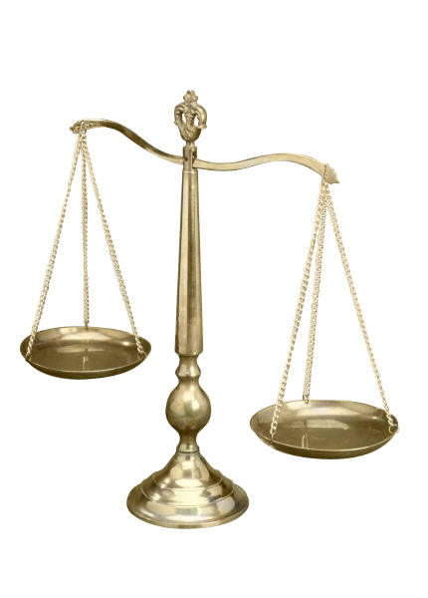
Productive Latency Rules
The ADoS attack must affect the lines of code between the session population and the session invalidation more then it affects the rest of the code.
For example, a denial of service attack that targets the web server is inefficient (since all the code is affected) while a denial of service attack that targets the database (and thus, the database access code) might be.
Session Variables
Database Code

Slide 29
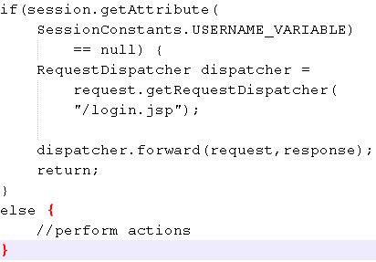
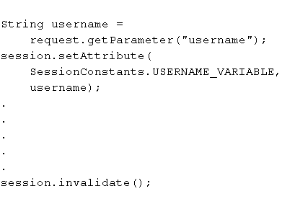

Temporal Session Race Conditions
The unnecessary / premature session variable must be granted a lifespan long enough for bypassing the session-level validation.
2
1
Productive Latency
4
3

Slide 30
Initial Samples of Layer Targeted ADoS
RegEx DoS
  Send Regular Expression DoS payloads to the target module, in order to increase the latency of validations that follow the session value population.
  http://www.youtube.com/watch?v=3k_eJ1bcCro
Connection Pool Consumption / Occupation
  Intentionally “consume” all the available connections in the connection pool, in order to delay database operations in a target entry point.
  http://www.youtube.com/watch?v=woWECWwrsSk

Slide 31
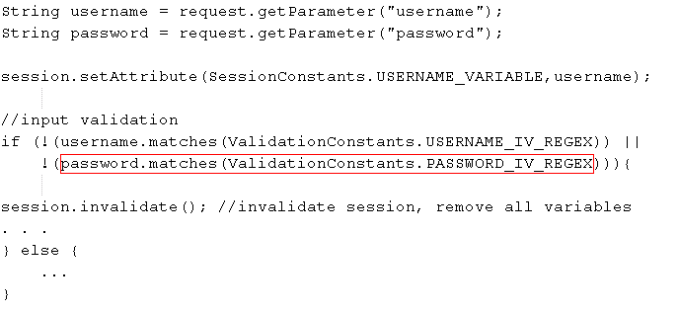
Increasing Latency with RegEx DoS
RegEx Dos Payloads can increase the latency of validation and search mechanisms. For example:
  RegEx: ([a-zA-Z0-9]+)*
  Input: Admin, aaaaaaaaaaaaaaaaaaaaaaaaaa!

Slide 32
Occupying Connections to Increase Latency
Use an automated script that consistently accesses modules, which use connections from a size-restricted connection pool for querying the database.
  The script must use a number of threads equal or higher to the maximum connections in the pool.
  In order to continue occupying connections, each thread should
  re-access the module again, immediately after getting a response.
  The script should use less threads then the amount supported by the server.
  The script should not affect the availability of the server, or any other layer (but the target layer).

Slide 33
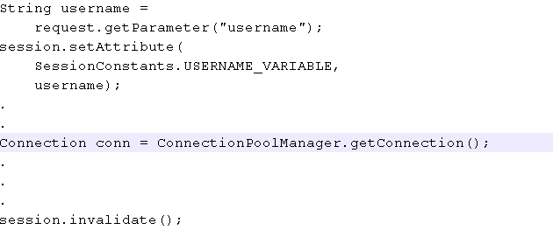
Occupying Connections to Increase Latency
Occupying connections will guarantee that code, which requires a database connection, will experience some latency.
Delayed until a connection is released

Slide 34
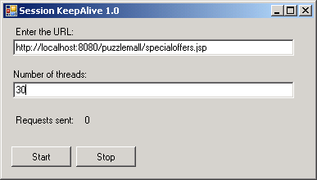
Occupying Connections to Increase Latency
“Session KeepAlive” – a sample tool that can exhaust the connection pool:

Slide 35
Additional Samples of Layer Targeted ADoS
Intentional Execution of Complex Queries
  Access entry points that execute resource-consuming queries, in order to delay the database responses.
Shared Backend DoS
  Perform ADoS on a web site that consumes services from a backend server shared by the target web site, effectively increasing the response time of the shared backend server.

Slide 36
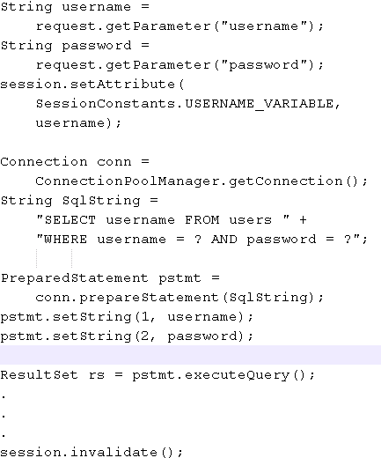
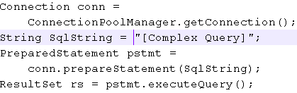
Intentional Execution of Complex Queries
Login Module
Query Module
1
2
Internal Module
4
3
Productive Latency
5

Slide 37
Detecting TSRC
Black-box
  Becomes possible upon the detection of an ADoS exposure, which affects specific lines of code (database access, input validation, web service access, etc.).
  Attempt to perform session puzzling while executing the ADoS in a manner that will cause a sufficient latency in a page that might temporarily populate session variables (login, registration, etc.).
Code Review
  Any premature or unnecessary creation of a session variable, which is followed by code that can be targeted by layer specific DoS (DB access, validation, etc.), prior to the invalidation of the session content / variable.

Slide 38
TSRC Mitigation
The mitigation of temporal session race conditions is very similar to the mitigations required for session puzzles:
  Avoid storing unnecessary values in the session.
  Avoid using session variables with identical names in different modules, multiphase processes, and particularly in public vs. private entry points.
  Store objects in the session instead of variables. The name of the objects should include the process / module they should serve.
  Don’t rely on the session as a temporary container for values that should not be stored in the context of the module.
  Perform validations on session originating values before using the in the application code.

Slide 39

Additional Uses for Layer Targeted DoS
DoS is mainly used to do exactly what the initials stand for - denial of service… but when the focus of DoS becomes certain lines of code, it can do a lot more then just affect the availability of applications and servers
  Help exploit race conditions. ALL race conditions.
  Cause specific information to be disclosed.
  Enable the exploitation of various logical attacks, not just session puzzling.
  Who knows what more?

Slide 40
And Finally…
Notes:
The graphic on the divider slide is an AutoShape with a solid fill. To insert an appropriate image, ensure you have the image you wish to use (ideally a .jpg or a .png file) in an accessible folder. The image should have a ratio of 2:1 to ensure it does not appear distorted.
In the View tab, click Slide Master from the Presentation Views group.
Right-click on the graphic and select Format Shape.
From the Fill menu, select Picture or texture fill and click Insert from file.
Navigate to the folder containing the image you wish to insert in the divider slide graphic. Highlight the image and click Insert.
You can now preview the image before continuing. If you are happy with how it looks, click OK to continue. Otherwise, repeat the process until you are happy with your selected image.
To exit from Slide Master View, click Normal from the Presentation Views group in the View tab.
The change you made to the divider slide graphic should now be visible on the slide.

Slide 41
Additional Resources
Session Puzzling – Indirect Application Attack Vectors
  Original Paper
  Digital Whisper Translation (Simplified - Heb)
Puzzlemall Homepage
  http://code.google.com/p/puzzlemall/
  A vulnerable training application for practicing session puzzling (Derby & MySql version) and temporal session race conditions (MySql version)
  A collection of movies demonstrating the attacks
RegEx DoS (Adar Weidman, Checkmarx)
  https://www.owasp.org/images/3/38/20091210_VAC-REGEX_DOS-Adar_Weidman.pdf

Slide 42
Additional Resources, Cont.
Race Conditions
  https://www.owasp.org/index.php/Race_Conditions
Application DoS
  https://www.owasp.org/images/d/da/OWASP_IL_7_Application_DOS.pdf
  http://www.slideshare.net/robertosl81/defending-against-application-dos-attacks

Slide 43
Acknowledgments
Ernst & Young, for investing the resources necessary to publish the research.
Additional Contribution
  Oren Ofer – for coming up with the idea to use RegEx DoS to increase latency.
  Liran Sheinbox – for creating the demonstration movies for the various exploits of this exposure.
  Alexander Ganelis – for creating a sample connection pool exhaustion software for the research.

Slide 44
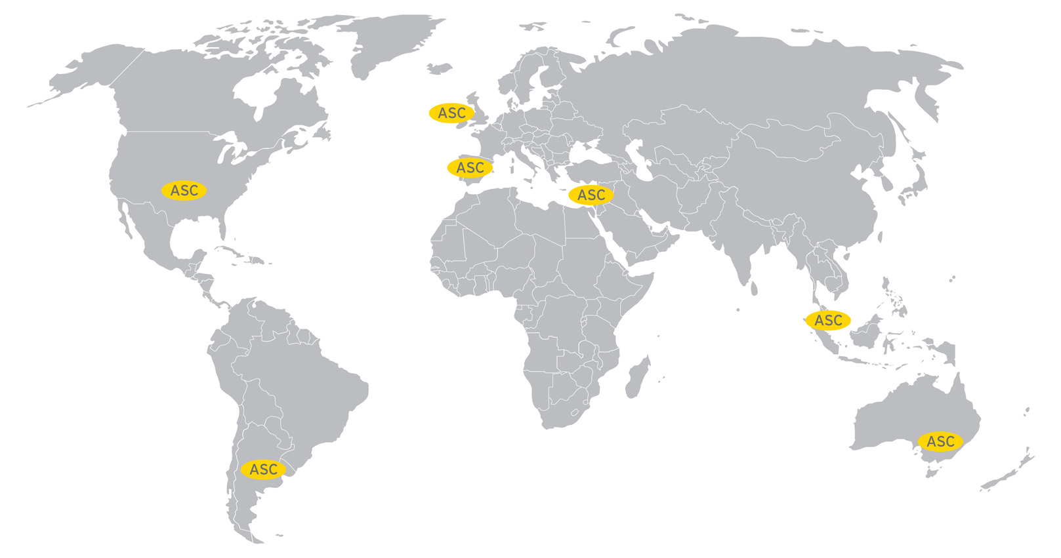
Ernst & Young Advanced Security Center
Americas
  Hacktics Israel
  Houston
  New York
  Buenos Aires
EMEIA
  Dublin
  Barcelona
Asia Pacific
  Singapore
  Melbourne

Slide 45
Ernst & Young
Assurance | Tax | Transactions | Advisory
About Ernst & Young
Ernst & Young is a global leader in assurance, tax, transaction and advisory services. Worldwide, our 130,000 people are united by our shared values and an unwavering commitment to quality. We make a difference by helping our people, our clients and our wider communities achieve potential.
About Ernst & Young’s Technology Risk and Security Services
Information technology is one of the key enablers for modern organizations to compete. It gives the opportunity to get closer, more focused and faster in responding to customers, and can redefine both the effectiveness and efficiency of operations. But as opportunity grows, so does risk. Effective information technology risk management helps you to improve the competitive advantage of your information technology operations, to make these operations more cost efficient and to manage down the risks related to running your systems. Our 6,000 information technology risk professionals draw on extensive personal experience to give you fresh perspectives and open, objective advice – wherever you are in the world. We work with you to develop an integrated, holistic approach to your information technology risk or to deal with a specific risk and security issue. And because we understand that, to achieve your potential, you need a tailored service as much as consistent methodologies, we work to give you the benefit of our broad sector experience, our deep subject matter knowledge and the latest insights from our work worldwide. It’s how Ernst & Young makes a difference.
For more information, please visit www.ey.com.
© 2008 EYGM Limited. All Rights Reserved.
Proprietary and confidential. Do not distribute without written permission.
Ernst & Young refers to the global organization of member firms of Ernst & Young Global Limited, each of which is a separate legal entity. Ernst & Young Global Limited, a UK company limited by guarantee, does not provide services to clients.

Slide 46

Questions
shay.chen@il.ey.com
http://il.linkedin.com/pub/shay-chen/0/91b/217

