Slide 1


The Spy in the Sandbox: Practical Cache Attacks in Javascript and their Implications
OWASP AppSec Israel, 13/Oct/2015
Yossi Oren, Ben Gurion University
yos@bgu.ac.il, @yossioren
Joint work with Vasileios P. Kemerlis, Simha Sethumadhavan and Angelos D. Keromytis

Slide 2


\
Want to keep your job? We got you covered
Want to jump in? We got you covered
Only 62 minutes from Azrieli! (closer than Hertzliya)
More info: batelgo@bgu.ac.il, or talk to me!

Slide 3
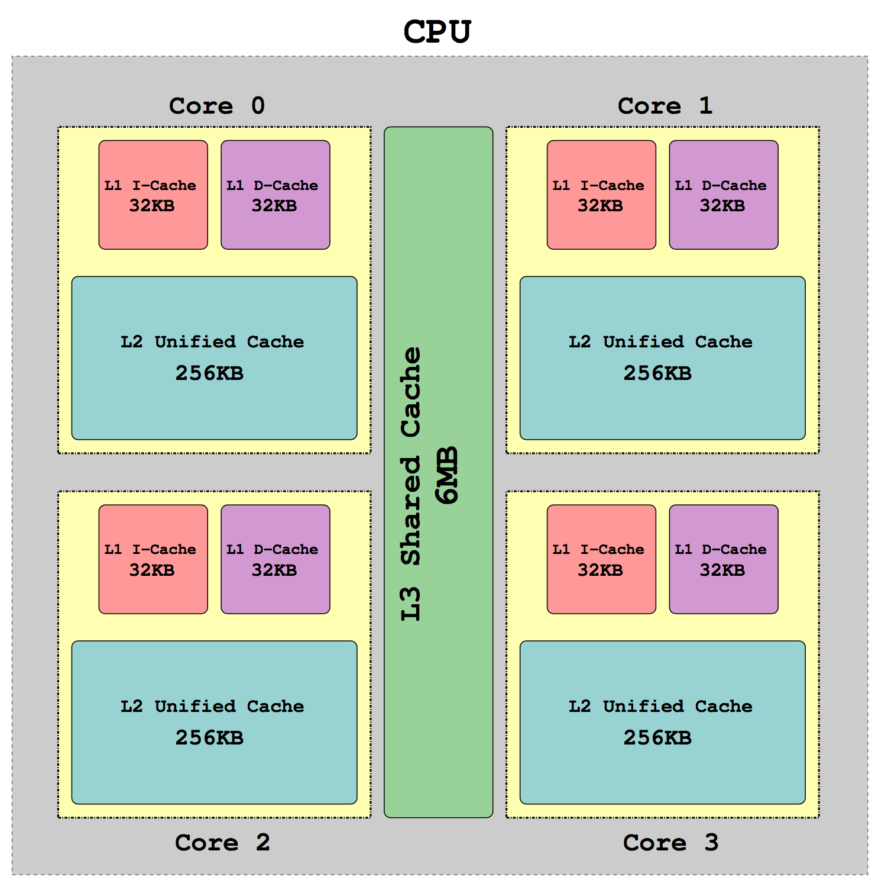
Capisce?
Mapping strategy
Sets, lines and associativity
Replacement policy
Cache slicing
Virtual memory
Notes:
]

Slide 4
Side-Channel Attacks
(In this work: cache attacks)
Input
Secure Functionality
Output
Secret

Slide 5
Side-Channel Attacks
(In this work: cache attacks)
Input
Secure Device
Output
Secret
Side-Channel

Slide 6

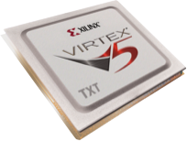
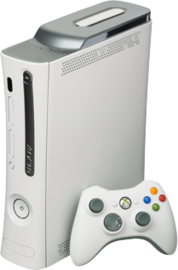
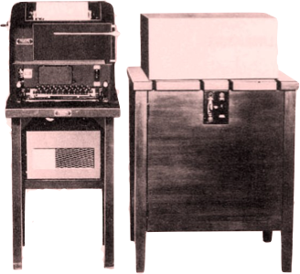
Side-Channel Attacks are powerful!
From: An Introduction to Implementation Attacks and Countermeasures,
Thomas Popp, MEMOCODE 2009
Notes:
]

Slide 7
The Problem with Side-Channel Attacks
Most side-channel attacks require “close proximity” to the victim
For cache attacks, this means code execution privileges
No “close proximity” ⇒ no risk ⇒ no countermeasures

Slide 8
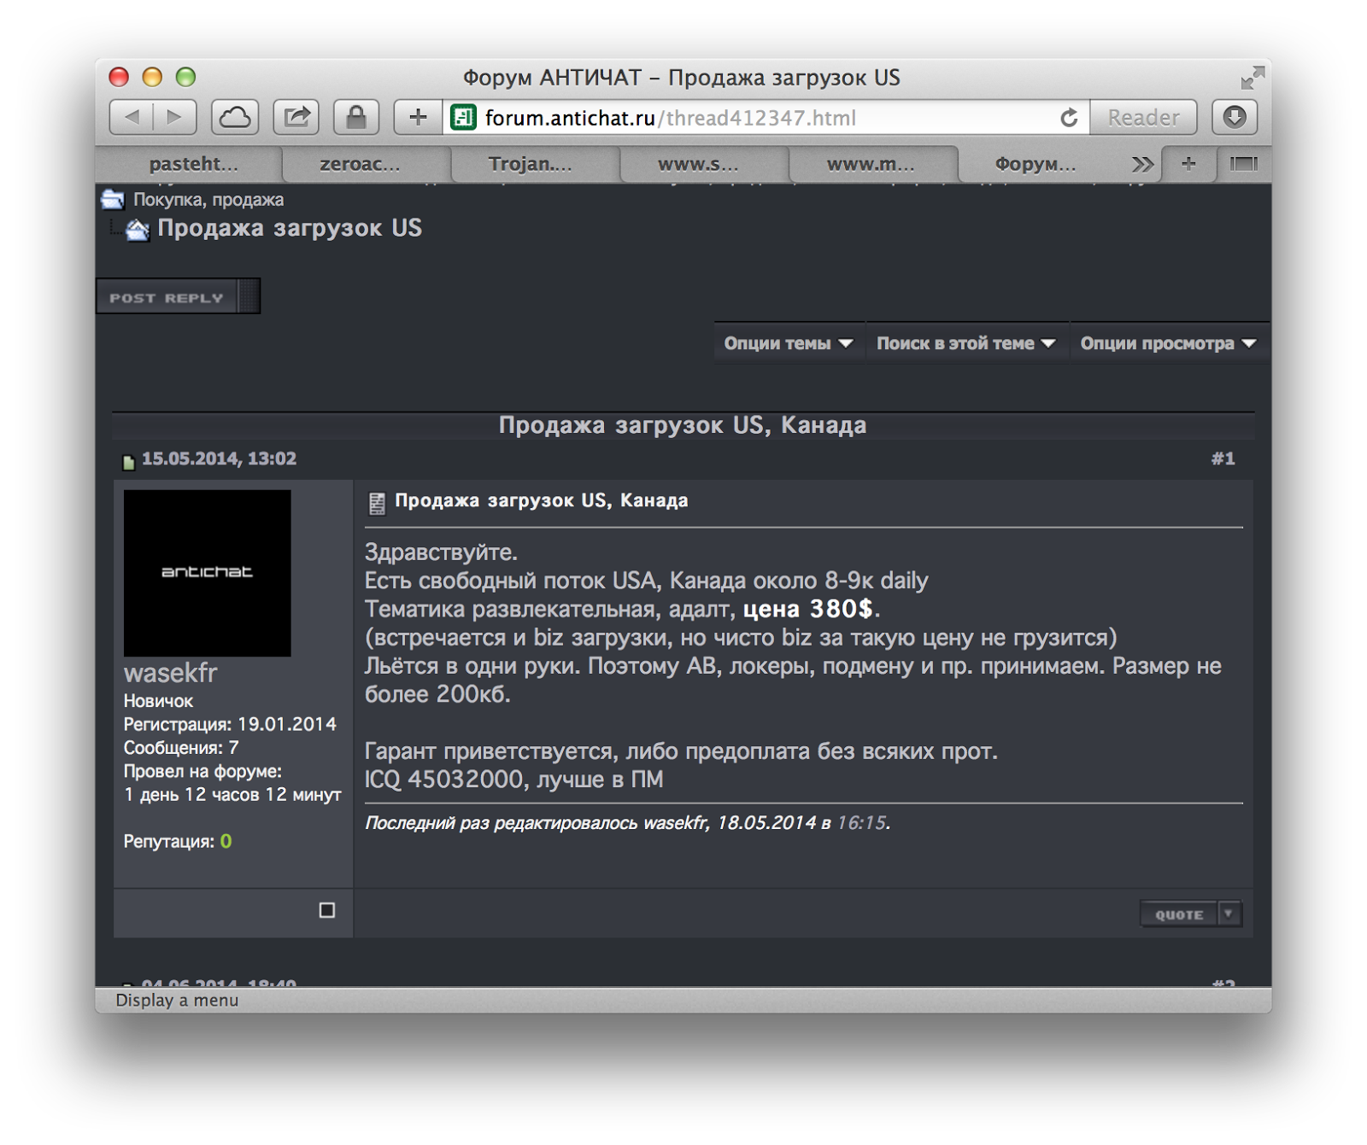

In This Work
A cache attack delivered from a webpage
  Minimal requirements from the victim
  Attack is scalable to millions of victims
How to use the attack to compromise the victim’s privacy

Slide 9
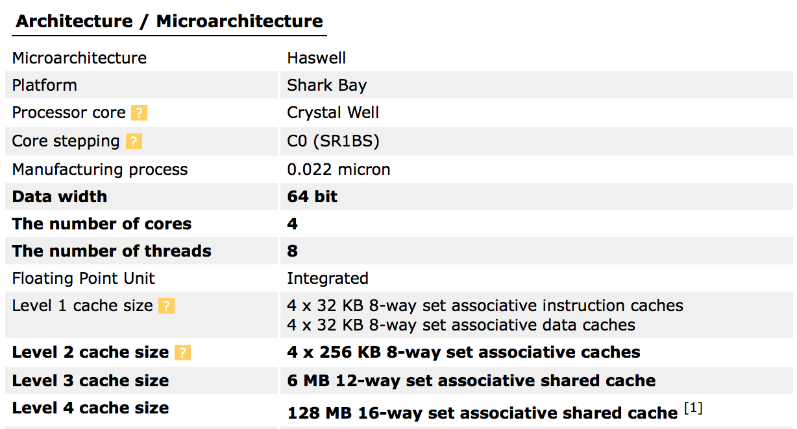
Cache, Cache and more Cache
Mapping strategy
Sets, lines and associativity
Replacement policy
Cache slicing
Virtual memory

Slide 10
Cache Attack Fundamentals
Basic idea: Find a cache set which attacker shares with the victim, and then monitor its usage over time
First identified in 1992, used since to attack AES, RSA, defy sandboxing, break ASLR and more
One common form of attack is Prime+Probe

Slide 11

The Prime+Probe Attack
Attacker Memory
Cache
Page 1
Set 1
Page 2
Set 2
Set n
Page m

Slide 12

The Prime+Probe Attack
Attacker Memory
Cache
Page 1
Set 1
Page 2
Set 2
Set n
Page m

Slide 13

The Prime+Probe Attack
Attacker Memory
Cache
Page 1
Set 1
Page 2
Set 2
Set n
Page m

Slide 14
The Prime+Probe Attack
Attacker Memory
Cache
Page 1
Set 1
Page 2
Set 2
Set n
Page m

Slide 15

Implementation Challenges
Attack must be written in Javascript:
  Non-deterministic just-in-time compiler
  No direct memory access
  No pointers
  No native code/syscalls
  BUT: some nice new APIs...

Slide 16
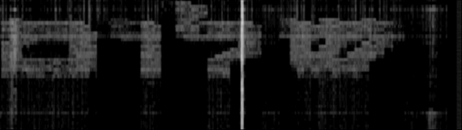
Memorygrams

Slide 17
An Attack on Privacy
Traditional Cache Attacks | This Work
Victim is a virtual machine instance running in the cloud, performing some business process | Victim is a standard personal computer, used for browsing the web, e-mail, etc.
No interactive input capability (keyboard, mouse) | Private information is encoded in victim’s interactive inputs
Attack targets victim’s cryptographic keys | Attack targets victim’s privacy
Note: Attack setup is technically capable of extracting cryptographic keys!

Slide 18
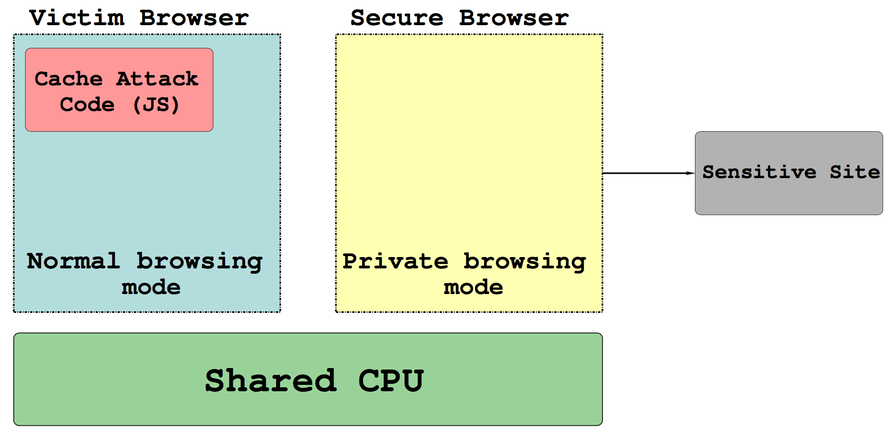
An Attack on Privacy – Setup

Slide 19
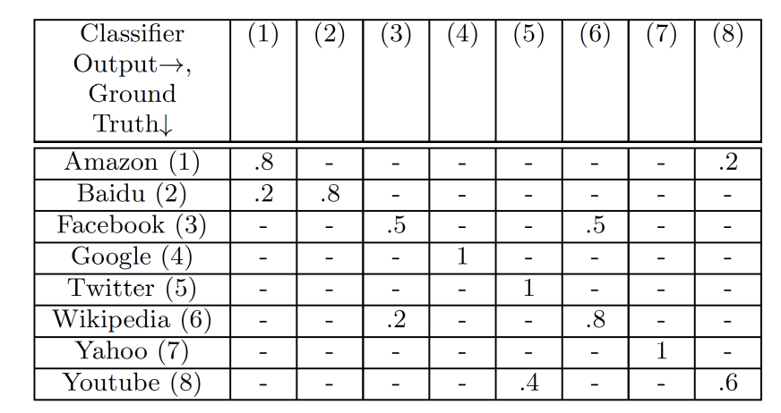
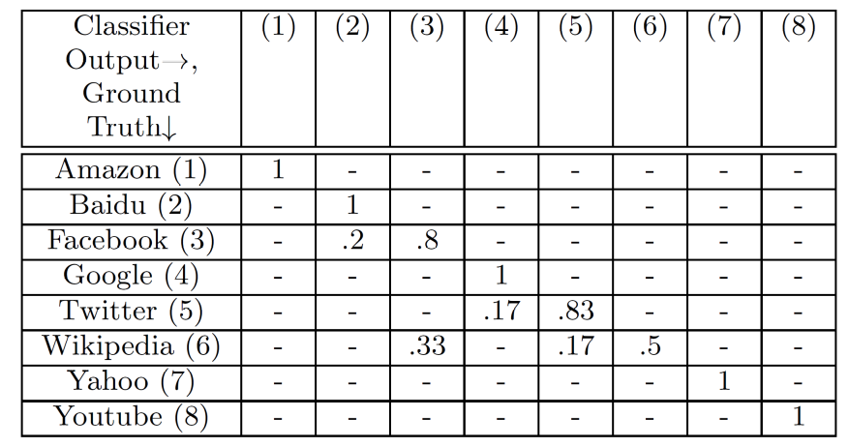
An Attack on Privacy – Results
Safari 8.0.6 Private Browsing
Tor Browser 4.5.1

Slide 20
Responsible Disclosure
Reported in March 2015 to Apple, Microsoft, Google and Mozilla (CVE-2015-5825)
Already fixed in Safari 9, Chrome 45, Firefox 41
Future APIs in Javascript also affected

Slide 21
Conclusion and Discussion
We presented a side-channel attack that has minimal requirements from the victim
The attack compromises “human secrets” and not cryptographic keys
Many more systems should consider side-channel defenses

Slide 22

Thanks!
source:instagram.com/50cent
For more info:
      http://iss.oy.ne.ro/SpyInTheSandbox#OWASP
Notes:
Join my research group!

